Slide 1


Role of protoplanetary disk in forming planetary architecture
& Transit detection in Dome A
Ji-Lin Zhou(周济林)
School of Astronomy and Space Science,
Nanjing University,
zhoujl@nju.edu.cn
2014.4.2-3,NAOC &KIAA, PKU

Slide 2
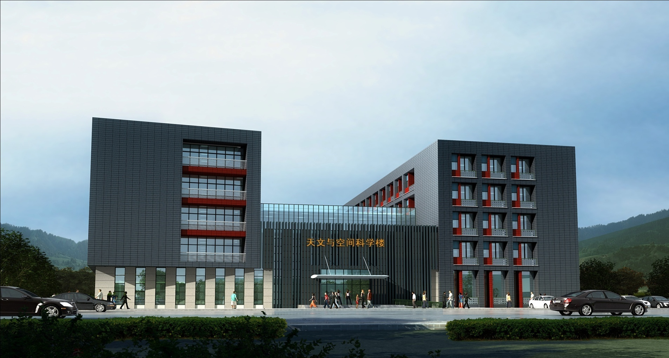
New astronomy building in Nanjing University, after Aug.2014

Slide 3
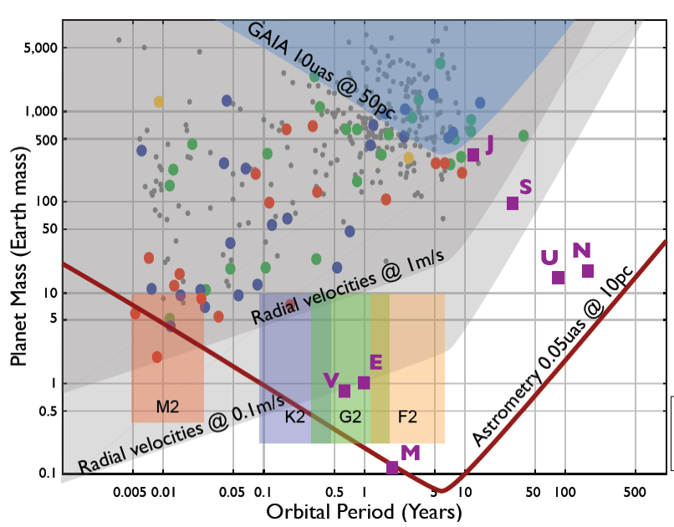
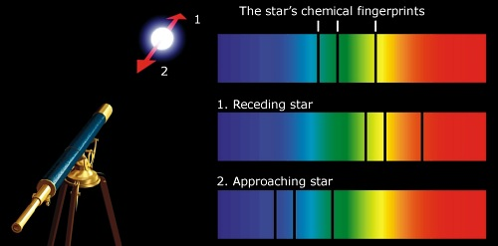
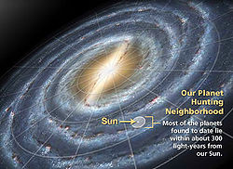
Background
With radial velocity, TTV etc., -1490 exoplanets are found
(exoplanets.org)
Kepler : from 156,000stars, 3845 candidates were detected, ~961 are verified as exoplanets (kepler.nasa.gov);

Slide 4
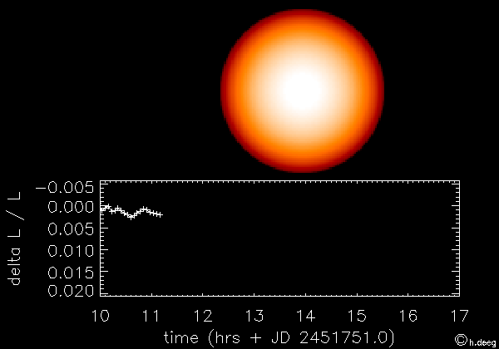
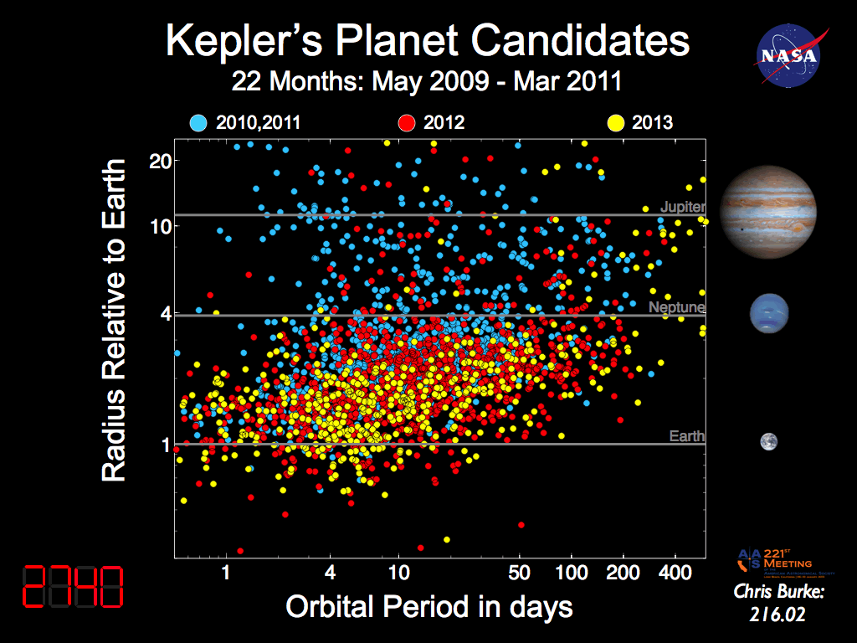
Kepler
Planet detection rate by transit

Slide 5
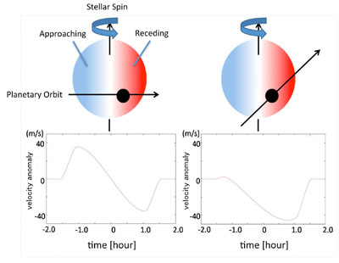
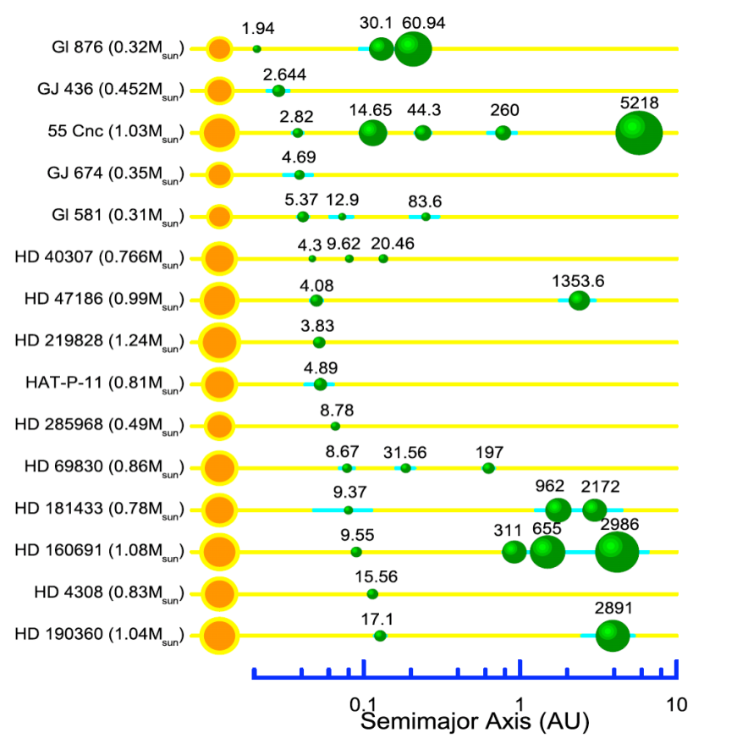
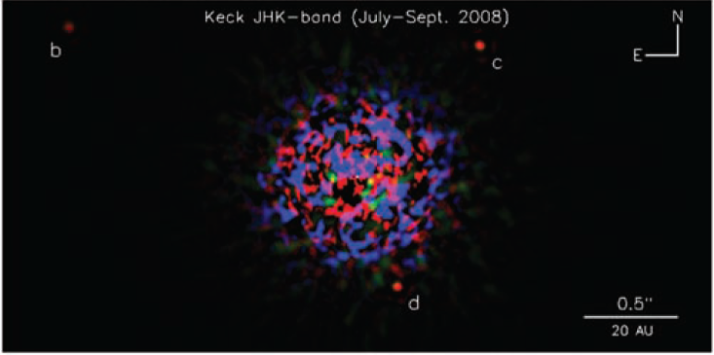
Classification of single star planet systems
１. Hot Jupiter systems: gas giant planets in close-in orbits, some in retrograde orbits
2. Solar-likes systems: like solar system with
suitable migration
3. Direct imaged systems: gas giant in distant orbits, mostly formed by gravitation instability
Zhou et al. 2012, RAA (review))

Slide 6
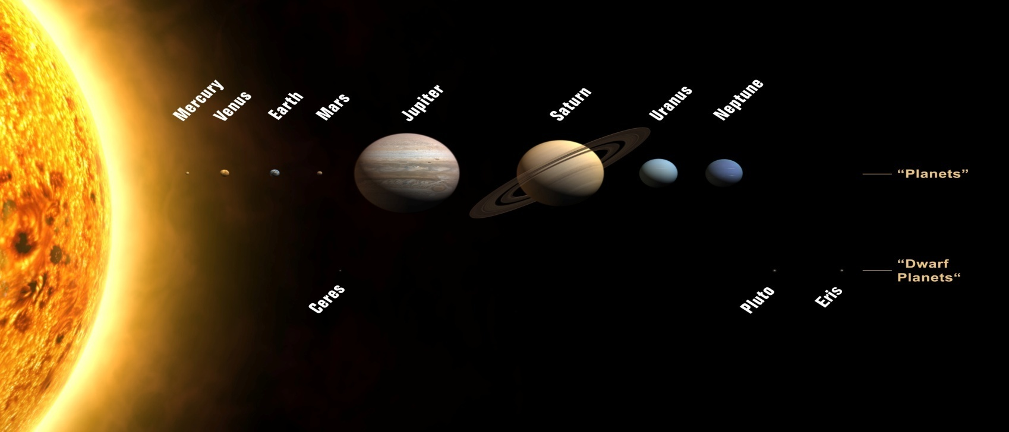
solar system
What a planet system should like?

Slide 7
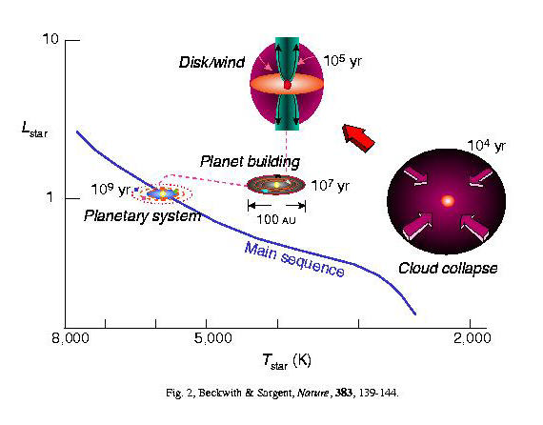
Planet Formation: a general picture
Notes:
7
The study of planet formation can be casted back to the age of Laplace, who proposed a solar nebular theory.
Modern astronomy tells us that, planets form at the early stage of star formation. In the universe, there are regions that full of melecular, we call melrcular cloud. When it’s density is bigger enough, it begins to contract at a timescale of 10^4 years. Due to the conservation of angular momentum, a disk forms, at the time (T Tori stage). Planets forms in the disk within 10Myr, The disk will disappear at 10^ years, so
Plaent formation must form.
Shu, Adams & Lizano 1987

Slide 8
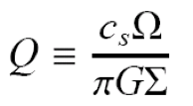
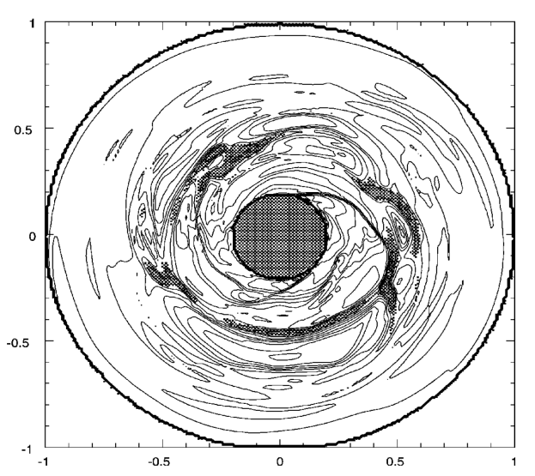
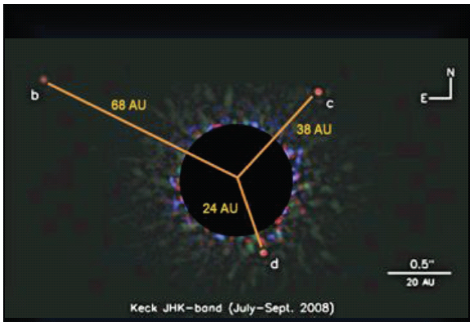
Classical Planet Formation Scenario
(1) gravitational instability model
With MMSN:
<1
Boss A.
HR 8799 system
Notes:
8

Slide 9
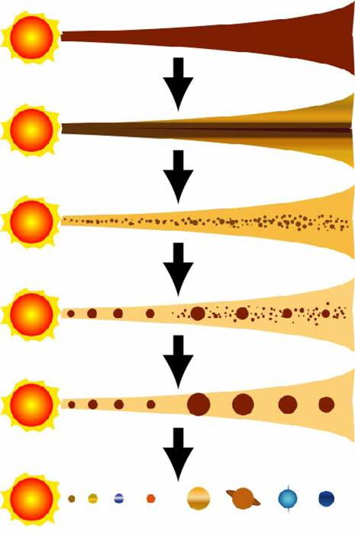
(2) Core accretion model
  Formation of km size planetesimals
  Accretion of planetesimals into planetary embryos
  Gas accretion, giant impact
www.planet.sci.kobe-u.ac.jp

Slide 10
Question :
What makes the planet systems so different?
The reasons might be:
Initial conditions (different stars, disks,…),
Dynamical interactions among planet and disks,
(3)Different stellar environments.,
……
Today, I will more focus on the role of protoplanetary disk.

Slide 11
Disk-single planet interactions: standard outcome
type-I migration
type-II migration
Goldreich & Tremaine (1979),
Ward (1986, 1997), Tanaka et al. (2002)
Lin & Papaloizou (1985),....
planet’s perturbation
viscous diffusion
disk torque imbalance
viscous disk accretion
Notes:
11

Slide 12
I will show some examples on disk that makes
the above standard scenarios more complicate,
and thus in making different architectures:
(1) Disk in making hot-Jupiters.

Slide 13
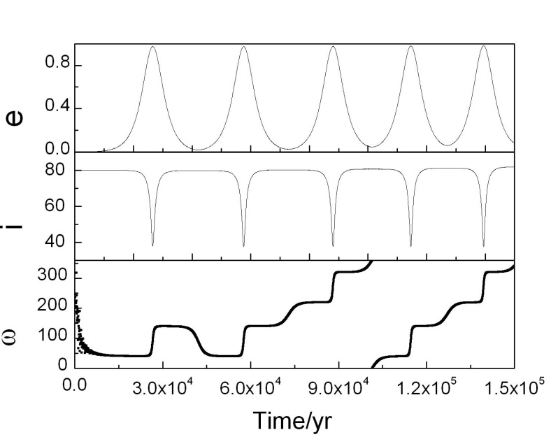
Kozai effect
(1) Disk in forming Hot-Jupiter systems
3-body system
Companion
Central star
ib
Planet orbit
(Innanen et al. 1997)
The eccentricity will be periodically excited to a very large value :

Slide 14

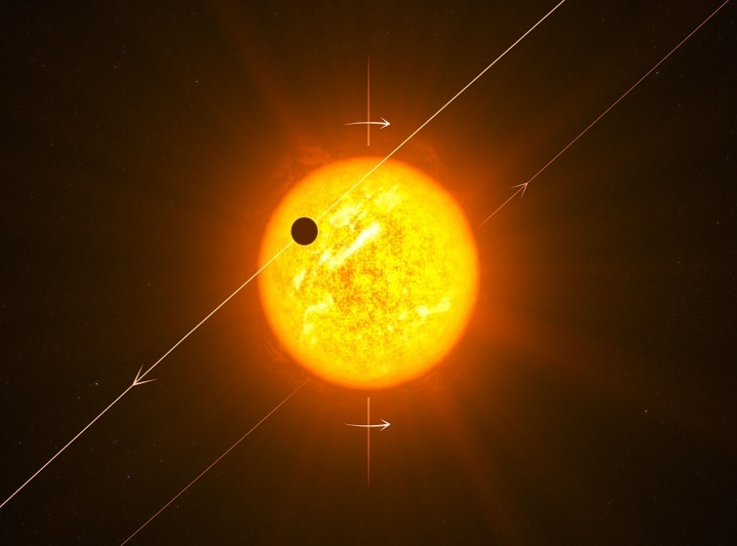
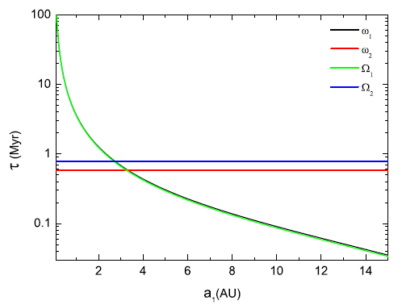
Disk can help to reduce i0
At the place where two planets’ nodal
processing rates equal, secular
resonance will occur.
Notes:
逆行热木星的起源问题是近年来的热门问题之一。根据行星形成理论，木星质量的行星应该形成于雪线以外的盘平面上，所以需要特殊的机制来实现这样的转移。之前针对热木星的轨道迁移机制有些不能适用，比如气体盘迁移。其他的这些机制均需要首先激发偏心率和轨道倾角，再通过潮汐耗散使轨道圆化。其中行星散射主要是Nagasawa他们在研究，需要很致密的几个行星同时存在。Naoz等在2011年提出了Kozai机制中的八极矩项可以使内行星变为逆行，他们给出的例子中外行星初始倾角和偏心率很大，这么大的偏心率和倾角很难通过散射形成。于是我们提出了长期共振加Kozai机制的激发机制，利用长期共振中激发倾角的过程大大降低轨道激发的初始倾角。我们将在后面给出详细介绍。另外，Wu等还提出长期混沌效应的激发机制。

Slide 15
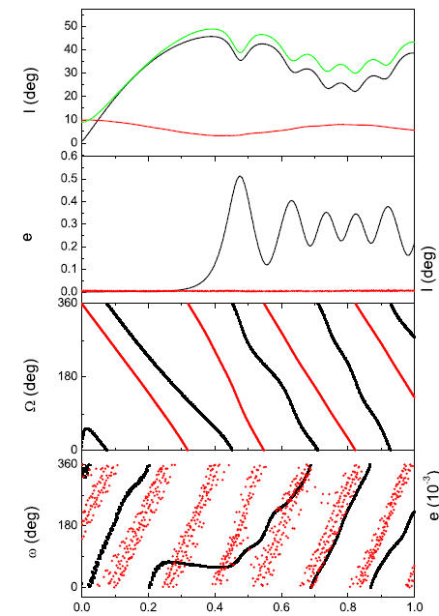
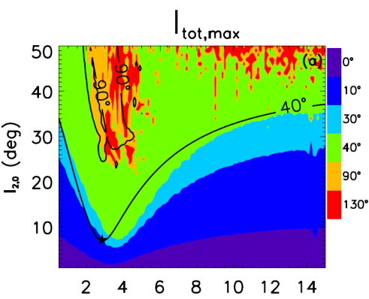
Take: m1=1 M_{J}, a1= 2.7au
outer disk M= 50 M_{J} @ 50-1000au
then for out planet:
5 M_{J} , 25au，i> 10º
can trigger Kozai mechnism；
10 M_{J}, 25au，i> 20º
can make inner planet retrograde
Chen Y.Y, Zhou,JL,Wang.S, ApJ 2013
Notes:
我们首先改变外行星的质量和半长径，将上面所说激发区域对应的I2的最小值和此时a1的值分别作等高线图。上面是针对两行星夹角Itot大于40度的区域，下面是I1大于90度为激发区。由图可看出，在外行星靠近盘的内边界的情况下，质量越大对应的临界倾角越小。并且对于固定的盘，给出了可以把雪线附近的木星激发到逆行的外行星的条件。

Slide 16
Disk in making hot-Jupiters
----decrease ic in some special situations,
Disk in making multiple planet systems:
-----trap in Mean Motion Resonance,

Slide 17
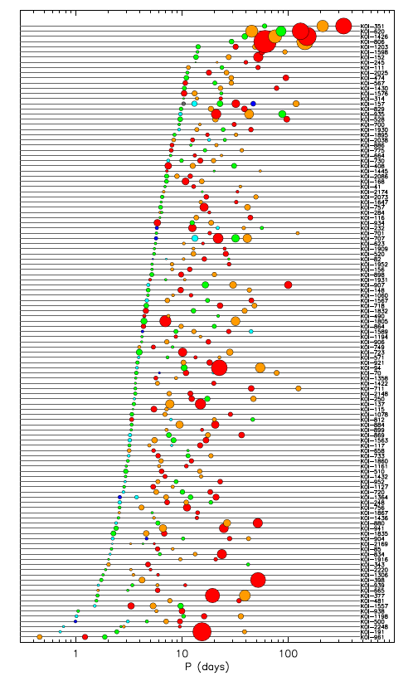
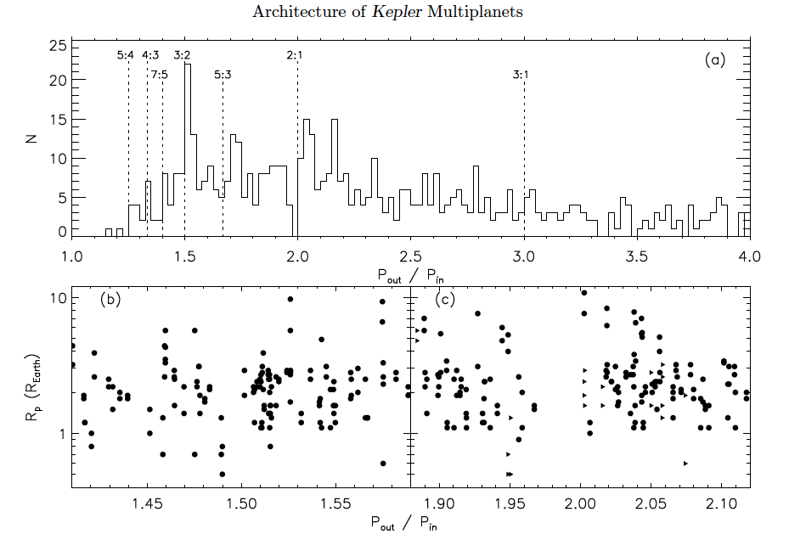
Batalha et al. 2012, 1202.5852
Most multiple planets: small and closely packed
885 KIC in 361 multiple planet systems; typically not in MMR, some near MMR;
Typically near coplanar within few degrees.

Slide 18
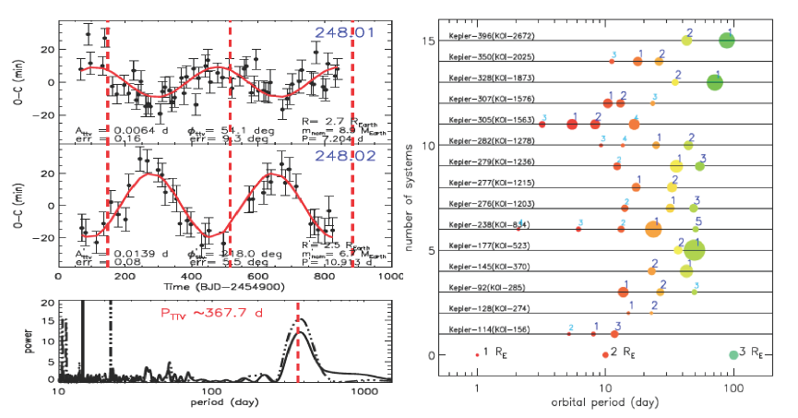
With TTV + Kepler data
TTV, Xie 2013,2014, APJS, Yang et al. 2013,
indentified 62 Kepler planets

Slide 19
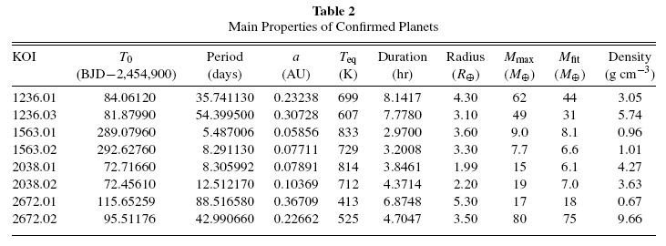
Some of them are near 1st order MMR: 3:2, 2:1
Yang et al. 2013, APJ,

Slide 20
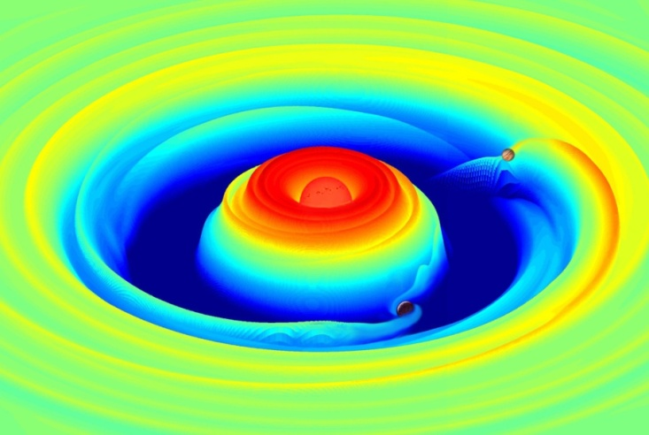
Standard migration is for single planet:
When two planets are involved:
Convergent or divergent migration?
Trap in mean motion resonance?
We use hydrodynamic simulations:
Model: Jupiter (inside) + Saturn (out)

Slide 21
Migration direction of planet-pair varies with α.
Viscous torque:
Radial movement of gas under this viscous torque
Type II migration: planet follows the movement of disk
Jupiter migrates outward when α>1/2
Zhang & Zhou ,ApJ 2010,a,b

Slide 22
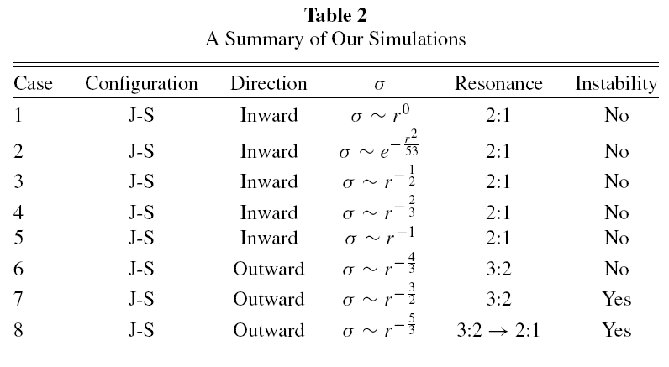
B. two planets may be trapped in different MMRs depending on α.

Slide 23

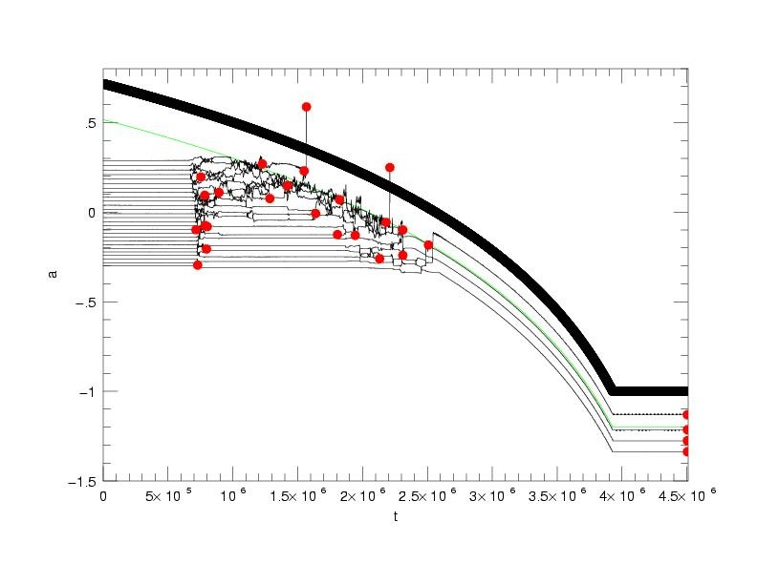
for super-Earth systems:
Induced by giants’ migration
Zhou，Aarseth, Lin, Nagasawa, 2005
Notes:
23
color

Slide 24

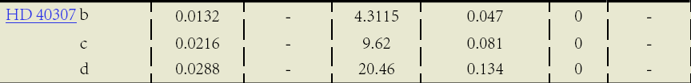
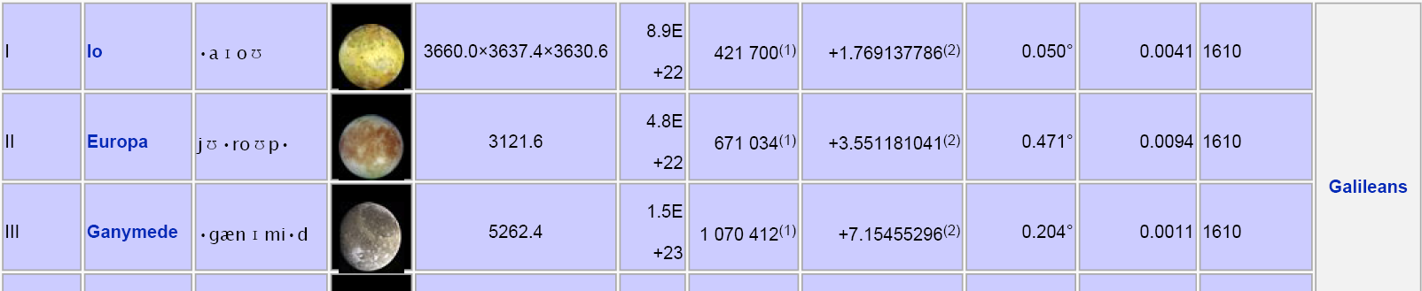
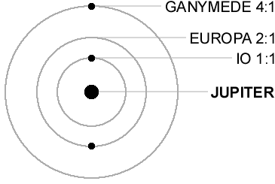
HD40307
Mayor et al. 2008
c.f. First 3 Galileans satellites of Jupiters 1:2: 4
http://en.wikipedia.org/wiki/Moons_of_Jupiter

Slide 25
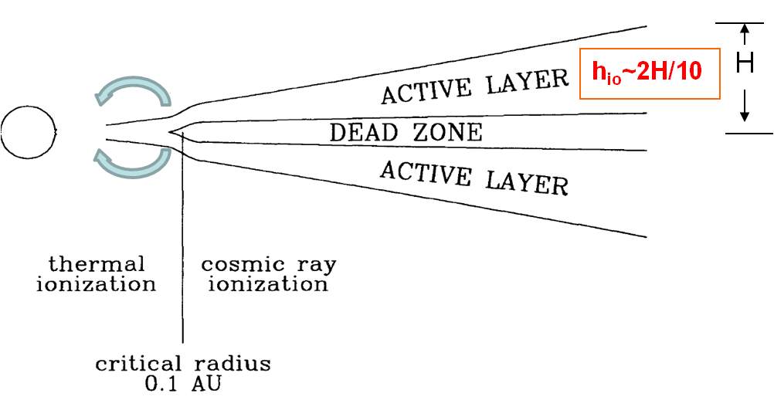
A scenario for HD 40307 formation (Lin, Zhou, et al) ：
Stop of type I migration
The scenario:
1、planets were formed ~AU and migrated inward
2、trapped in 1:2:4 one by one
3、tidal interactions with star gradually dive them out of MMRs

Slide 26
Simulations

Slide 27
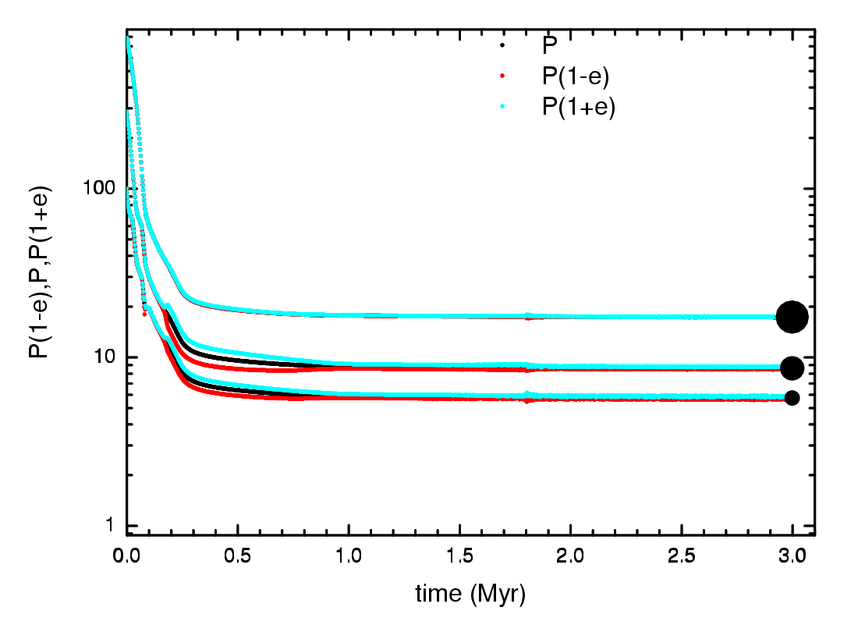
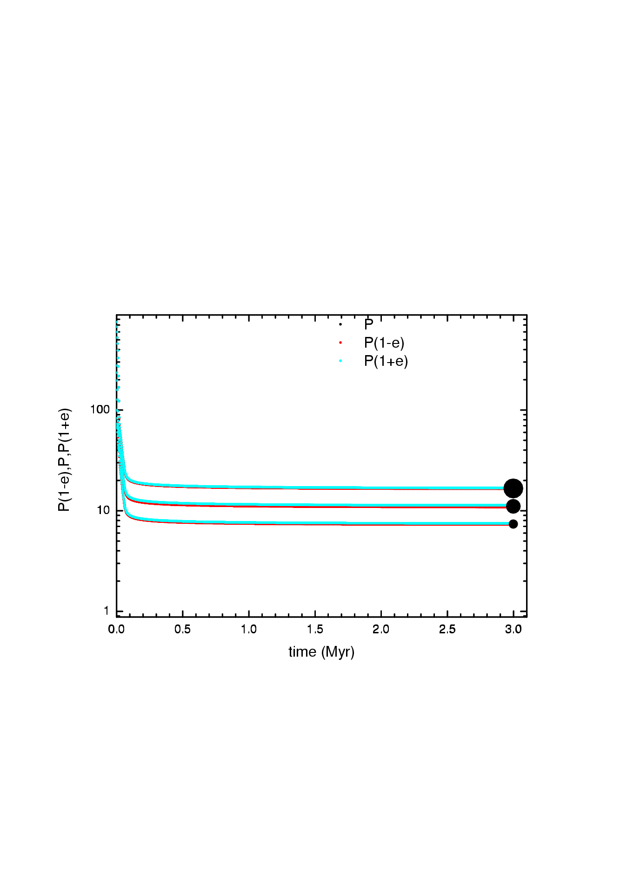
Different type-I speed
C₁=0.3
Results:
2:3:6
C₁=1
4:6:9
partly see Zhou 2010 (Torun conference) .

Slide 28
Conclusion for PART I
Protoplanetary disk makes the planetary system more colorful,
The varieties of planet systems are not fully revealed & understood,
Observational selections: RV & Transit : inner, image: out
Host star properties (distance, age) are not exact: e.g., dim stars
Theoretically : dynamical interactions are too complicate.
We need more samples, especially for bright stars,
PART II. Transit survey in Dome A, Antarctic

Slide 29
On ground

Slide 30
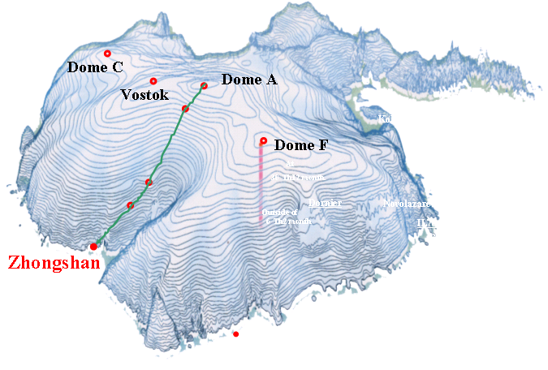
Dome A – the summit of the Antarctic icecap
Antarctic--future observatories
Latitude:
80°22′00″S
Longitude
77°21′11″E
Height:
4093m
Yuansheng Li, 2005

Slide 31
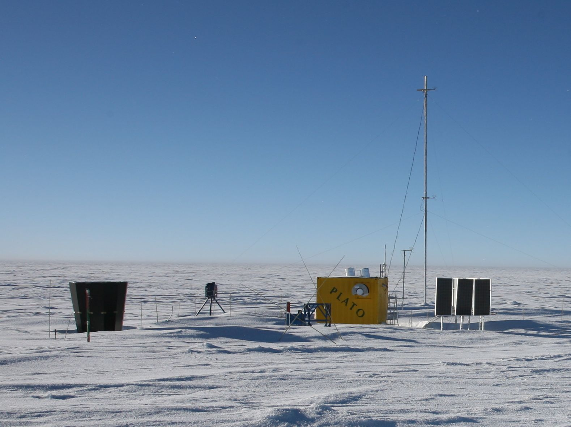
DASLE 声波风速计塔
Nigel 天光光谱仪
声雷达
CSTAR
PreHeat毫米波望远镜
太阳能电池板

Slide 32
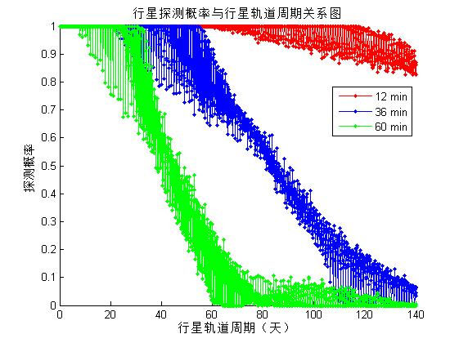
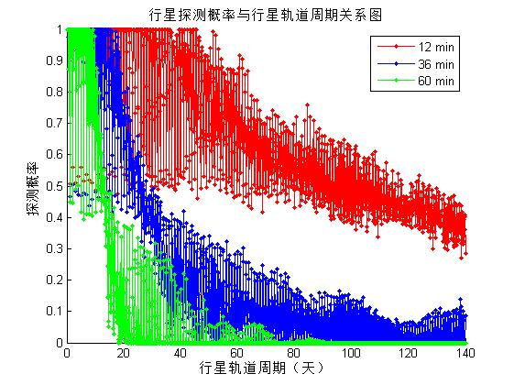
Detectability for a one year continues observation
XinLong
DOME A
Solar Altitude<-18º
Star Altitude>45º
Requirements: Solar Altitude<-13º
Star Altitude>45º

Slide 33
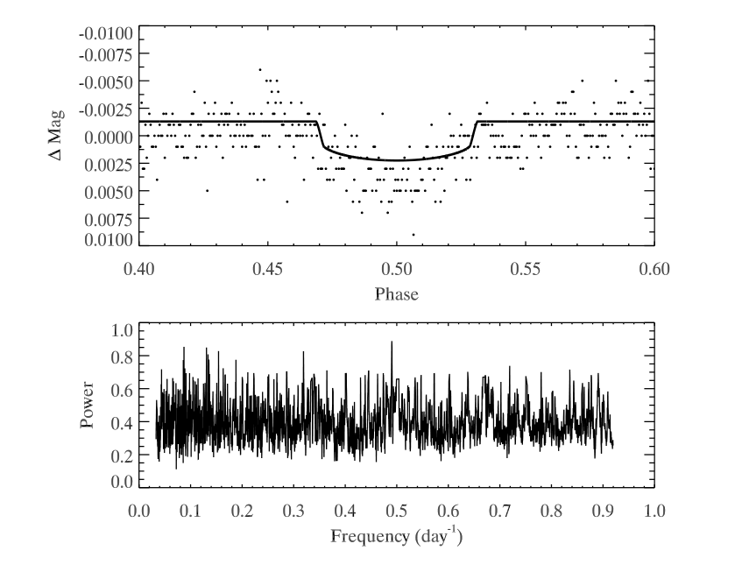
Wang et al. ApJS. 2014
CSTAR数据: 发现了6颗左右的候选体
2008 data: Total of ~20,000stars, we choose ~10000 stars with precision of <2%, We find 6 most-promising candidates.
According to Kepler’s results (transiting, P<100 days)
Photometric accuracy | Frequency of Exoplanets
1% | 0.047%
0.5% | 0.085% | N:0.038%
0.1% | 0.28% | sE:0.233%
CSTAR-1
P=2.04 days
R~0.5RJ
The binned phase-folded light curve (top panel) along with the normalized BLS periodogram (bottom panel) of one CSTAR object. The solid line in the top panel show the best-fit transit model

Slide 34
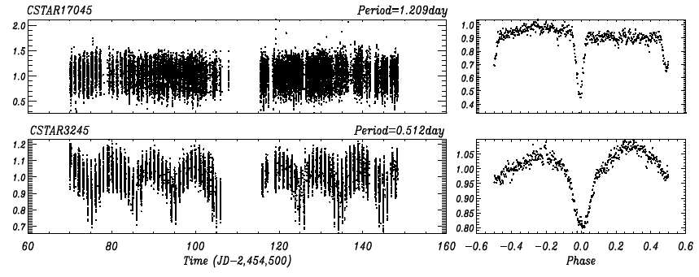
CSTAR 2008 data: 56 binary catalogue
With CSTAR2008 data, we find 56 binary stars from 10,000 sources.
Yang Ming, Zhang Hui & Zhou Ji-Lin, Zhou Xu, Liu Hui-Gen, Wang Lifang, et al
Eclipsing Binary Stars from 14.5cm Telescope at Dome A Antactica, in preparing;

Slide 35
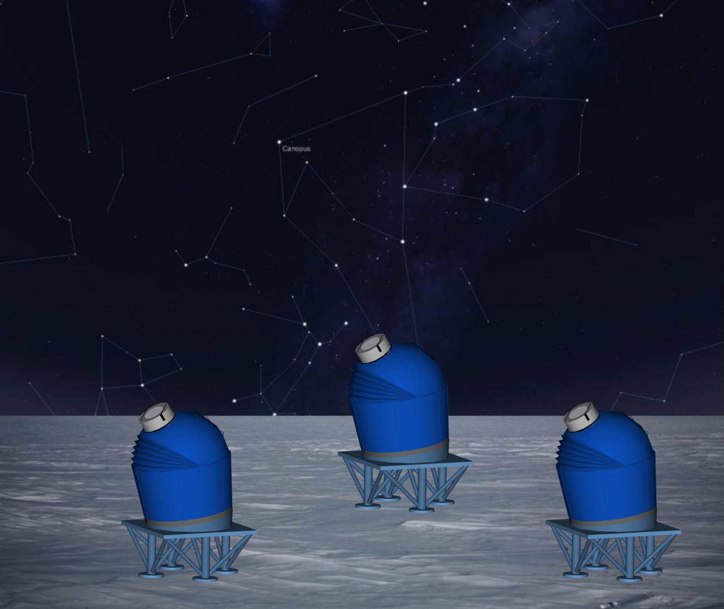
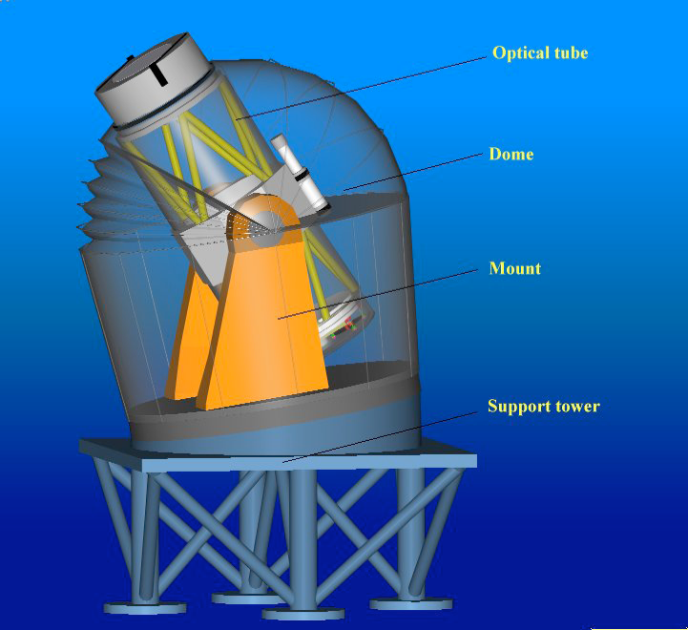
AST3
Ia Sne & dark matter;
exoplanet;
Variable stars;
Stellar sesmology;
50cm x 3

Slide 36
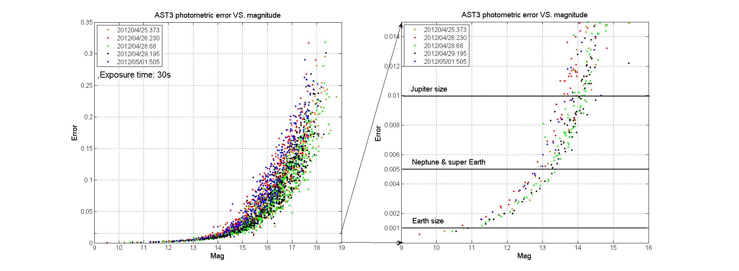
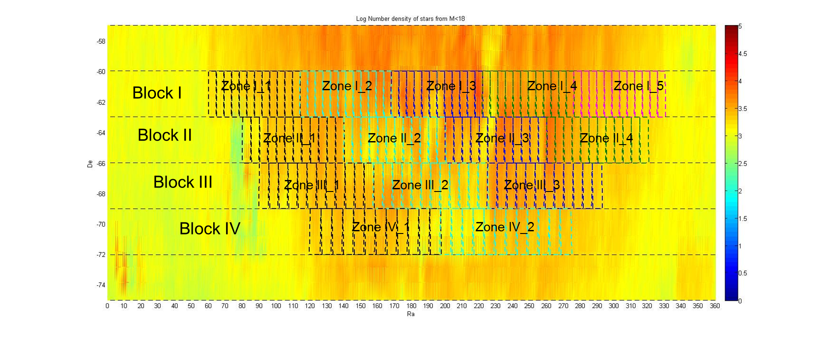
Transiting candidates expected by AST3
According to Kepler’s results:
Photometric accuracy | Frequency of Exoplanet
1% | 0.047%
0.5% | 0.085%
0.1% | 0.28%
With a single 30s exposure, AST3 can achieve 1% accuracy for V<14.5m and
0.1% for V<11m
super
Exoplanet searching area: cover 900,000 objects( 8m -14.5m )
Total candidates expected:
90days/year, 5-10years
Planet size | Expected number
>Jupiter | > 400
Neptune - Jupiter | ~ 250
Neptune | ~ 150
Total | > 750

Slide 37
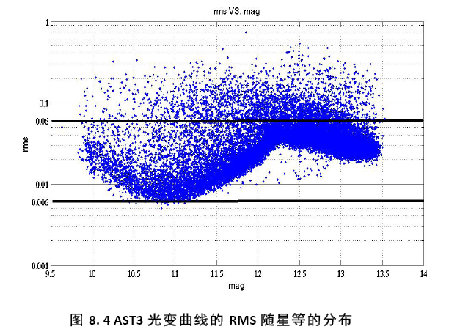
AST3-1

Slide 38
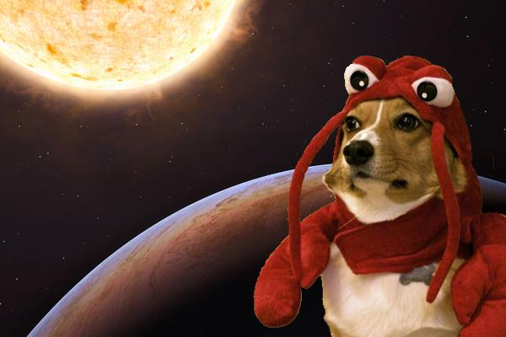

Thank you!
(zhoujl@nju.edu.cn)

