Slide 1

Observations & Modelings
of Solar Coronal Waves
Peng-Fei Chen
陈鹏飞
chenpf@nju.edu.cn
天文与空间科学学院
Notes:
4 aspects of observations which can help us better understand the standard model

Slide 2
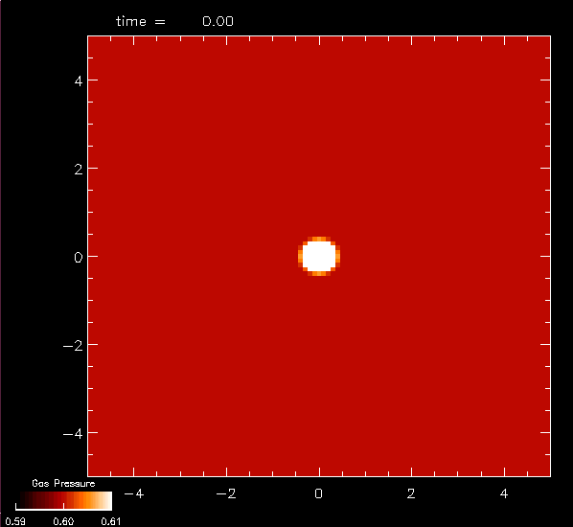

If there is no magnetic field,
Sound wave
Courtesy of
T. Magata

Slide 3
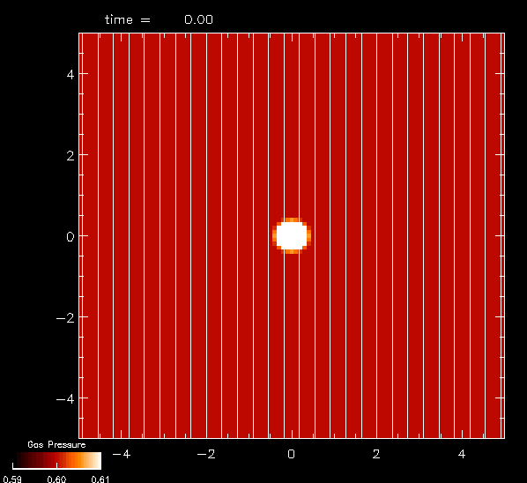

If there is magnetic field,
Fast-mode wave
Nearly isotropic
Slow-mode wave
Along the B field
Alfven wave
Along the B field
Courtesy of T. Magata

Slide 4
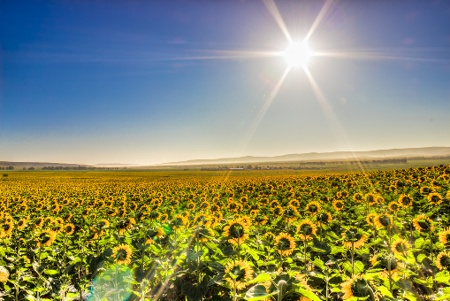

Slide 5
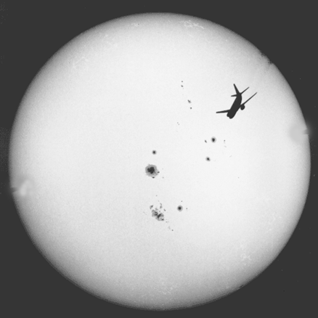
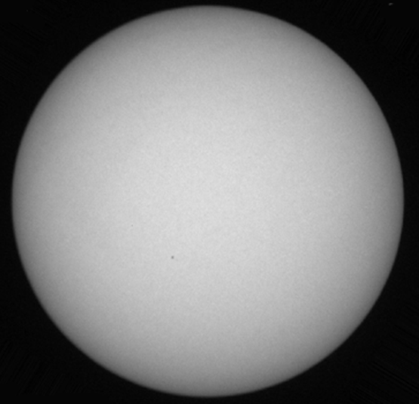
The Sun in most people’s view

Slide 6
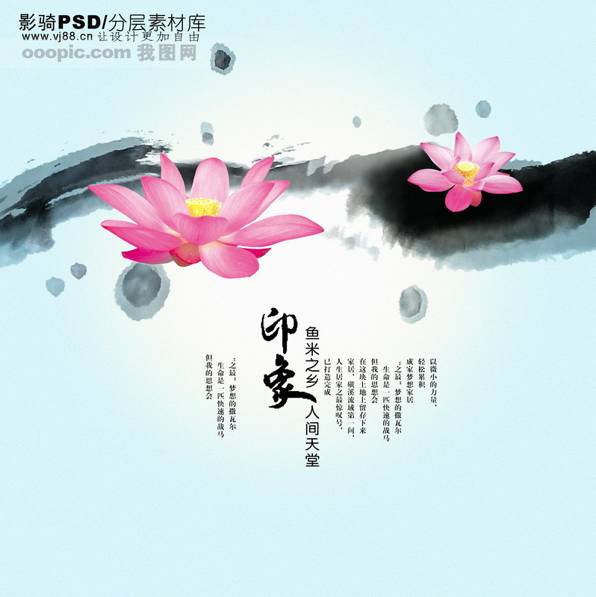
Outline
Background
Two Debates on Coronal Waves
Recent Work
P. F. Chen @KIAA
Notes:
4 aspects of observations which can help us better understand the standard model

Slide 7
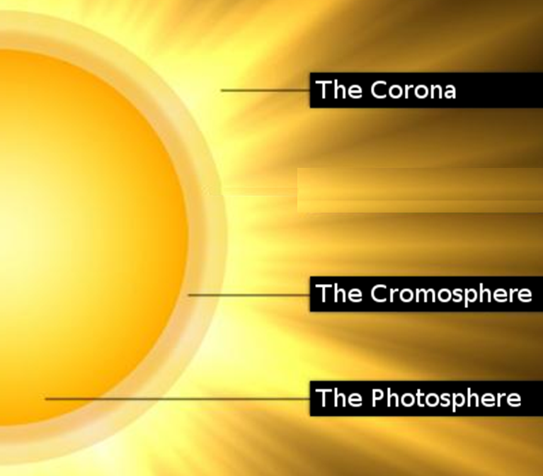

Slide 8
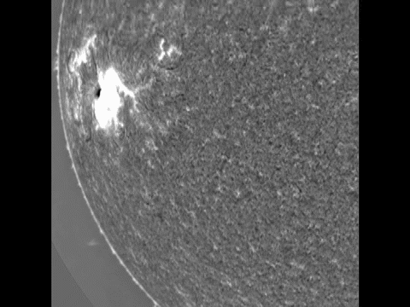
Moreton wave
Moreton et al. (1961)
A wave observed in the chromosphere
Propagation velocity: ~1000 km/s
Propagation distance: 5×10⁵ km
Credit: ISOON
P. F. Chen @KIAA

Slide 9
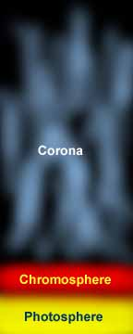
Magnetoacoustic Wave Speed
~1000 km/s
~100 km/s

Slide 10
Moreton wave
Moreton et al. (1961)
A wave observed in the chromosphere
Propagation velocity: ~1000 km/s
Propagation distance: 5×10⁵ km
Credit: ISOON
P. F. Chen @KIAA

Slide 11
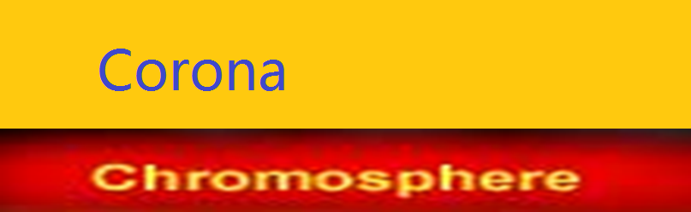
Moreton wave
Uchida (1968):
Fast-mode wave in the corona
Theoretical Explanation
P. F. Chen @KIAA

Slide 12
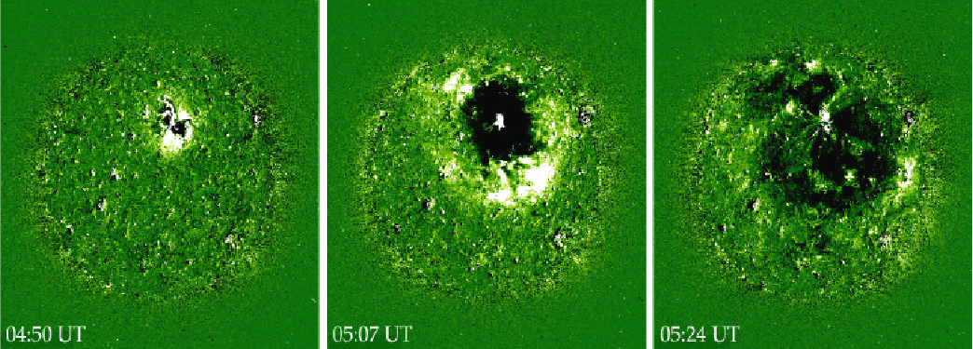
EIT Waves: Discovery
1997 May 12
Thompson et al. (1998)
V=250 km/s
SOHO/EIT
P. F. Chen @KIAA

Slide 13
Debates
Flare pulse
CMEs
Wu et al. (2001), Warmuth et al. (2004),
Vrsnak et al. (2002), Vrsnak et al. (2006) ……
source
Thompson et al. (2000), Biesecker et al. (2002), Kay et al. (2003), Cliver et al. (2005), Chen et al. (2002, 2005)
Fast wave
Non-wave
Wang (2000), Wu et al. (2001), Ofman et al. (2003), Warmuth etl. (2004), Vrsnak et al. (2002), Ballai et al. (2005), ……
nature
Delannee & Aulanier (1999) Delannee (2000), Chen et al. (2002, 2005), Chen (2006), Harra & Sterling (2003)
P. F. Chen @KIAA

Slide 14
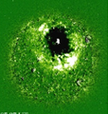
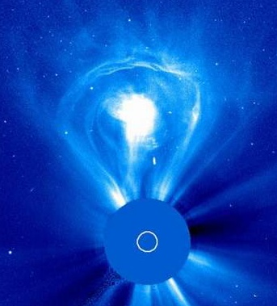
What is the Driving Source?
Flare
Wu et al. (2001), Warmuth et al. (2004), Vrsnak et al. (2002), Vrsnak et al. (2006) ……
CME
Thompson et al. (2000), Biesecker et al. (2002), Attril et al. (2003), Cliver et al. (2005), Chen et al. (2002, 2005) , Chen (2006)
Half EIT wave events are associated with B-class flares
Cliver et al. (2005)
P. F. Chen @KIAA

Slide 15
Is Flare the Driving Source?
CME-less Flares
Search for EIT waves
Strong Flares
(M-, X-classes)
P. F. Chen @KIAA

Slide 16
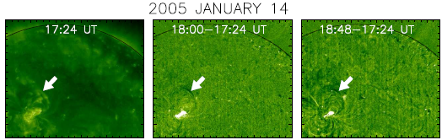
Is Flare the Driving Source?
No!
Chen (2006, ApJ, 641, L153)
P. F. Chen @KIAA

Slide 17
Is Flare the Driving Source?
Chen, P. F. 2006, ApJ, 641, L153
EIT waves are generated
by CMEs,
rather than solar flares.
P. F. Chen @KIAA

Slide 18
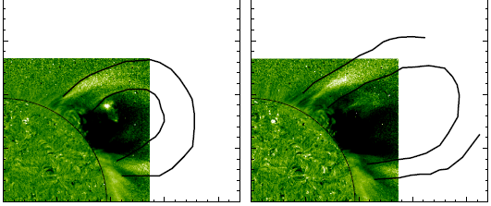
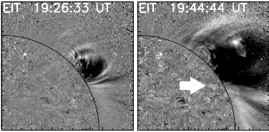
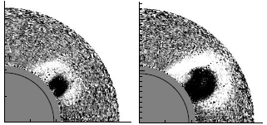
CME-EIT wave relation
EIT waves fronts are the EUV signature of CME loop!
Chen, P. F. (2009, ApJ, 698, L112)
P. F. Chen @KIAA

Slide 19
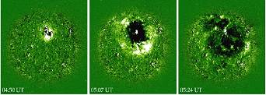
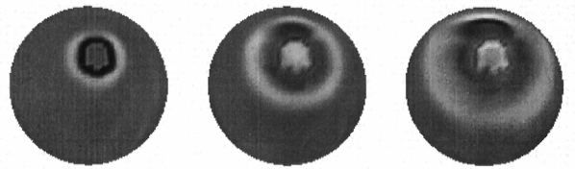
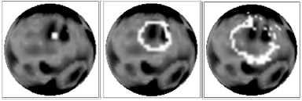
What Is the Nature?
?
Fast-mode wave
coronal Moreton wave
Thompson et al. (1998)
Y.-M. Wang (2000)
Wu et al. （2001）Zheng et al. (2002)
Ofman （2003） Warmuth & Mann (2005), Grechnev et al. 2008; Pomoell et al. (2008), Veronig et al., (2008), Gopalswamy et al. (2009), Long et al. (2009), Patsourakos et al., 2009; Kienreich et al. (2009), ……
P. F. Chen @KIAA

Slide 20
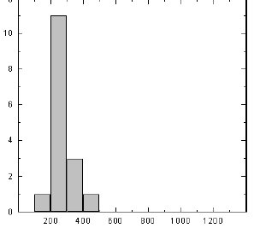
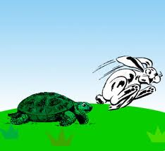
Drawback 1 of Fast-mode Wave Model
You’re too slow!
V_{EIT} ~1/3 V_{f}
Klassen et al. (2000)
Fast-mode
wave
EIT wave
P. F. Chen @KIAA

Slide 21
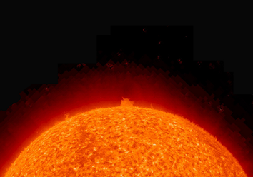
Drawback 2 of Fast-mode Wave Model
Delannee & Aulanier (1999)
Delannee (2000)
Stationary front
P. F. Chen @PKU

Slide 22
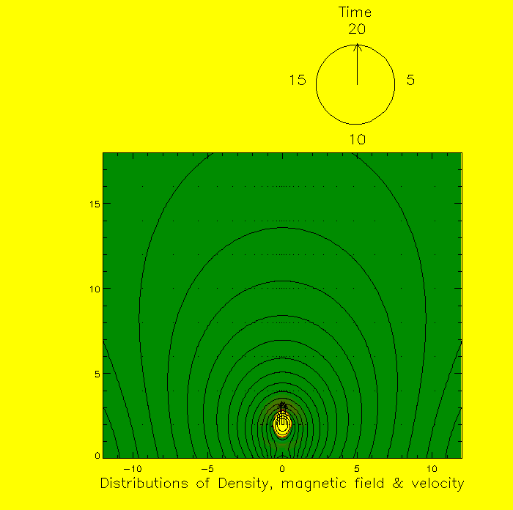
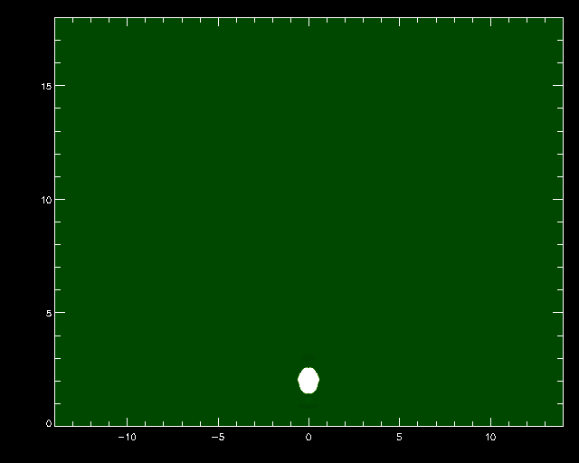
Our Field-line Stretching Model
Chen, Wu, Shibata, & Fang (2002); Chen, Fang, & Shibata (2005)
Fast-mode wave 775 km/s
EIT wave 250 km/s
195 Å
P. F. Chen @KIAA

Slide 23
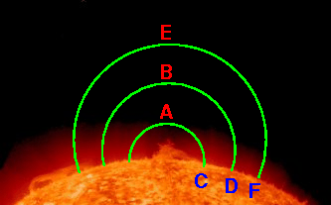
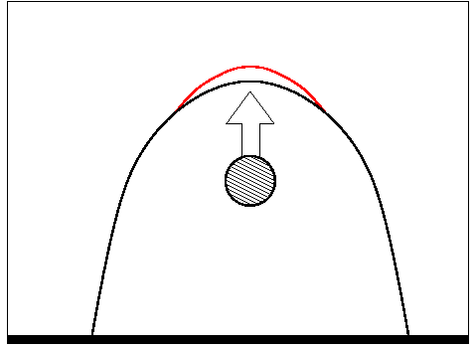
Our Field-line Stretching Model
P. F. Chen @KIAA

Slide 24
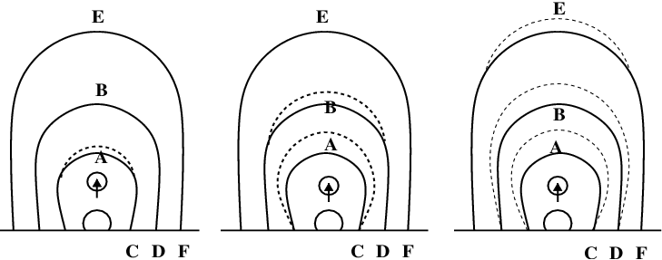
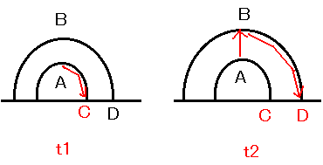
Our Field-line Stretching Model
t₁
t₂
t₃
P. F. Chen @KIAA

Slide 25
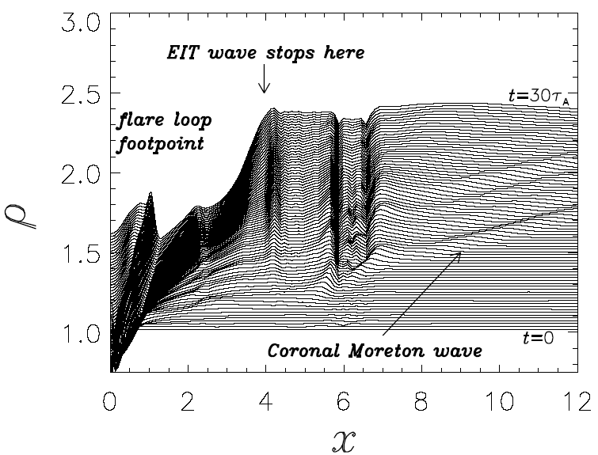
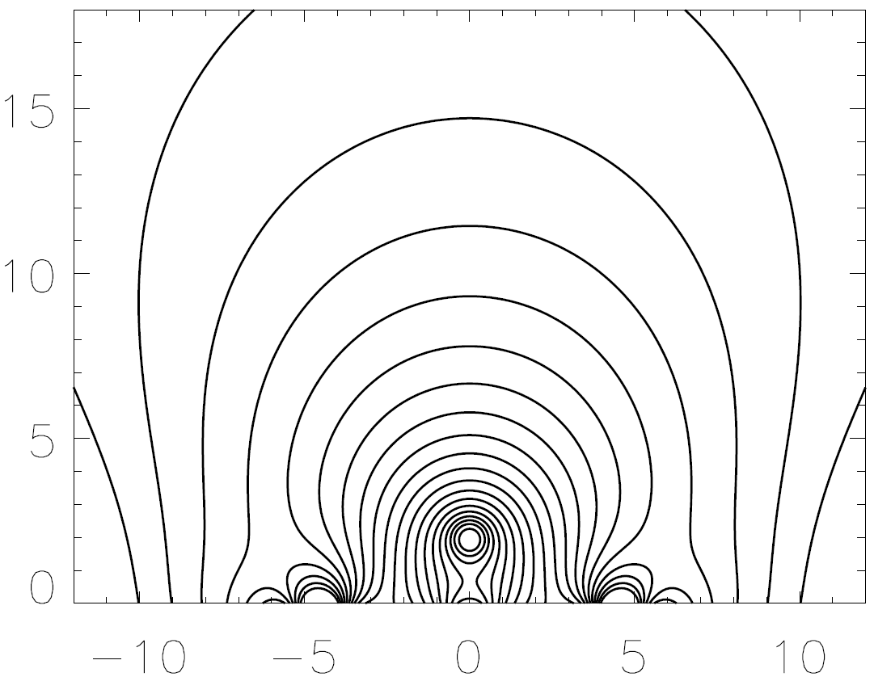
Why EIT Wave Stops near Magnetic Separatrix
Chen, Fang, & Shibata (2005)
P. F. Chen @KIAA

Slide 26
A Full View of EIT Waves
Chen et al. (2002, 2005)
1. Coronal Moreton waves
due to piston-driven shock
2. Diffuse “EIT waves”
due to successive opening of
closed field lines.
EIT telescope missed the faster one because of low time cadence, 15 min
P. F. Chen @KIAA

Slide 27
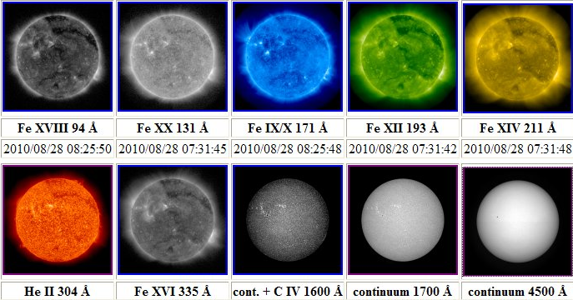
SDO Era (since 2010)
SDO: 12 s, 4K*4K
P. F. Chen @KIAA

Slide 28
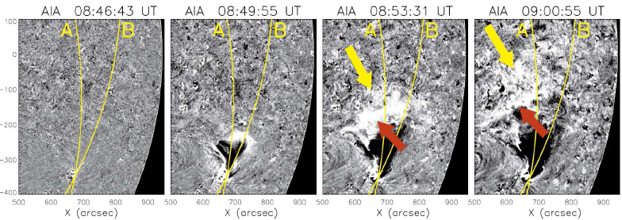
SDO Era
Chen, P. F. & Wu, Y. (2011, ApJ, 732, L20)
P. F. Chen @KIAA

Slide 29
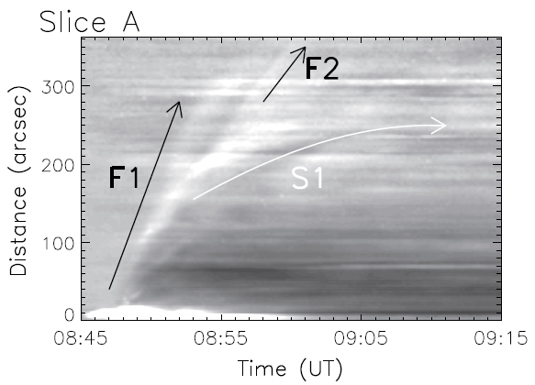
SDO Era
Chen, P. F. & Wu, Y. (2011, ApJ, 732, L20)
P. F. Chen @KIAA

Slide 30
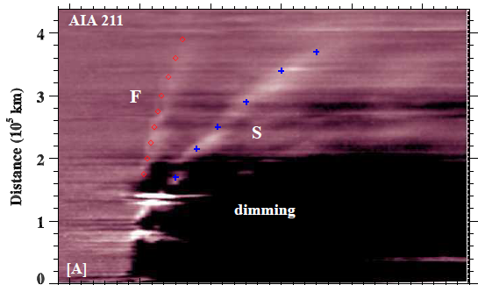
SDO Era
Schrijver et al. (2011), Cheng et al. (2012), Shen et al. (2012, 2013), Kumar, Cho, Chen, P. F. (2013) ……
P. F. Chen @KIAA

Slide 31
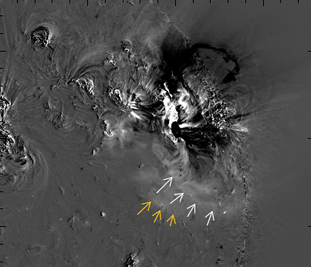
However,
Chandra, Chen et al. (2016, ApJ)
EUV wave event on 2011 May 11
P. F. Chen @PKU

Slide 32
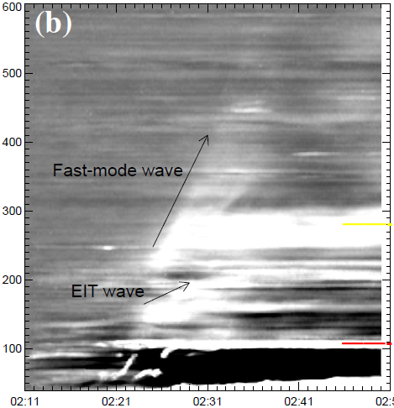
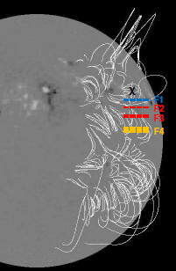
Another Stationary Front
Distance
Time (UT)

Slide 33
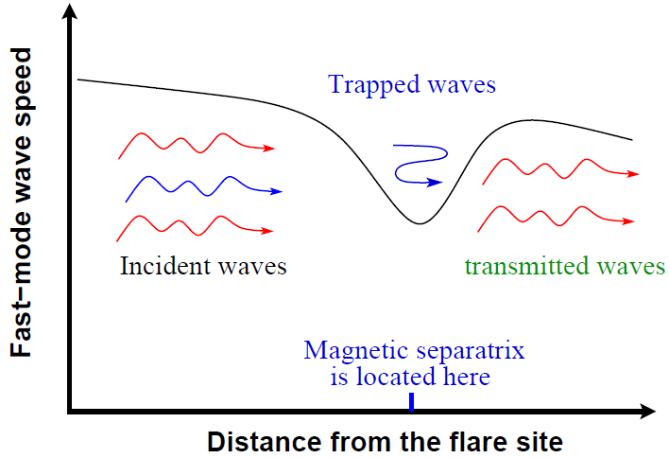
Why?
Chandra, Chen et al. (2016, ApJ)
F1
F2

Slide 34
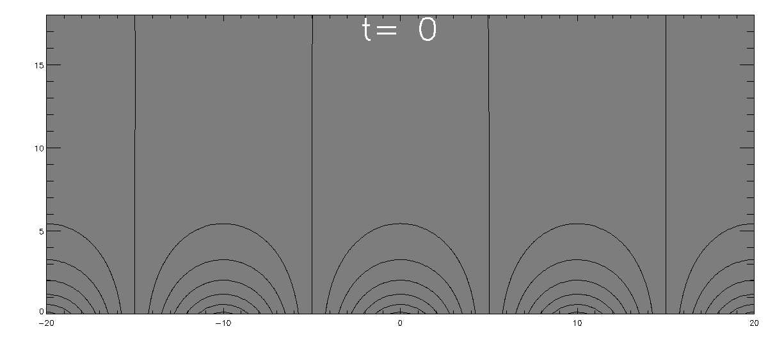
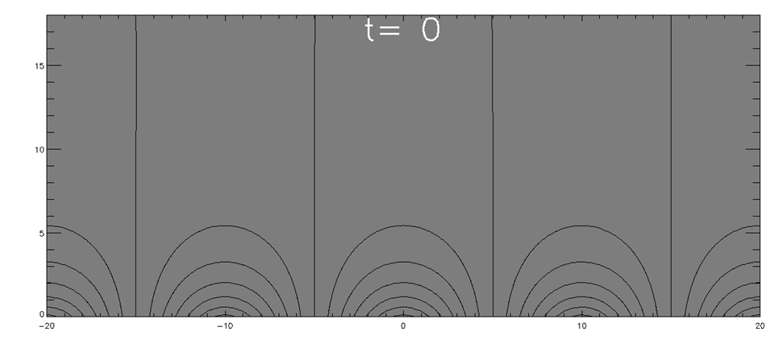
Simulation
Chen et al. (2016)
193 Å

Slide 35
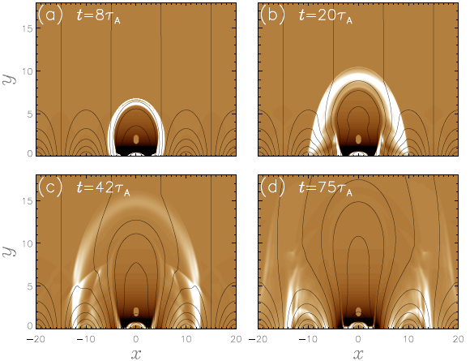
Simulation
Chen et al. (2016)
193 Å

Slide 36
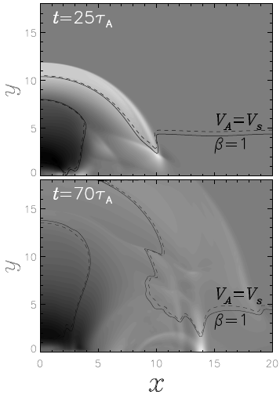
Simulation
Chen et al. (2016)
193 Å

Slide 37
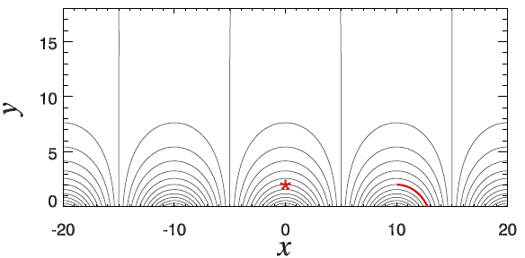
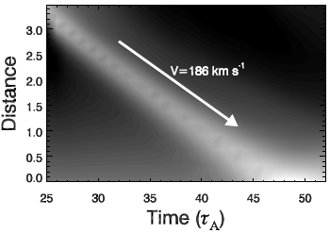
Simulation
Chen et al. (2016)
193 Å

Slide 38
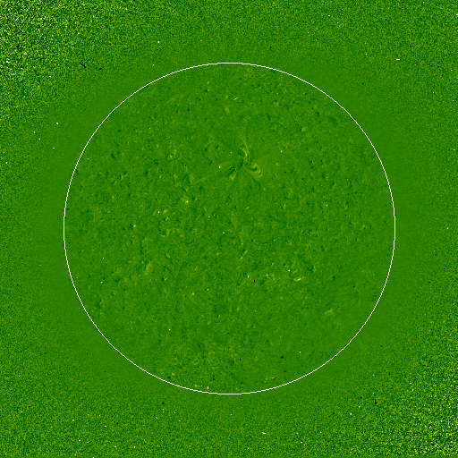
Why Do We Study EIT Waves (1)
P. F. Chen @KIAA

Slide 39
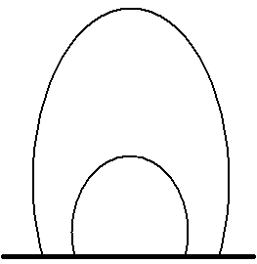
Why Do We Study EIT Waves (2)
coronal seismology (Nakariakov et al. 2005)
Chen, 2009,
Sci. China (G), 52, 1785
P. F. Chen @KIAA

Slide 40
谢谢！
chenpf@nju.edu.cn
http://astronomy.nju.edu.cn/~chenpf

