Slide 1


Pulsars and FRBs: Recent Developments
R. N. Manchester
CSIRO Astronomy and Space Science Sydney Australia
Summary
The YMW16 model for pulsar and FRB distances
Pulsar profile stability
Galactic magnetic fields
Binary pulsar tests of general relativity
Pulsar Timing Arrays and their applications

Slide 2
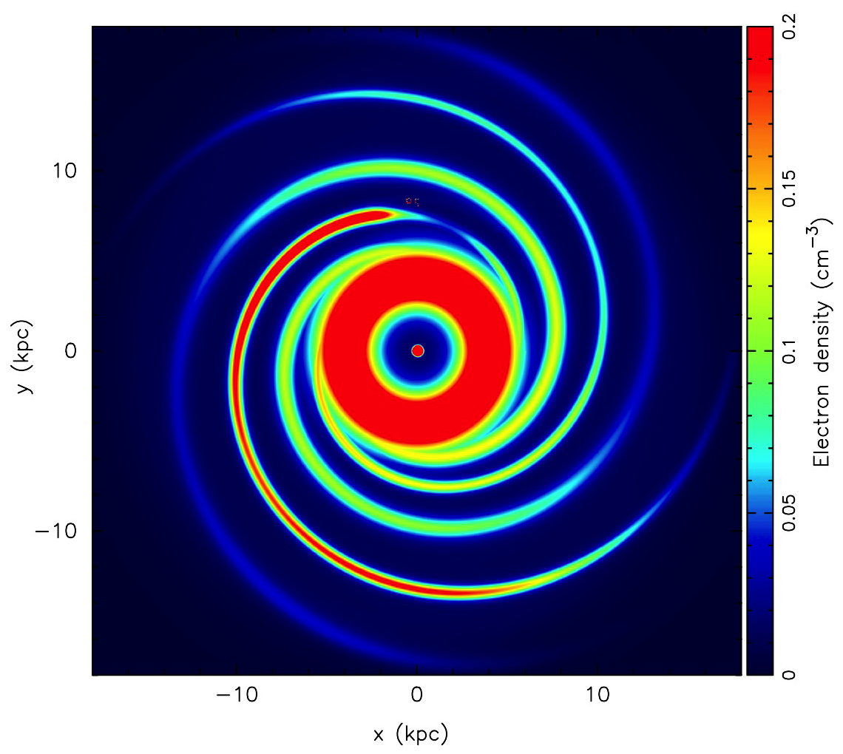
The YMW16 Electron Density Model
Electron density models for the Galaxy, Magellanic Clouds and intergalactic medium
Galactic model based on independent distances for 189 pulsars – 32 fitted parameters, 64 fixed parameters
Magellanic Cloud model based on spectral-line and radio continuum data – 3 fitted parameters, 15 fixed parameters
Accepted by ApJ today!
Also on arXiv:1610.09448
IGM model based on Katz (2016) relation, 3 fixed parameters, one adjustable parameter
Scattering data not used as input to Galactic model, but τ_{sc} estimates output for all modes (Gal, MC, IGM)

Slide 3
Components of the Galactic Model
Thick disk: plane parallel disk, DMperp =19 cm⁻³ pc, n₁ = 0.0116 sech²(z/H₁) cm⁻³, H₁ = 1640 pc
Thin disk: Annulus ctr at 4 kpc, half-width =1200 pc, n₂ ~ 0.4 sech²(z/H₂) cm⁻³, H₂ = K₂ H_{G}
Spiral arms, based on Hou & Han fitting of HII-region distances, radial scale ~ 14 kpc, H_{a} = K_{a} H_{G}
Galactic Centre disk
Local Bubble rim
Spiral arms
Thin disk
Thick disk
Local Bubble
Galactic Centre disk, central n_{e}~6 cm⁻³
Local features: Local Bubble, LB rim (2 clumps), Gum Nebula., Loop I, Carina over-density, Sagittarius under-density
Spiral arm H_{a}
Thin disk H₂
H_{G}

Slide 4
N_{e} in Local Region
Local Bubble rim 1,2
Local Bubble
Gum Nebula
Loop I
Carina
Sagittarius
Notes:
Blue square – under-estimate, Aqua triangle – over-estimate

Slide 5
Thick Disk: DM_{perp} vs |z|
Thick disk only
YMW16 predicts distances more accurately than either NE2001 or TC93

Slide 6
Galactic Scattering Timescales
PSR J1745-2900
Predicted scattering times based on Krishnakumar et al. (2015) fit:
Τ_{sc}(DM) = 4.10 x 10⁻¹¹ DM^{2.2} (1.0 + 0.00194 DM²)
NE2001 predictions systematically low by about a factor of four (except for PSR J1745-2900)

Slide 7
Fast Radio Bursts (FRBs)
Isolated dispersed pulse, width ~ few ms
Accurately follows both DM (~ν⁻²) and scattering (~ν⁻⁴) frequency dependence
DM much greater than total Galactic DM
In all but one case, repeated observations of same region show no recurrence
17 FRBs now known, DMs: 375 – 1600 cm⁻³ pc, all-sky occurrence rate ~2500/day (Keane & Petroff 2015)
Many different models proposed: GRBs, supernovae, magnetar flares, giant pulses
YMW16 models Galactic, Magellanic Cloud and IGM contributions to DM and scattering, derived redshifts z ~ 0.24 – 2.1
“Lorimer Burst”

Slide 8
FRB Host Galaxy Identification(?)
FRB150418 discovered at Parkes by SUPERB transient survey, DM 776 cm⁻³ pc, pulse width ~ 0.8 ms (Keane et al. 2016)
Real-time analysis system reported detection just 10s after the pulse arrival time – Parkes continued observing same sky position for 4.5 hours – no further pulses
ATCA observation started ~2 hours after radio burst – apparent “afterglow” ~6 day decay – arc-sec posn
Subaru 8-m telescope found galaxy at the position, redshift z ~ 0.492
Further imaging of field by VLA, Merlin, VLBA shows that the galaxy contains a weak variable AGN core (Williams & Berger 2016, Bassa et al. 2016)
Initial radio “afterglow” probably unrelated to FRB – implies that galaxy ID is incorrect
However, YMW16 predicts z = 0.492 for this burst!

Slide 9
FRBs and RRATs
Only repeating FRB discovered at Arecibo: FRB121102
Ten more pulses detected over two days in 2015
All have DM 556 ± 4 cm-3 pc
Variable pulse shape and spectral properties
NE2001 model gives DM_{Gal} ~ 188 cm⁻³ pc << DM_{Obs}
Giant pulses from an extragalactic pulsar? (Cordes & Wasserman 2016)
(Spitler et al. 2016)
YMW16 model gives DM_{Gal} ~ 287 cm⁻³ pc, ~ 50% of DM_{Obs}
Is FRB121102 actually a Galactic RRAT?
Pulse properties are consistent with this, but so far no periodicity detected
(Spitler et al. 2016)

Slide 10
The FRB Source Population
For non-evolving cosmological population expect N(>F) ~ F^{-3/2}
Observed distribution is flatter – more strong bursts
Vedantham et al. reassess fluence (pulse energy) distribution for FRBs using 16 Parkes FRBs
(Katz 2016)
Additional constraints from searches using other telescopes
Obtain limits: 0.66 < α < 0.96, where α is slope of cumulative N-F relation (90% confidence)
Implies that most FRB sources are at large z and that searches with small telescopes are more efficient
(Vedantham et al. 2016)

Slide 11
Correlated Profile and Spin-down Changes
Mode changes – sudden changes in pulse profile – are relatively common in pulsars
Correlation with ν found with “intermittent” pulsars (e.g., B1931+24, Kramer et al. 2006) and with profile shape changes (Lyne et al. 2010) in other pulsars
.
More examples found, e.g., PSR B0736-40 (Brook et al. 2014, 2016)
Changes attributed to asteroid impact - possible, but unlikely
Most likely same phenomenon as mode changing and intermittent pulsars – abrupt changes in magnetospheric current distribution result in both profile changes and changes in spin-down rate

Slide 12
A Profile Glitch in the MSP J1643-1224
Sudden appearance of component on leading side of profile
Strongest at 10cm, not seen at 50cm, unpolarised
Mostly decayed over 4 months, but small permanent change
Weaker repeated events like this could be a source of timing noise
(Shannon et al. 2016)
Notes:
Similar to B0736-40 (Karastergiou et al. 2011) but first in MSP

Slide 13
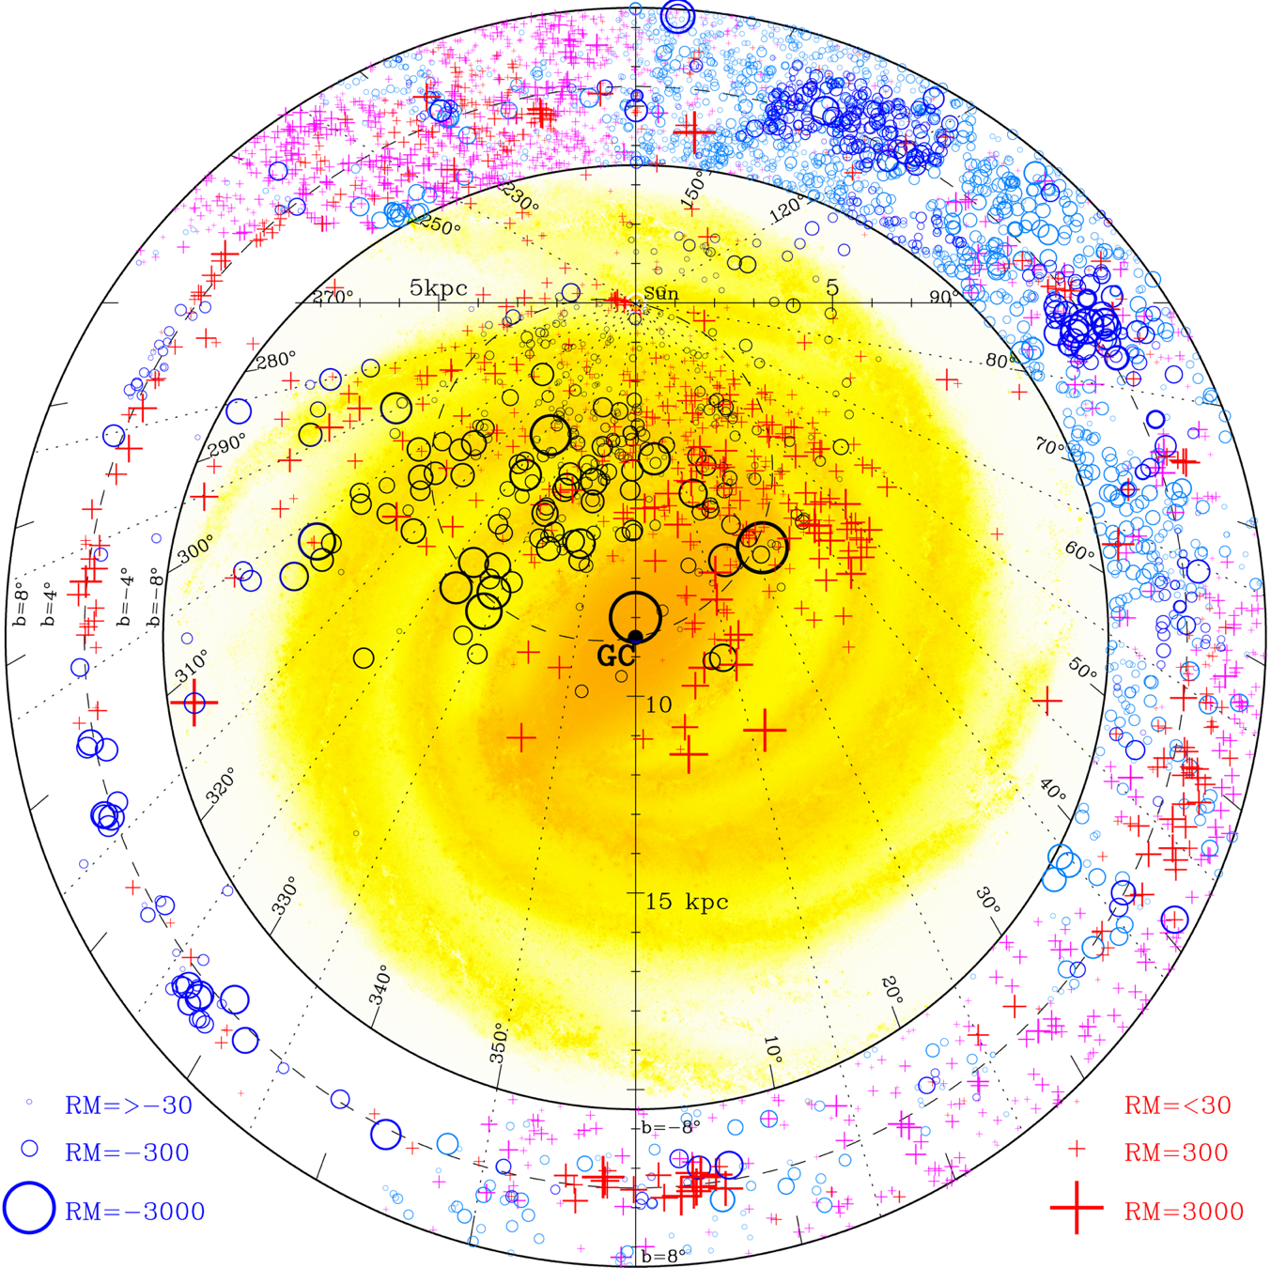
Large-scale Structure of the Galactic Magnetic Field
Slope of RM vs DM gives direct measure of mean line-of-sight magnetic field
With pulsars at different distances can derive a 2D (or even 3D) tomographic image of field
New RM measurements for 477 pulsars from Parkes and GBT
With earlier measurements, 788 pulsars with |b| < 8º used to investigate field in Galactic disk
Also used RMs for 3900 extra-galactic sources with |b| < 8º
(Han et al. 2016)

Slide 14
Galactic Disk Magnetic Field
Field direction and magnitude in tangential arm and interarm regions
EGRS RMs used for outer disk fields
Reversals in field dirns between arm and inter-arm regions – bisymmetric structure
New model accounts for both pulsar and EGRS RMs
RM (rad m⁻²)
(Han et al. 2016)

Slide 15
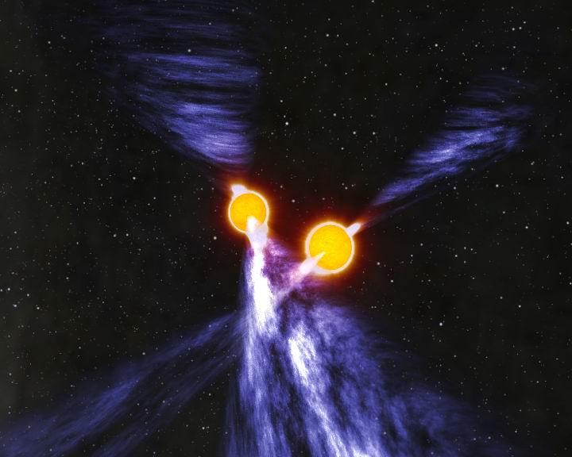
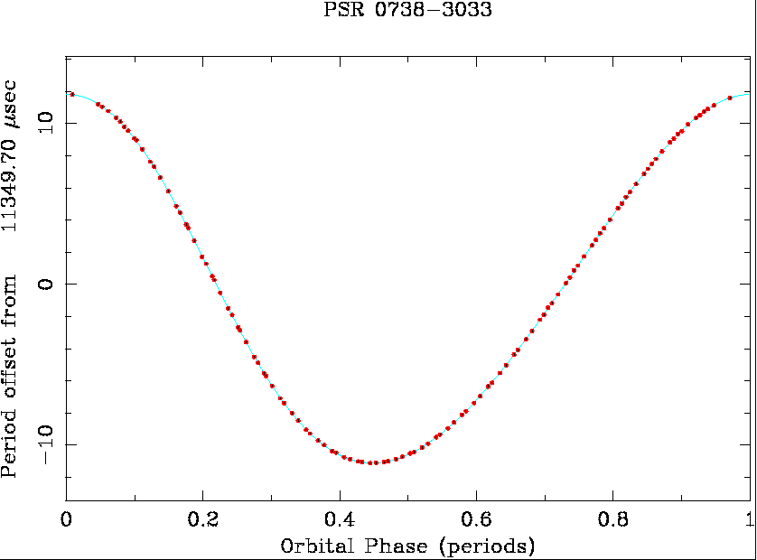
PSR J0730-3039A/B
The first double pulsar!
Discovered at Parkes in 2003
P_{A} = 22 ms, P_{B} = 2.7 s
Orbital period 2.4 hours!
Periastron advance 16.9 deg/yr!
(Burgay et al., 2003; Lyne et al. 2004)
Highly relativistic binary system!

Slide 16
Double Pulsar GR Test – Update
R: Mass ratio
ω: periastron advance
γ: gravitational redshift
r & s: Shapiro delay
P_{b}: orbit decay
Ω_{SO}: Spin-orbit coupling
.
.
Six measured relativistic parameters!
Five independent tests of GR (using R)
Best measurement of P_{b}
Now limits deviations from GR to 0.02%
.
(Kramer et al. 2016)
Notes:
Omega_SO from eclipse modelling

Slide 17
Double Pulsar: Orbit Decay
20 years of timing using Parkes and GBT
Orbit decay measured to 0.02% - order of magnitude better than with B1913+16
Fully consistent with GR prediction
Only just now starting to be limited by uncertainty in Galactic acceleration
(Kramer et al. 2016)

Slide 18
Pulsar Timing Arrays (PTAs)
A PTA consists of many pulsars widely distributed on the sky with frequent high-precision timing observations over a long data span
Can in principle detect gravitational waves (GW)
    GW passing over the pulsars are uncorrelated – add noise
    GW passing over Earth produce a correlated signal in the TOA residuals for all pulsars
PTAs are sensitive to very low-frequency (nanohertz) GW – complementary to laser-interferometer systems
Most likely source of GW detectable by PTAs is a stochastic background from super-massive binary black holes in distant galaxies
Predictions of GWB amplitude suggest that observations of ~20 MSPs over ~10 years needed for detection
Idea first discussed by Hellings & Downs (1983), Romani (1989) and Foster & Backer (1990)

Slide 19
Gravitational Waves Detected!
aLIGO detected strong signals on Sept. 14, 2015
Inspiral and merger of two stellar-mass black holes
Precisely described by GR waveforms: 36±5 M; 29±4 M
3.0±0.5 M radiated as GWs!
Final BH spin: 0.67±0.06
(Abbott et al. 2016a)
A beautiful result – congratulations to LIGO-Virgo team!

Slide 20
Tests of GR with GW150914
Observed waveforms accurately conform to the GR predictions (after fitting for binary system parameters)
Can perturb waveform by adding hypothetical higher-order terms and set limits on possible perturbations
Limit on fractional deviation of 0PN (GW emission) term ~20%; higher-order terms limited to factors ~1 – 10
Double Pulsar results give much lower limits for lowest two orders, but do not limit higher orders since v/c ~0.002
GR waveform
90% confidence region for observed waveform
(Abbott et al. 2016b)
Note: 0PN as used here is equivalent to 2.5PN based on the equations of motion, i.e., ~(v/c)⁵, where 0PN is Newtonian motion and 1PN is lowest-order relativistic term, ~(v/c)²
(v/c)⁵
(v/c)⁷
(Wex, priv. comm. 2016)

Slide 21
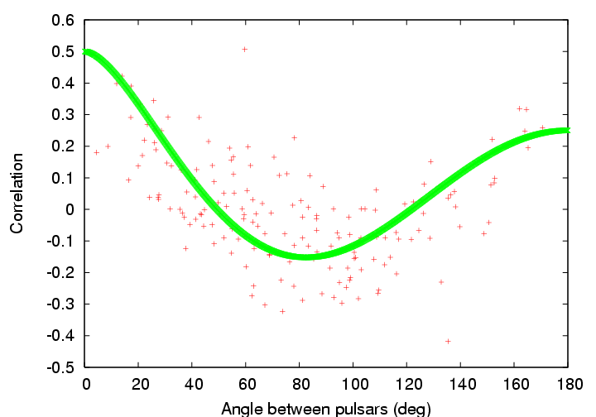
Correlated Pulsar Timing Signals
Clock errors
  All pulsars have the same TOA variations: Monopole signature
Solar-System ephemeris errors
  Dipole signature
Gravitational waves
  Quadrupole signature
Hellings & Downs GW correlation function
Can separate these effects provided there is a sufficient number of widely distributed pulsars
(Hobbs et al. 2009)

Slide 22

Major Pulsar Timing Array Projects
European Pulsar Timing Array (EPTA)
  Radio telescopes at Westerbork, Effelsberg, Nancay, Jodrell Bank, (Cagliari)
  Normally used separately, but can be combined for more sensitivity
  Timing 22 MSPs, 10 with σ_{ToA} < 2 μs, data spans 5 - 18 years
North American pulsar timing array (NANOGrav)
  Data from Arecibo and Green Bank Telescope
  Timing 40 MSPs, 16 with σ_{ToA} < 2 μs, data spans 1 - 28 years
Parkes Pulsar Timing Array (PPTA)
  Data from Parkes 64m radio telescope in Australia
  Timing 21 MSPs, 20 with σ_{ToA} < 2 μs, data spans 3 – 19 years

Slide 23
Sky Distribution of PTA MSPs
.
About 110 MSPs with P < 15ms, P < 10⁻¹⁹ and not in globular clusters
~70 MSPs currently being timed by PTAs
11 MSPs timed by two PTAs
8 MSPs timed by all three PTAs
(Zhu et al. 2015)

Slide 24
EPTA Limit on GWB
Best six EPTA pulsars, 18-year data span
Bayesian analysis: pulsar parameters, noise processes, GWB
GWB 95% limit: A_{1yr} < 3 x 10⁻¹⁵
Consistent with Sesana (2013) prediction for GWB from SMBHB in galaxies
Limit on cosmic-string tension: Gμ/c² < 10⁻⁷
LIGO limit
Spectra sensitivity
Power-law SMBH 95% Limit
String limit
Sesana (2013) SMBH prediction
(Lentati et al. 2015)
Notes:
BBN – Big Bang Nucleosynthesis

Slide 25
NANOGrav Limit on GWB
Bayesian analysis
Pulsar white noise parameters separately derived
Combined analysis for GWB and red noise
95% confidence limit A_{1yr} = 1.5 x 10⁻¹⁵
McWilliams model ruled out at 99.2% level, Sesana (2013) OK at 20% level
Models with environmental orbit decay (e.g., Ravi et al.) or eccentric binaries (Heurta et al. 2015) are favoured
(Arzoumanian et al. 2015b)

Slide 26
Most Recent PPTA Limit on the Nanohertz GW Background
Based on PPTA 10cm (3 GHz) data sets for the four best-timed pulsars
11-year data span – 3.5 yrs longer than Shannon et al. (2013) PPTA data set
Inclusion of 20cm and 50cm data reduces the sensitivity – corrections for dispersion delays are not sufficiently accurate
Bayesian analysis method
New limit: A_{1yr} < 1.0 x 10⁻¹⁵
Ω_{GW} < 2.3 x 10⁻¹⁰ at f = 0.2 yr⁻¹ (6 nHz)
J1909-3744
J0437-4715
J1713+0747
J1744-2304
(Shannon et al., Science, 2015)
Best current limit on nHz GWB - essentially rules out all standard models

Slide 27
Comparison with GWB Models
Observational limits (95% conf):
  N13: NANOGrav (Demorest et al.)
  E15: European PTA (Lentati et al.)
  P13: Parkes PTA (Shannon et al.)
  P15: PPTA 10cm (Shannon et al.)
GWB models:
  K15: Kulier et al. ✖ (99.5%)
  S13: Sesana ✖ (91%)
  M14: McWilliams et al. ✖ (99.8%)
  M14e: McWilliams et al. ✖ (96%)
  R14: Ravi et al. (✔) (20%)
  R15: Ravi et al. ✖ (95%)
Different assumptions about galaxy merger rates and SMBBH evolution
(Shannon et al., Science, 2015)
M14e and R14 include gas/stellar-interaction at late times
Notes:
Probabilities: K15

Slide 28
Scenarios for SMBBH Evolution
Fiducial: Std model
Slow merger: Dynamic friction x10⁻⁴
Recoil: 500km s⁻¹ kick – SMBHB escapes
Stalled: stellar/gas interaction x10⁻² (“last parsec” case)
Environment: stellar/gas
interaction at late times x10²
(Shannon et al. 2015)
GW: GW emission dominates over other loss processes
Slow merger, recoil, or stalled merger unlikely to be important
Most probable reason for lack of detection is orbit decay due to stellar/gas interactions at late times – less energy into GW
Also implies GWB detectability may be greater at higher frequencies (f > ~1 yr⁻¹)

Slide 29
Time to Detection of GWB
Probability density of true A_{1yr} based on current upper limit, no stall and 90% stall
Enhanced IPTA, 6 MSPs added per year, 250ns ToA precision
90% probability of detection in ~8 yrs (no stall), ~10 yrs (90% stall)
90% stall
No stall
No stall
Detn Probability
90% stall
Time from now (years)
(Taylor et al. 2016)

Slide 30
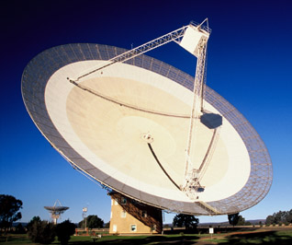
Pulsar Timing Parameters from the PPTA Dataset
20 MSPs, up to 17-yr data span, 3 bands (50cm, 20cm, 10cm)
Fit DM variations, noise models – split-Cholesky analysis
Parallaxes for 16 pulsars, five not previously measured
Distances from P_{b} for six pulsars (Shklovskii effect)
For J0437-4715, timing px 6.37 ± 0.09 mas, distance 156.9 ± 2 pc
P_{b} distance: 156.79 ± 0.25 pc – the most precisely known pulsar distance!
Improved measurement of Shapiro delay gives M_{c} = 0.224±0.007 M and orbit inclination angle i = 137.56 ± 0.04 deg
Can then derive M_{p} = 1.44 ± 0.07 M – less than previous estimate (1.75 ± 0.2 M, also from Shapiro delay)
.
.
(Reardon et al. 2016)

Slide 31
The GWB across 29 Decades of Frequency
Fluctuations in early Universe amplified by inflation
Expect wide-spectrum GWB, power-law slope n_{t} above f_{eq}
(f_{eq}⁻¹ = size of Universe at radiation/matter equality)
Planck + Sth Pole CMB telescopes constrain tensor-scalar ratio r < 5, n_{t} < 5
PPTA GWB limit constrains n_{t} < 0.35
With CMB, also constrains r < 0.5
Rules out some theories of early Universe
(Lasky et al. 2016)

Slide 32
Localisation of a GW Source
PPTA data set with simulated source in Fornax cluster, S/N ~ 5
Earth-term correlation statistic
Max detection statistic (o) close to source position ( )
Localisation poor ~ 400 sq deg
Use pulsar term! – pulsar-Earth interferometer
Fringe spacing θ_{f} = λ_{GW}/[2πd(1+γ)] – few arc min (γ is psr z dirn cosine, GW source dirn -z )
Localisation ~ θ_{f} /(S/N) – sub-arc-min possible
However, pulsar distances must be known to better than λ_{GW}/(1+γ)
So far, only one pulsar (J0437-4715) has a sufficiently accurate distance (Reardon et al. 2015)
(Zhu et al. (2015)
(Lee et al. 2011)

Slide 33

The International Pulsar Timing Array
The IPTA is a consortium of consortia, formed from existing PTAs
Currently three members: EPTA, NANOGrav and PPTA
Aims are to facilitate collaboration between participating PTA groups and to promote progress toward PTA scientific goals
The IPTA organises annual Student Workshops and Science Meetings – 2017 meetings will be in France in late June
Now have the combined DR1 data sets (Verbiest et al. 2016) and working on DR2 which includes more recent data
Expect significant improvement in GW detection sensitivity and other scientific goals from analysis of full IPTA data set (at least 50 MSPs)
Notes:
Probably Paris

Slide 34
IPTA Data Release 1
Data from the EPTA, NANOGrav and PPTA (9 radio telescopes)
Multi-band data, 300 – 3100 MHz for 49 pulsars, 5 – 27 yr data spans
Observing cadence 5 – 30 days
Determined instrumental offsets, DM variations, noise models
Overlapping datasets valuable in identifying source of timing irregularities
Of 26 pulsars with >10-yr data spans, 25 show DM variations and 10 show evidence for intrinsic “red” timing noise
(Verbiest et al. 2016)

Slide 35
Pulsars as Clocks
Pulsars are timed against the most accurate international atomic timescales, TT(TAI) and TT(BIPM)
If all pulsars show the same timing signal, must be due to irregularities in the reference timescale
Can define a Pulsar Timescale which is:
independent of Earth-based timescales
based on entirely different physics
will continue for billions of years
Pulsars can provide a valuable independent check on the long-term stability of atomic timescales

Slide 36
IPTA Pulsar Timescale
Using IPTA DR1 dataset, 49 MSPs
Fitted DM variations and noise models to multi-band data
Extrapolated DM noise models to single-band data
Used split-Cholesky method to get final noise models
Determined common-mode or clock term using Tempo2
TT(BIPM) – TT(TAI)
(Li et al. 2016)
Used TT(TAI) as reference time standard
TT(BIPM) is post-corrected version of TT(TAI)
Pulsar clock signal accurately follows known TT(BIPM) – TT(TAI)
Confirms that TT(BIPM) is more stable than TT(TAI)
Notes:
KJ Bayesian analysis

Slide 37
Pulsar and Atomic-Clock Noise Spectra
11-year 10-cm data set for PSR J1909-3744 (Shannon et al. 2015)
4-year USNO rubidium-fountain clock data (D. Matsakis, priv. comm., cf. Peil et al. 2014)
Pulsar spectrum flat (“white”), 99 ns rms timing residual
Clock spectrum “red” power-law, slope = -3
Extrapolation of both spectra gives equal noise power at
90% confidence limits
(Coles et al., unpublised)
0.065 cycles/year – pulsar will reach that in a few years
Stability of pulsar clock will likely exceed that of current best long-running atomic clock for timescales >~ 15 years

Slide 38
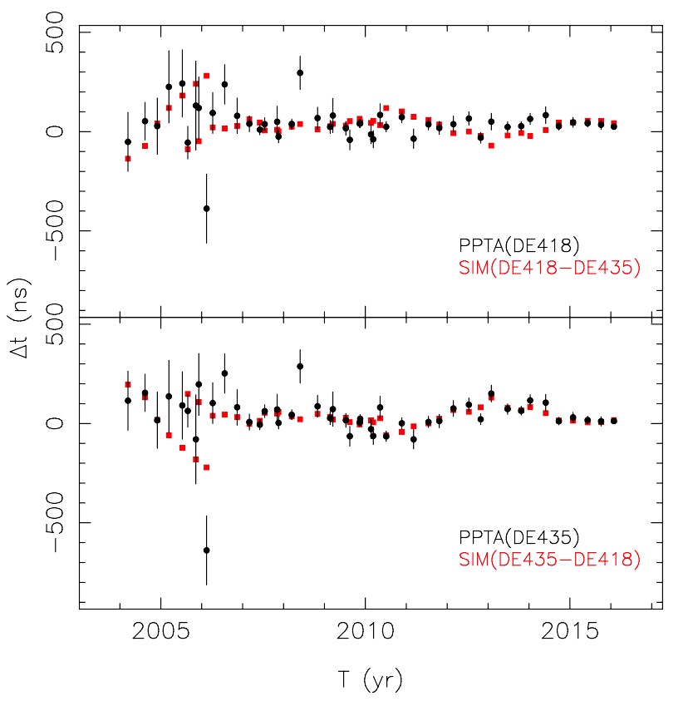
Solar System Ephemerides
All pulsar timing data referred to the solar-system barycentre using a planetary ephemeris
Most commonly used are the “DE” series from JPL
With DE418, PSR J1909-3744 timing residuals are “white”
With later ephemerides (DE421 – DE435) red noise in J1909-3744 progressively increases!
With DE435, J1909-3744 residuals track simulated ToAs representing DE435 – DE418
(Shannon et al., unpublished)
Suggests that later ephemerides are inferior to DE418!?

Slide 39
Future Developments
Large new radio telescopes (e.g., FAST, LOFAR, CHIME, SKA) will give increased sensitivity for all pulsar research
Large single dishes like FAST are the most versatile and useful
Ultra-wideband receiving systems provide many advantages
GPU-based signal processing systems are fast and adaptable
China has a big future in radio astronomy!

Slide 40
Many new and exciting results in pulsar and FRB astronomy and astrophysics
Great potential for future research!
谢 谢

