Slide 1

Spin-Orbit Interactions in Exoplanetary Systems
Josh Winn
Massachusetts Institute of Technology
Simon Albrecht (Aarhus University), Roberto Sanchis Ojeda (MIT)
John Johnson (Harvard), Andrew Howard (Hawaii), Geoff Marcy (UCB),
Paul Butler (DTM), Bill Chaplin (Birmingham), Daniel Huber (NASA Ames),
Dan Fabrycky (Chicago), Teru Hirano (Tokyo), Norio Narita (NAOJ)

Slide 2
Winn (2010)

Slide 3
With only radial velocities…
Orbital properties
Period
Eccentricity
Planet bulk properties
Minimum mass

Slide 4
With transits and occultations…
Orbital properties
Period
Eccentricity
Planet bulk properties
Mass
Radius
Planet atmospheric properties
Emission spectrum
Transmission spectrum
Reflectance spectrum
Phase function
Stellar properties
Limb darkening function
Gravity darkening function
Spots and plages
Obliquity
Multiple-planet systems
Dynamical masses
Mutual inclinations
Resonances and chaos
Multiple-star systems
Circumbinary planets
For the future
Moons and Trojans
Oblateness and rings
Apsidal motion constant
Relativistic precession
Orbital decay
Applegate effect
Planetary wind speed
Yarkovsky effect
Planetary magnetic field
Planetary aurorae
Artificial planet-sized objects

Slide 5
When was the first announcement of the detection of a planetary transit?

Slide 6
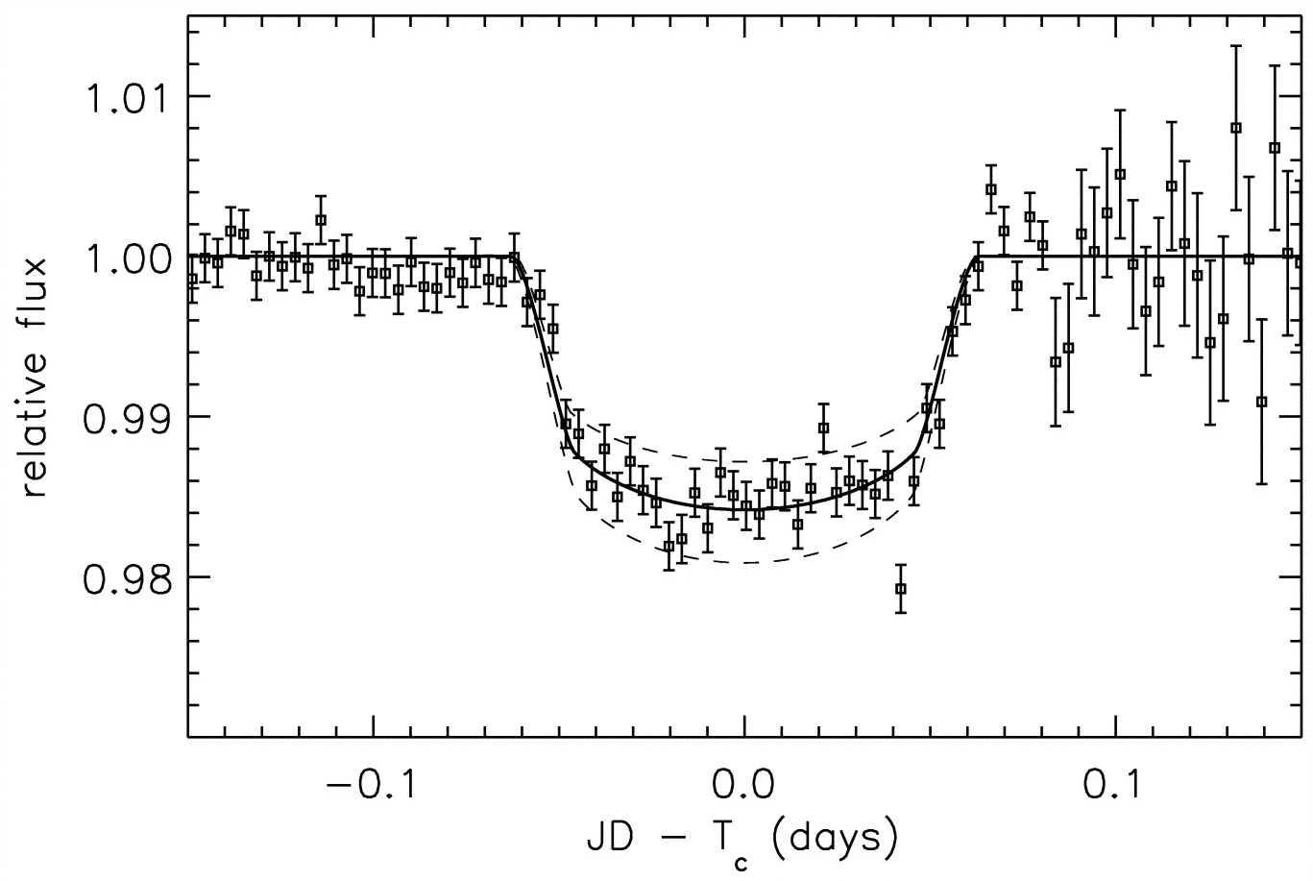
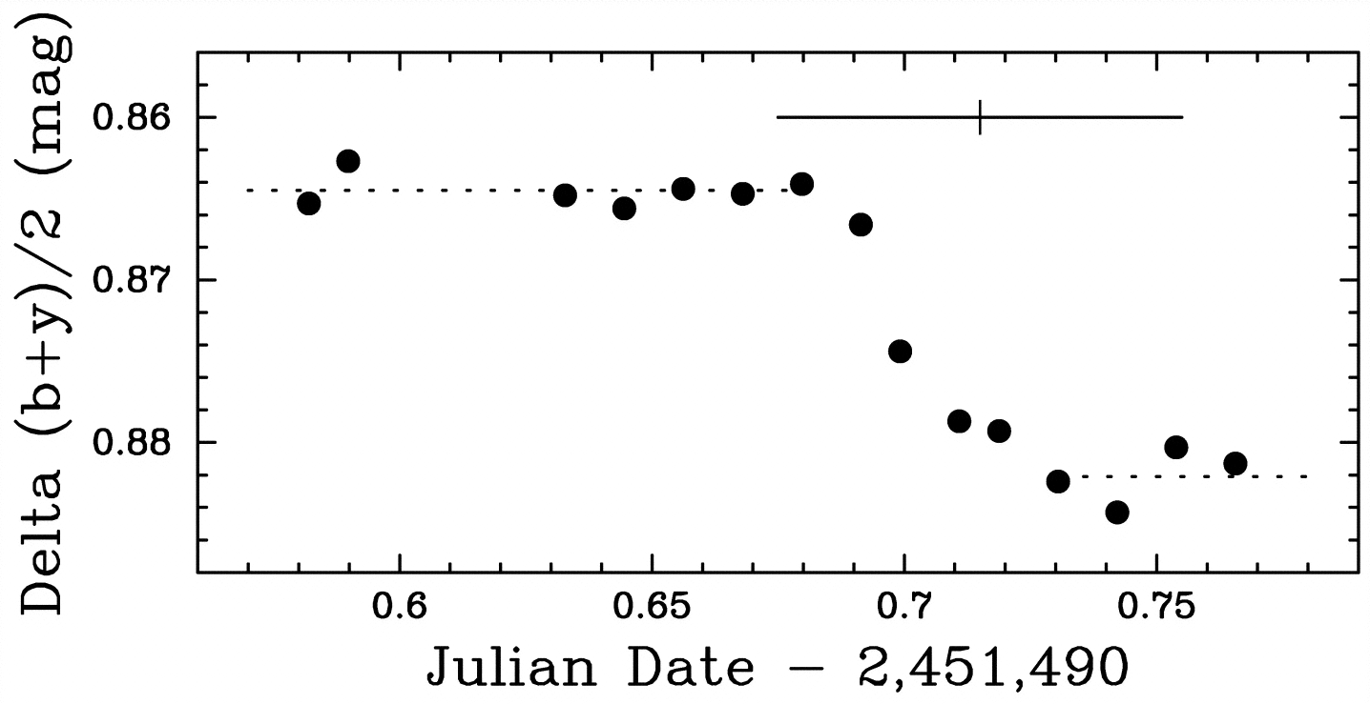
Charbonneau, Latham, Brown, & Mayor (2000)
Henry, Marcy, Butler, & Vogt (2000)

Slide 7

Jeremiah Horrocks (1639)

Slide 8
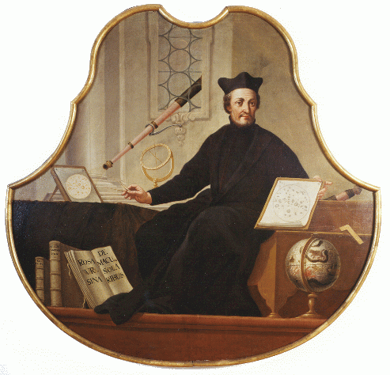
Christoph Scheiner (1611)

Slide 9
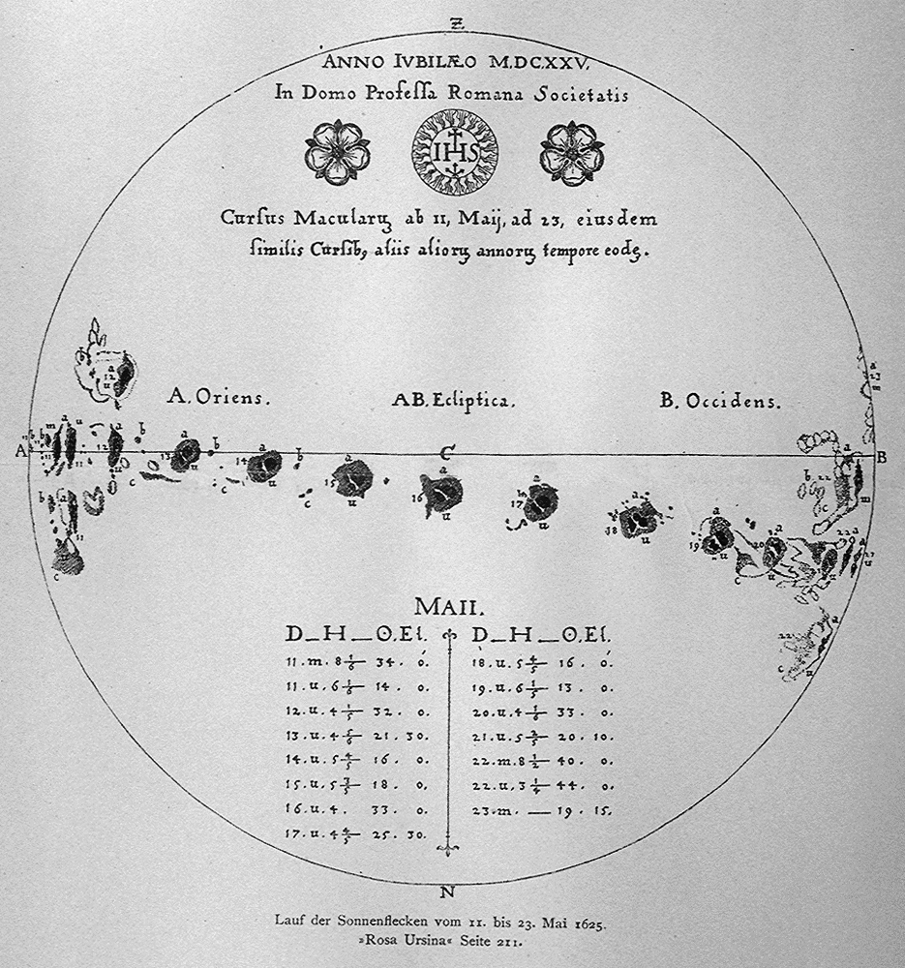
Rosa Ursina
Christoph Scheiner (1611)

Slide 10

The Sun’s obliquity is 7°
Christoph Scheiner (1611)

Slide 11
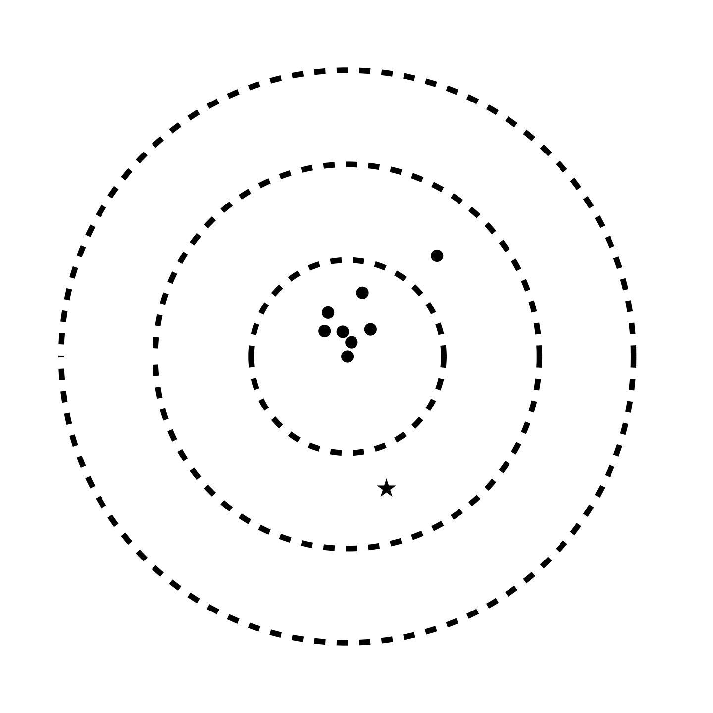
The Sun’s obliquity is 7°
Planetary orbital axes
5°
10°
Christoph Scheiner (1611)
15°
Solar spin axis

Slide 12
The Sun’s obliquity is only 7°
Evidence for formation in a single spinning disk (Laplace 1796)
Planetary orbital axes
Upper limits on “Planet X”
(Goldreich & Ward 1972),
and violations of Lorentz
invariance (Nordtvedt 1987)
5°
10°
15°
Solar spin axis

Slide 13
The Sun’s obliquity is not zero
Early close encounter with another star (Heller 1993)
Chaotic star formation (Bate, Lodato, & Pringle 2010)
Planetary orbital axes
5°
10°
15°
Solar spin axis

Slide 14
The Sun’s obliquity is not zero
What about exoplanetary systems?
Planetary orbital axes
5°
10°
15°
Solar spin axis

Slide 16
Hot Jupiters
Easy to detect
Hard to understand

Slide 17
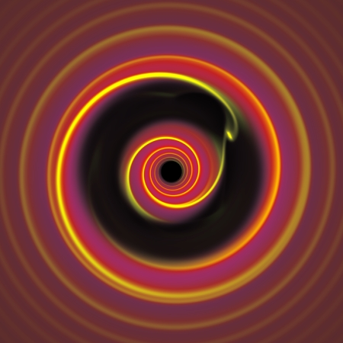
Few-body dynamics
Tidal dissipation
Rasio & Ford (1996)
Lin et al. (1996)
Disk-planet interactions

Slide 18
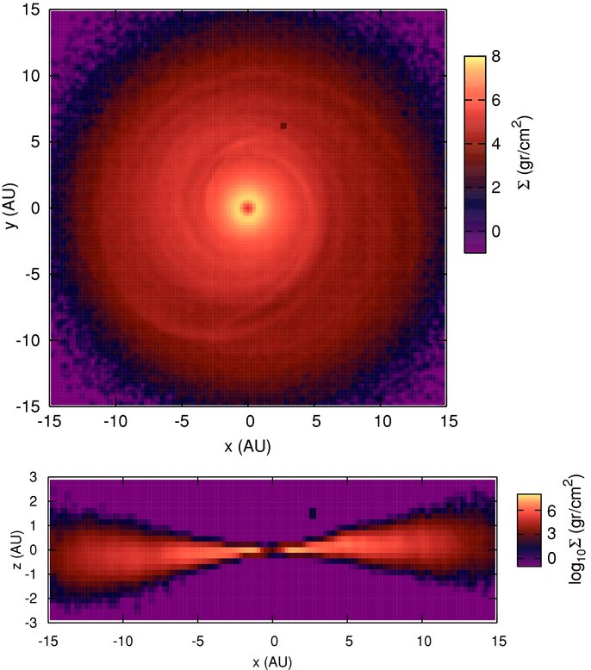
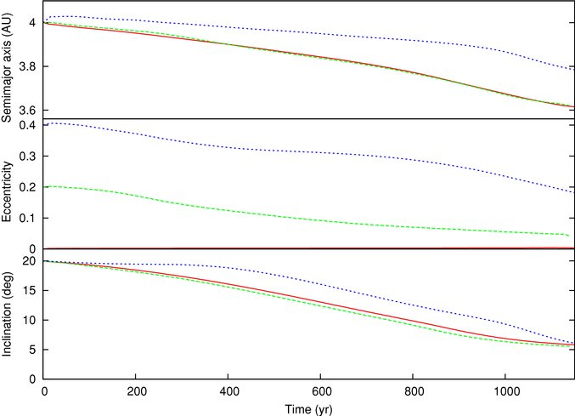
Disk-planet interactions
4.0
3.8
3.6
Orbital distance [AU]
0.3
0.2
0.1
Eccentricity
15
10
5
Inclination [degrees]
0
200
400
600
800
1000
Time [yr]
Marzari & Nelson (2009)

Slide 19
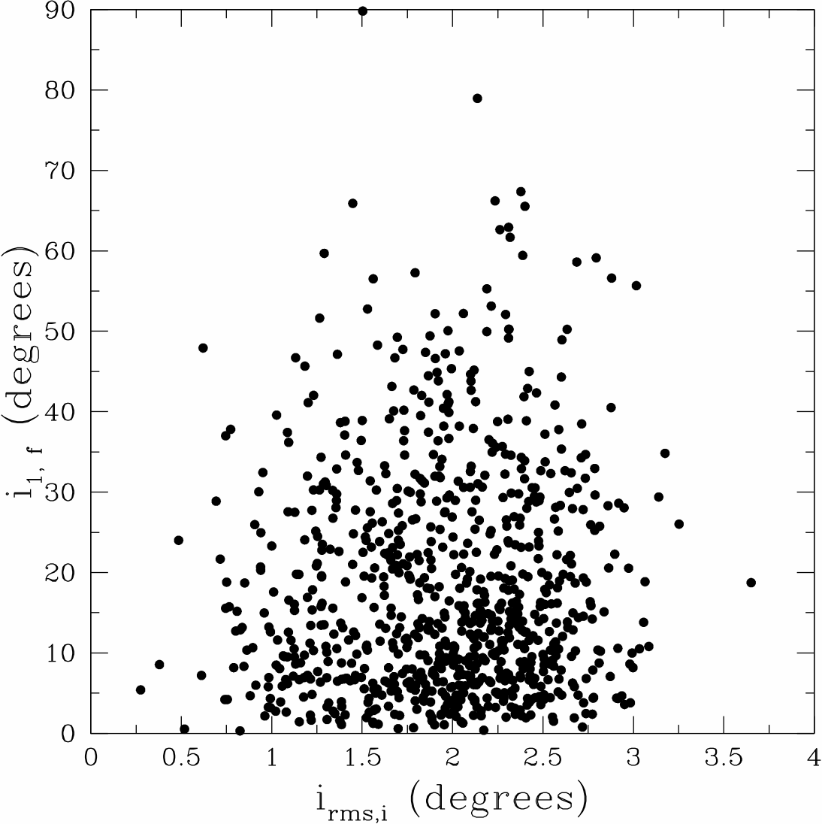
Chatterjee, Ford, Matsumura, & Rasio (2008)
Few-body dynamics amplify initial misalignments
Final incl. of inner planet [deg]
Nagasawa et al. (2008)
Juric & Tremaine (2008)
Matsumura, Peale, & Rasio (2010)
Initial rms incl. of 3 planets [deg]

Slide 20
Kozai oscillations
Mazeh et al. (1997)
Holman et al. (1997)
Innanen et al. (1997)
Wu & Murray (2003)
Eggenberger et al. (2004)
Wu, Murray, & Ramsahi (2007)
Fabrycky & Tremaine (2007)
Nagasawa, Ida, & Bessho (2008)
Naoz et al. (2011)
Lithwick & Naoz (2011)
Third body (star, distant planet)
Notes:
Above icrit, a circular orbit is unstable - oscillations

Slide 21
Kozai oscillations
Mazeh et al. (1997)
Holman et al. (1997)
Innanen et al. (1997)
Wu & Murray (2003)
Eggenberger et al. (2004)
Wu, Murray, & Ramsahi (2007)
Fabrycky & Tremaine (2007)
Nagasawa, Ida, & Bessho (2008)
Naoz et al. (2011)
Lithwick & Naoz (2011)
Third body (star, distant planet)
Notes:
Above icrit, a circular orbit is unstable - oscillations

Slide 22
Kozai oscillations
Tidal dissipation
Mazeh et al. (1997)
Holman et al. (1997)
Innanen et al. (1997)
Wu & Murray (2003)
Eggenberger et al. (2004)
Wu, Murray, & Ramsahi (2007)
Fabrycky & Tremaine (2007)
Nagasawa, Ida, & Bessho (2008)
Naoz et al. (2011)
Li et al. (2013)
Third body (star, distant planet)
Notes:
Above icrit, a circular orbit is unstable - oscillations

Slide 23
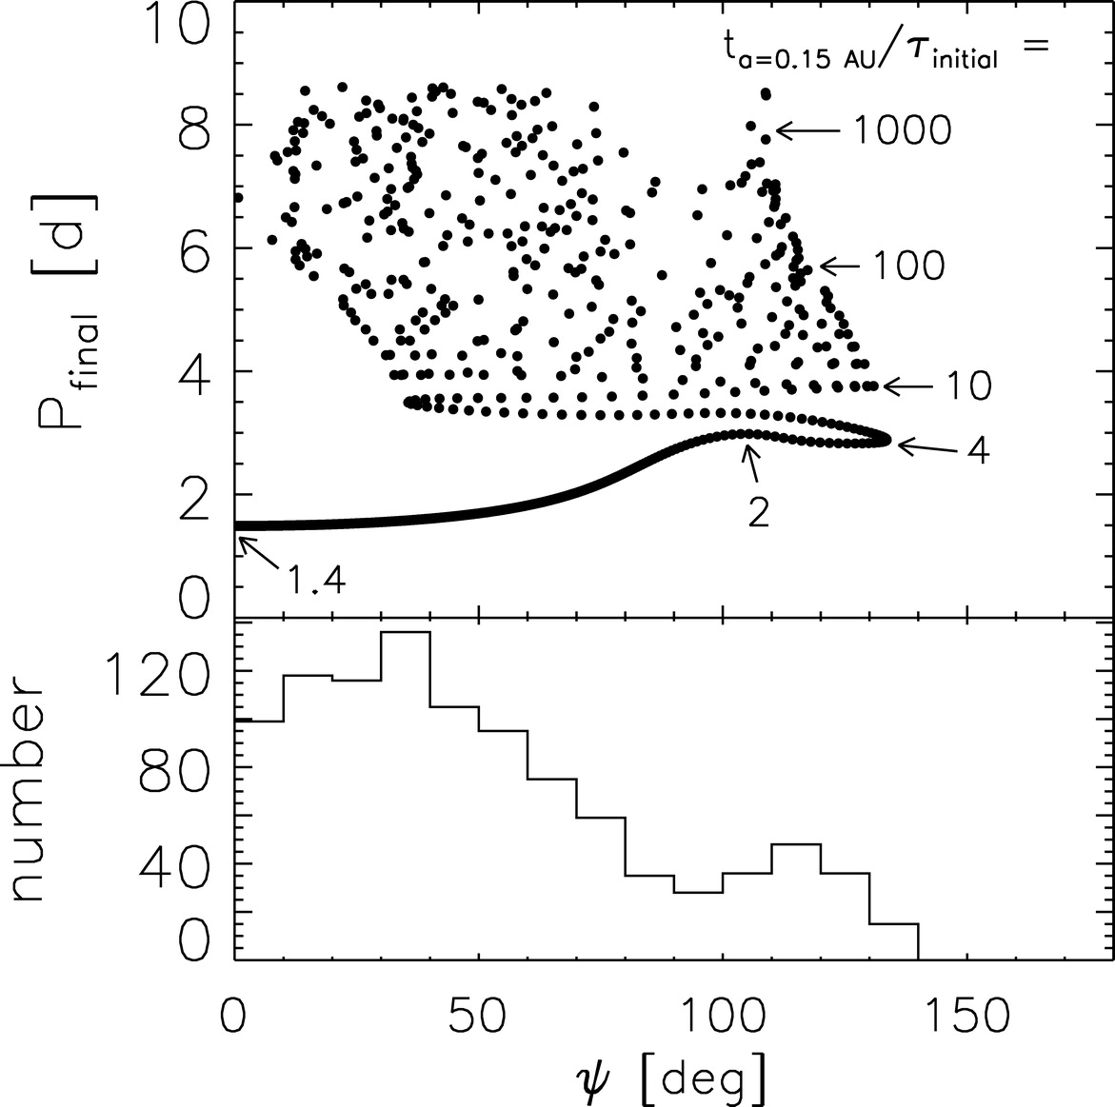
Kozai oscillations produce a very broad range of final inclinations
Fabrycky & Tremaine (2007)

Slide 24
Few-body dynamics
Tidal dissipation
Ford & Rasio (1996)
Lin et al. (1996)
High obliquity
Low obliquity
Disk-planet interactions

Slide 25
Stellar obliquity
Sun’s obliquity is 7º — how typical is this?
Specific reasons to check:
  Whatever perturbs eccentricities may also change orbital orientations
  Whatever produces hot Jupiters may also change orbital orientations

Slide 26
Brightness
Time

Slide 27
Doppler shift
Time

Slide 28
Doppler shift
Time

Slide 29
Doppler shift
Time

Slide 30
Doppler shift
Time

Slide 31
Doppler shift
Time

Slide 32
Doppler shift
Time

Slide 33
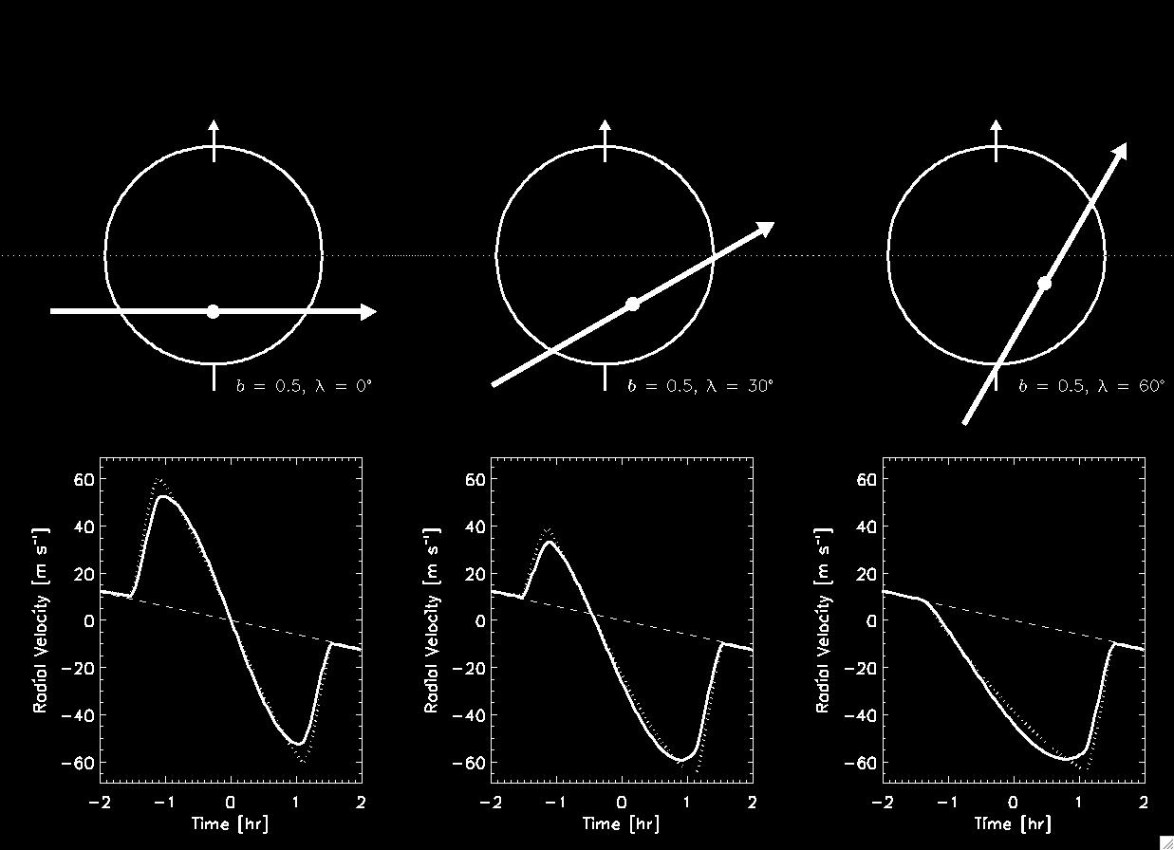
Measuring the stellar obliquity
Queloz et al. (2000); Ohta, Taruya, & Suto (2005); Gaudi & Winn (2007)

Slide 34
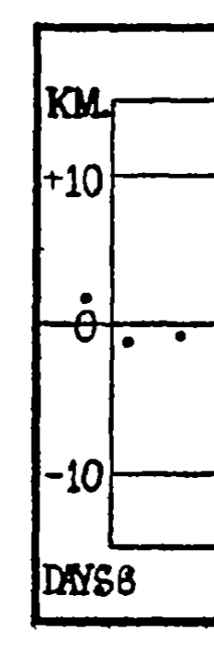
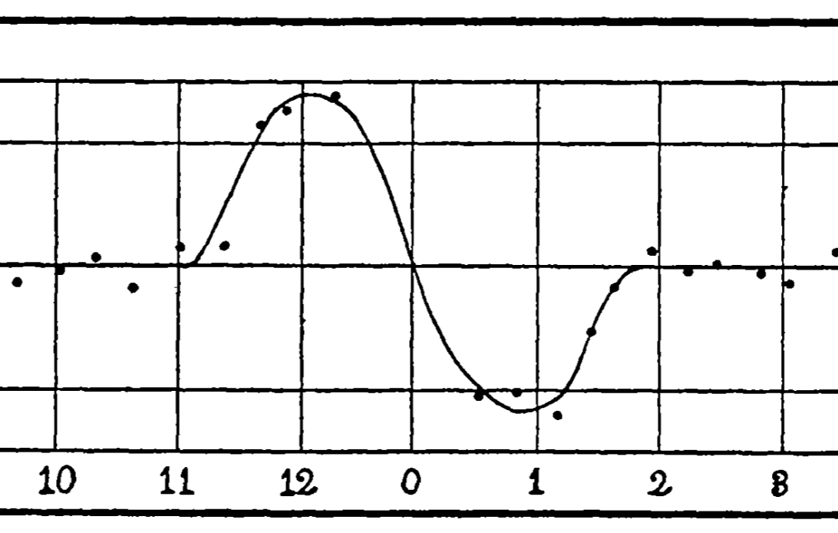

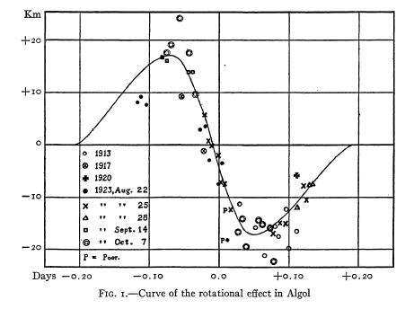
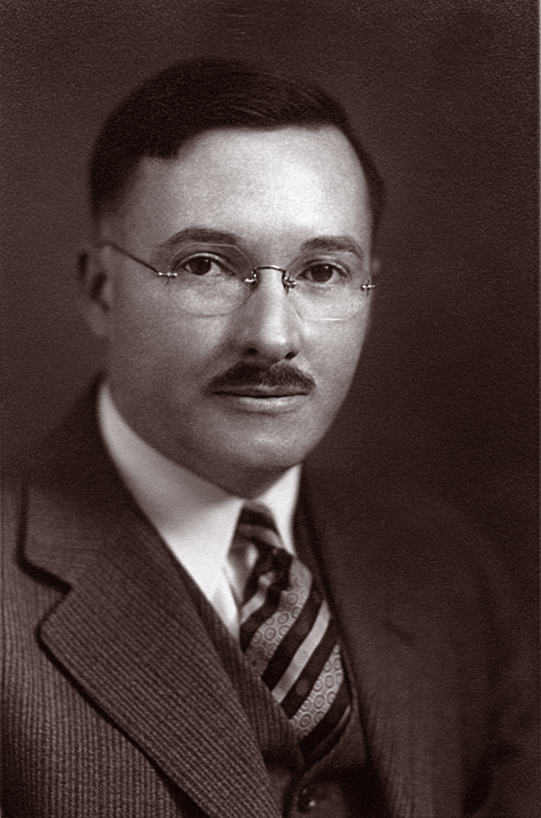
The Rossiter-McLaughlin effect
β Lyrae
Richard Rossiter (1886-1977)
Algol
Dean McLaughlin (1901-1965)

Slide 35
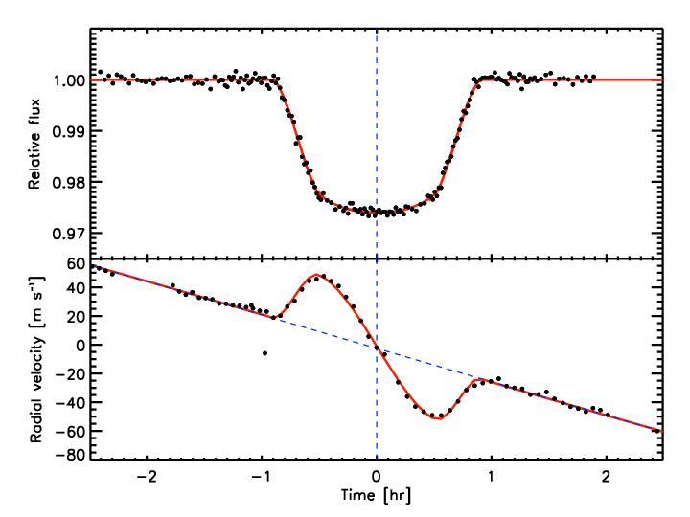
Low obliquity
HD 189733
λ = –1.4° ± 1.1°
Winn et al. (2006)

Slide 36
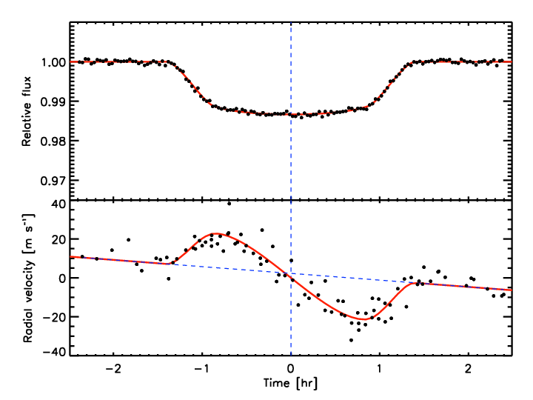
Low obliquity
HAT-P-1
λ = +3.7° ± 2.1°
Johnson et al. (2008)

Slide 37
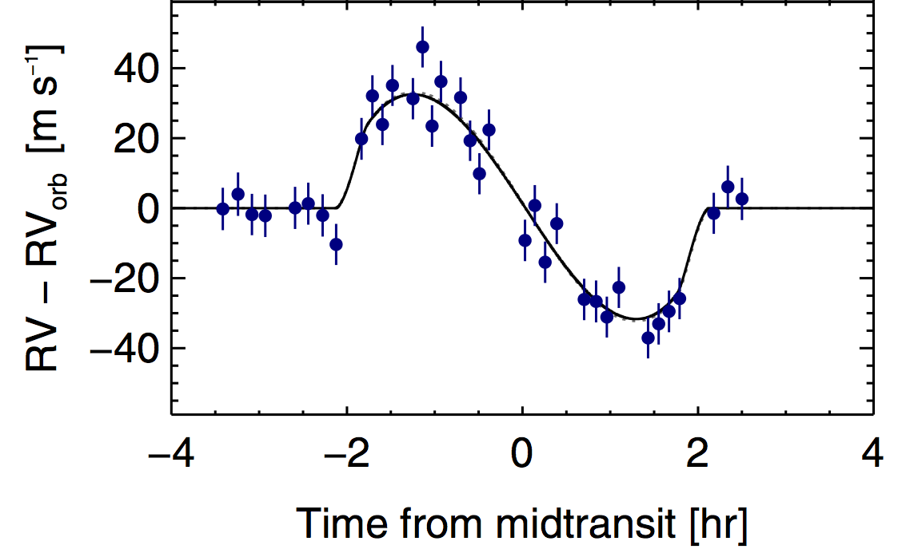
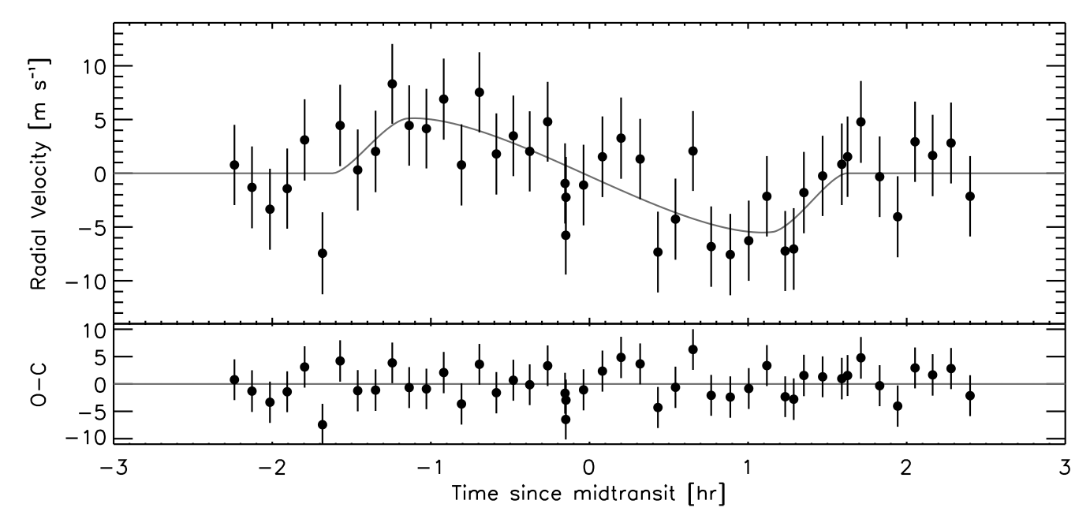
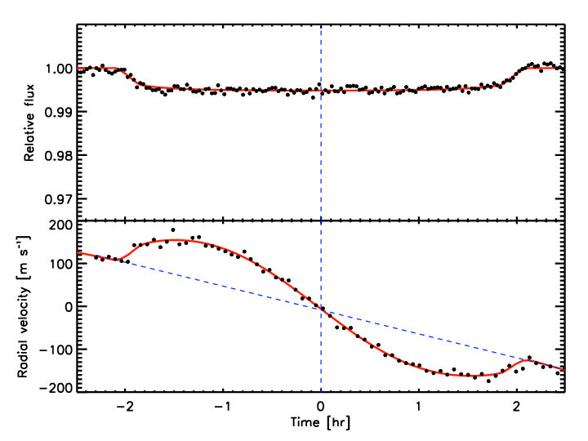
More low obliquities…

Slide 38
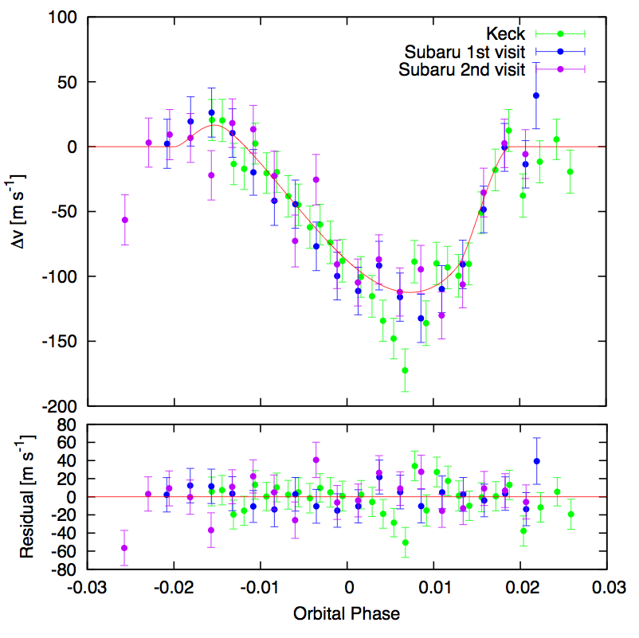
Moderate obliquity
XO-3
λ = 37° ± 3°
Hébrard et al. (2008), Winn et al. (2009); Hirano et al. (2011)

Slide 39
High obliquity
WASP-7
λ = 86° ± 6°
Albrecht et al. (2011)

Slide 40
Very high obliquity (retrograde)
HAT-P-7
Winn et al. (2009)

Slide 41
λ = 0°

Slide 42
λ = 0°

Slide 43
λ = 0°

Slide 44
λ = 0°

Slide 45
λ = 0°

Slide 46
λ = 0°

Slide 47
λ = 0°
λ = 100°

Slide 48
λ = 0°
λ = 100°

Slide 49
λ = 0°
λ = 100°

Slide 50
λ = 0°
λ = 100°

Slide 51
λ = 0°
λ = 100°
…

Slide 52
λ = 0°
λ = 100°
…

Slide 53
λ = 0°
λ = 100°
…

Slide 54
λ = 0°
λ = 100°
The starspot-anomaly pattern reveals the stellar obliquity
…

Slide 55
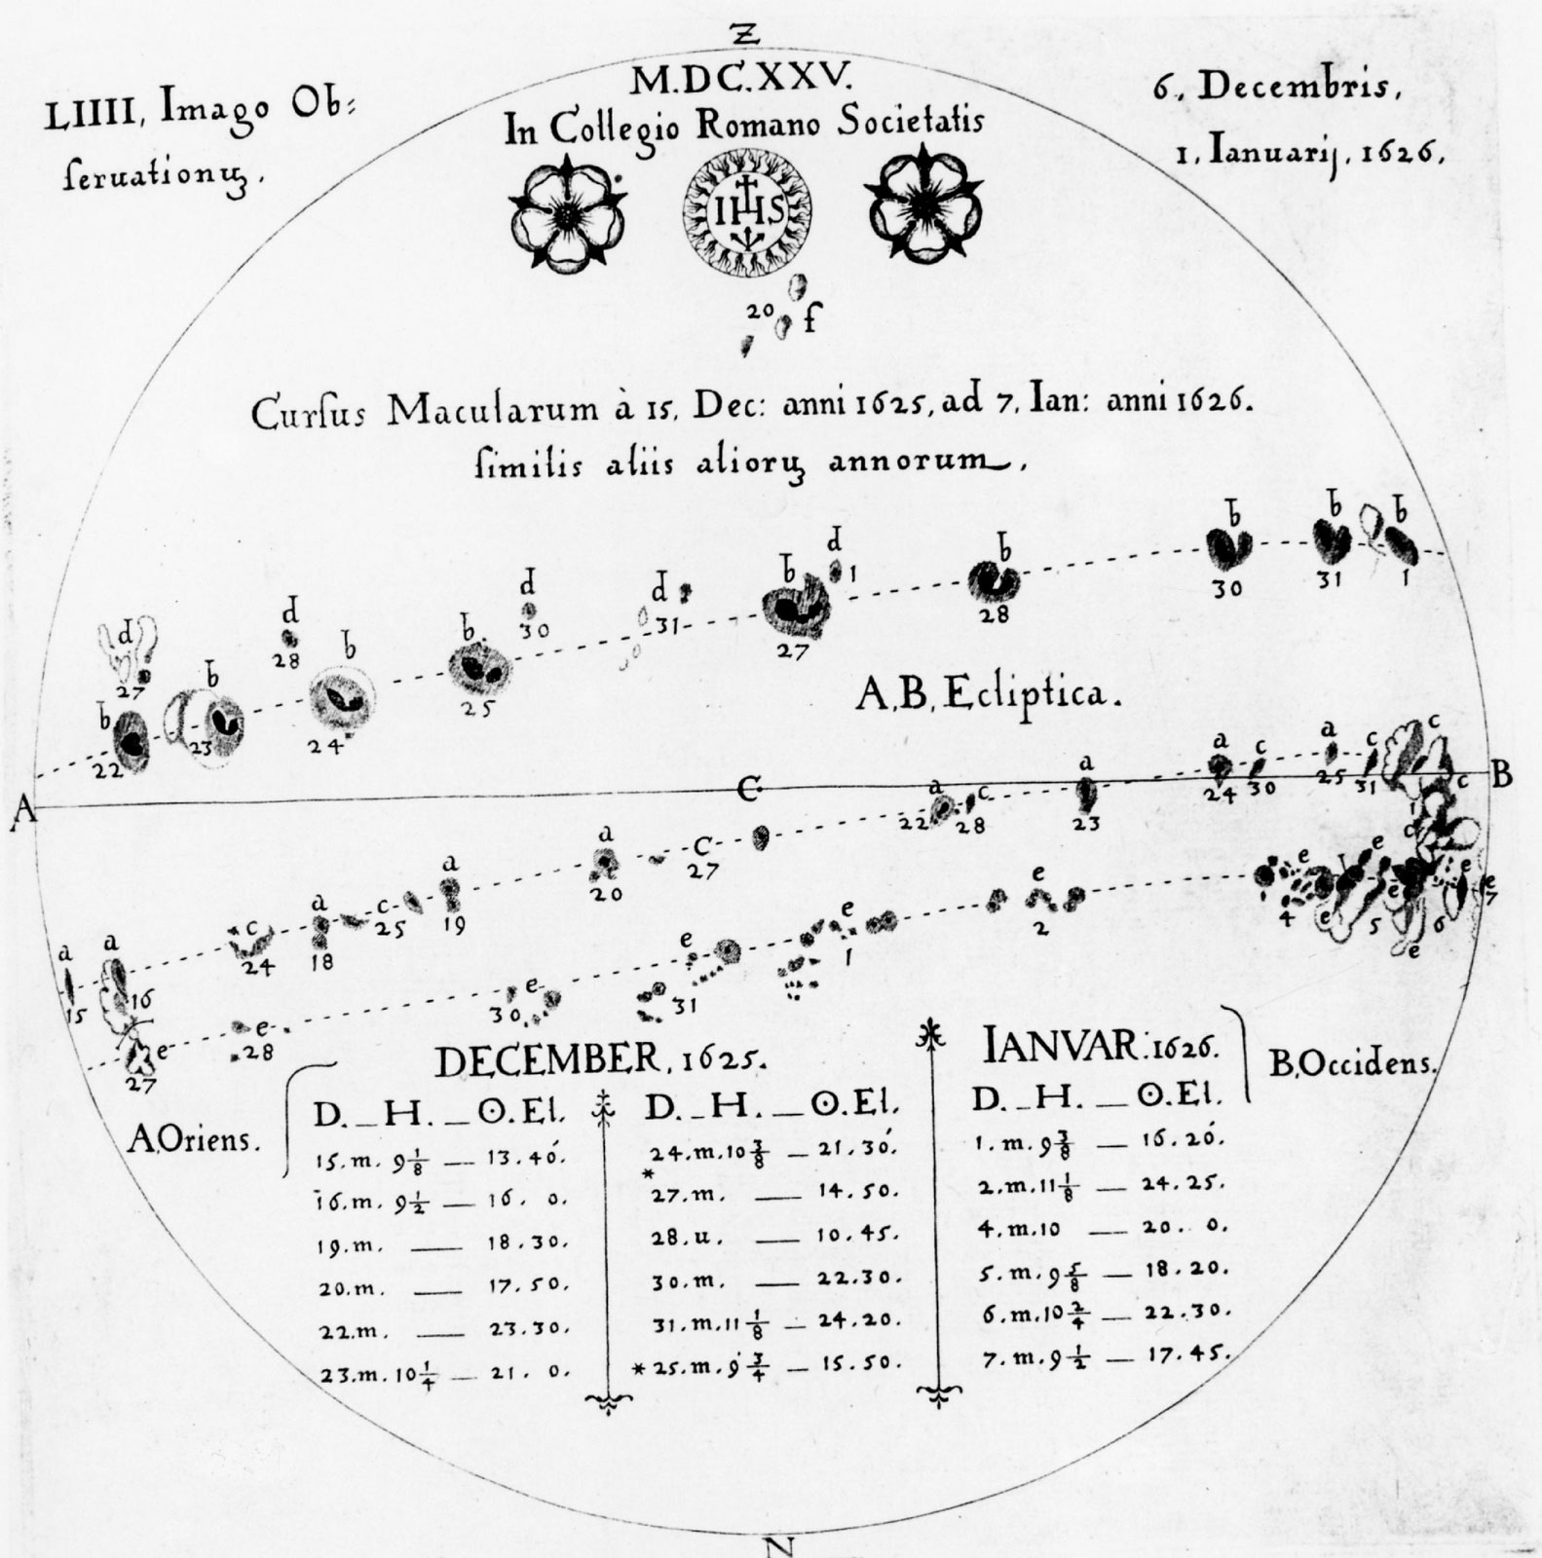
Christoph Scheiner (1573-1650)

Slide 56
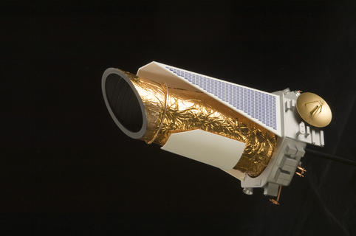
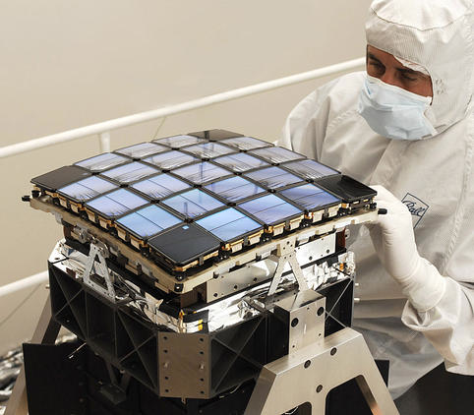
The Kepler mission
1-meter telescope
CCD array, 10° x 10° field of view
Monitored 10⁵ stars for 4.5 years
Limiting precision 20 ppm, 30 min

Slide 57
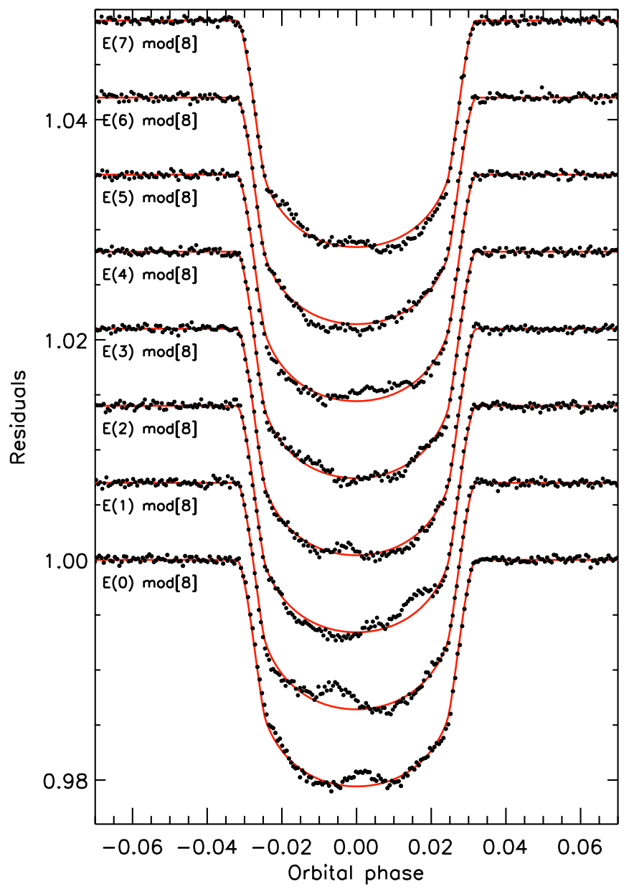
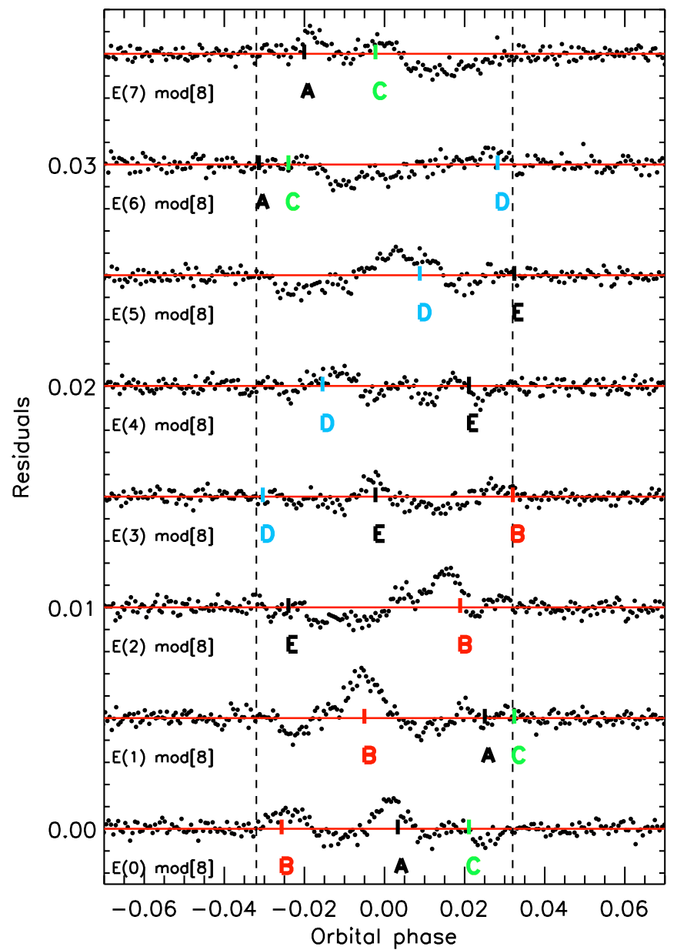
Kepler-17
Désert et al. (2011)

Slide 58
Sanchis-Ojeda et al. (2013)

Slide 59
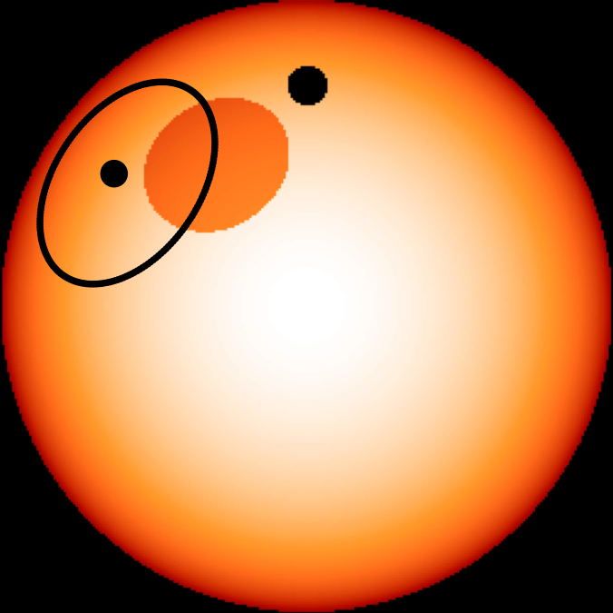
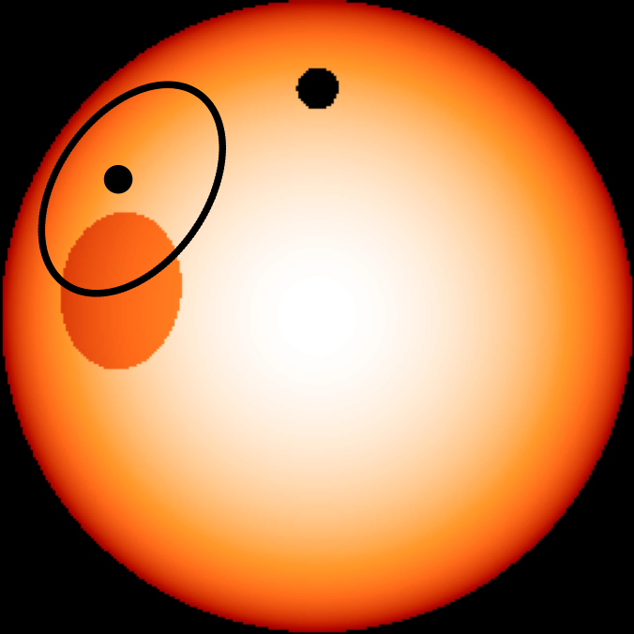
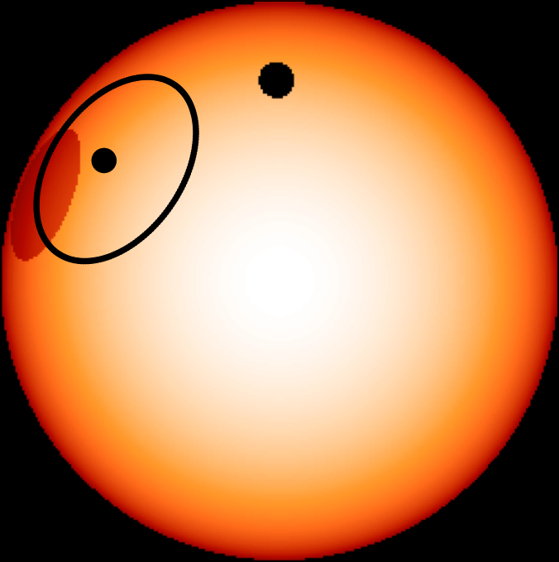
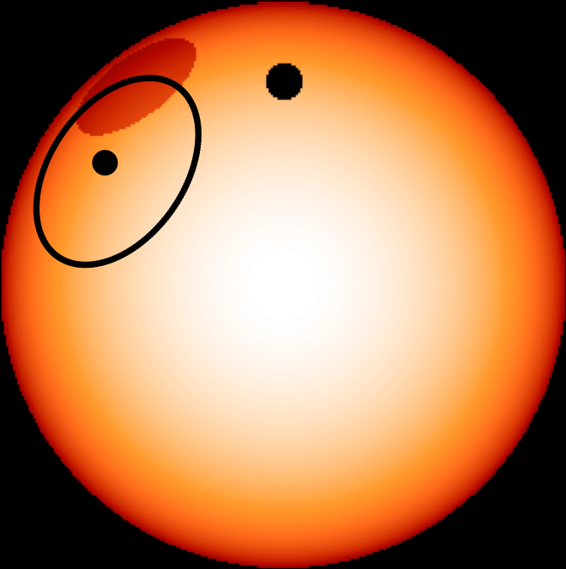
Sanchis-Ojeda et al. (2013)

Slide 60
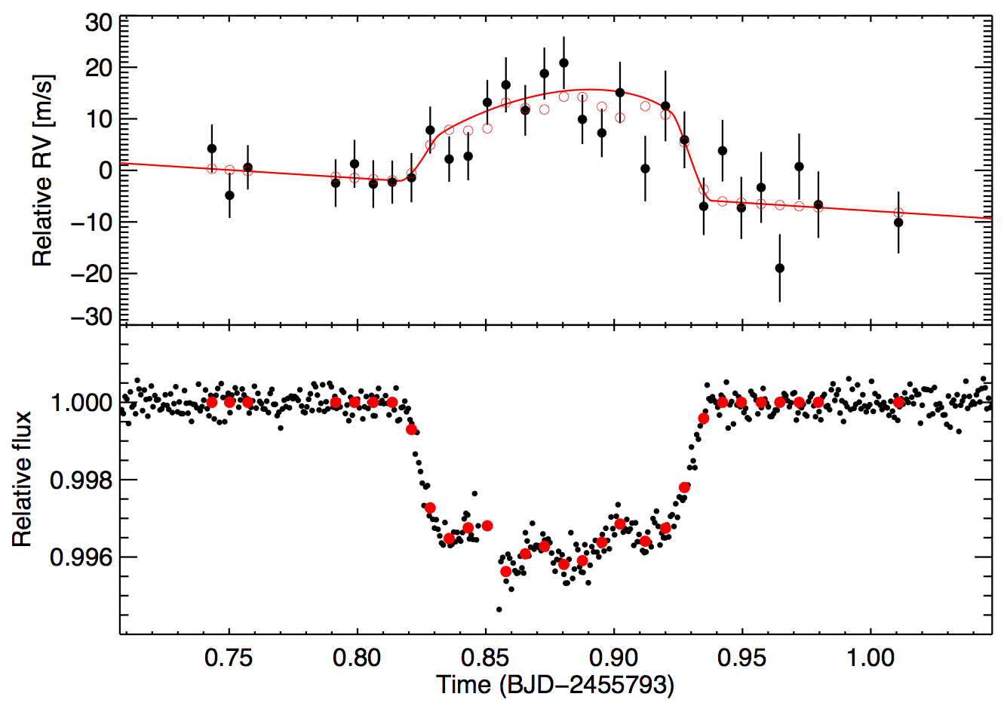
Kepler-63
Sanchis-Ojeda et al. (2013)

Slide 62
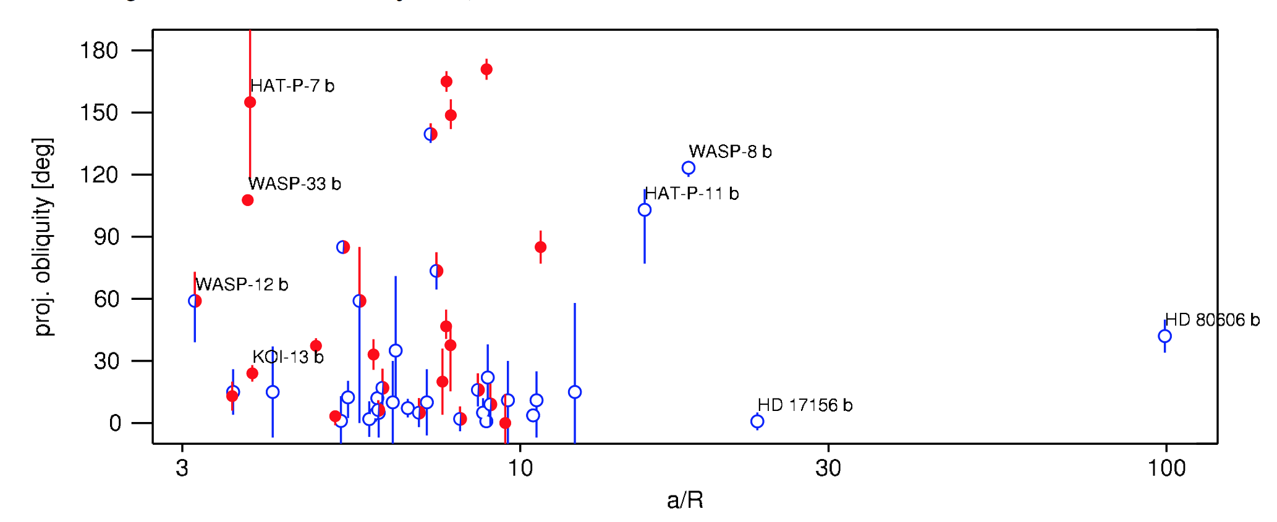
Orbital distance / stellar radius

Slide 63
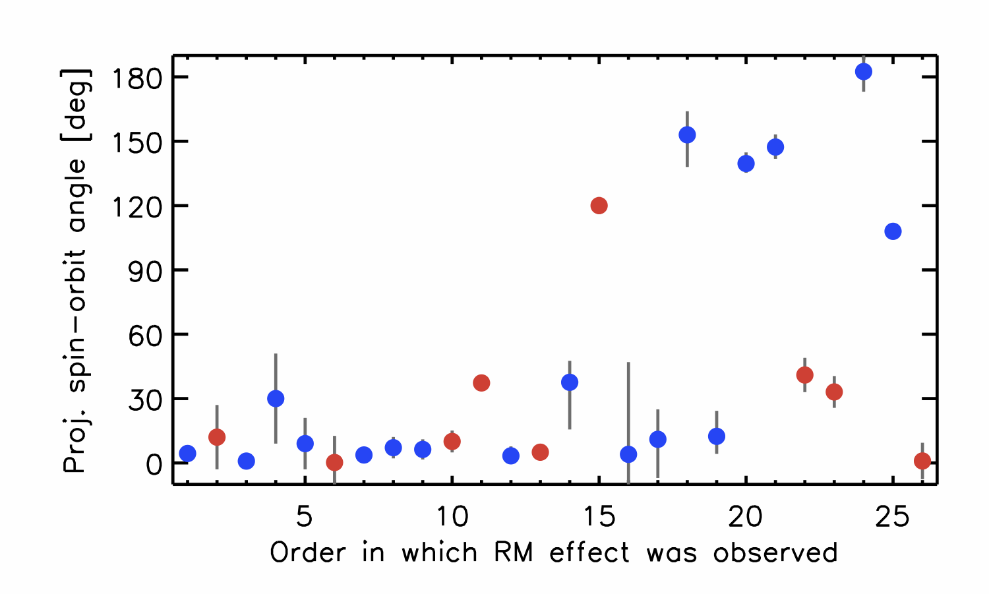
Projected obliquity [deg]
Time order of observations

Slide 64
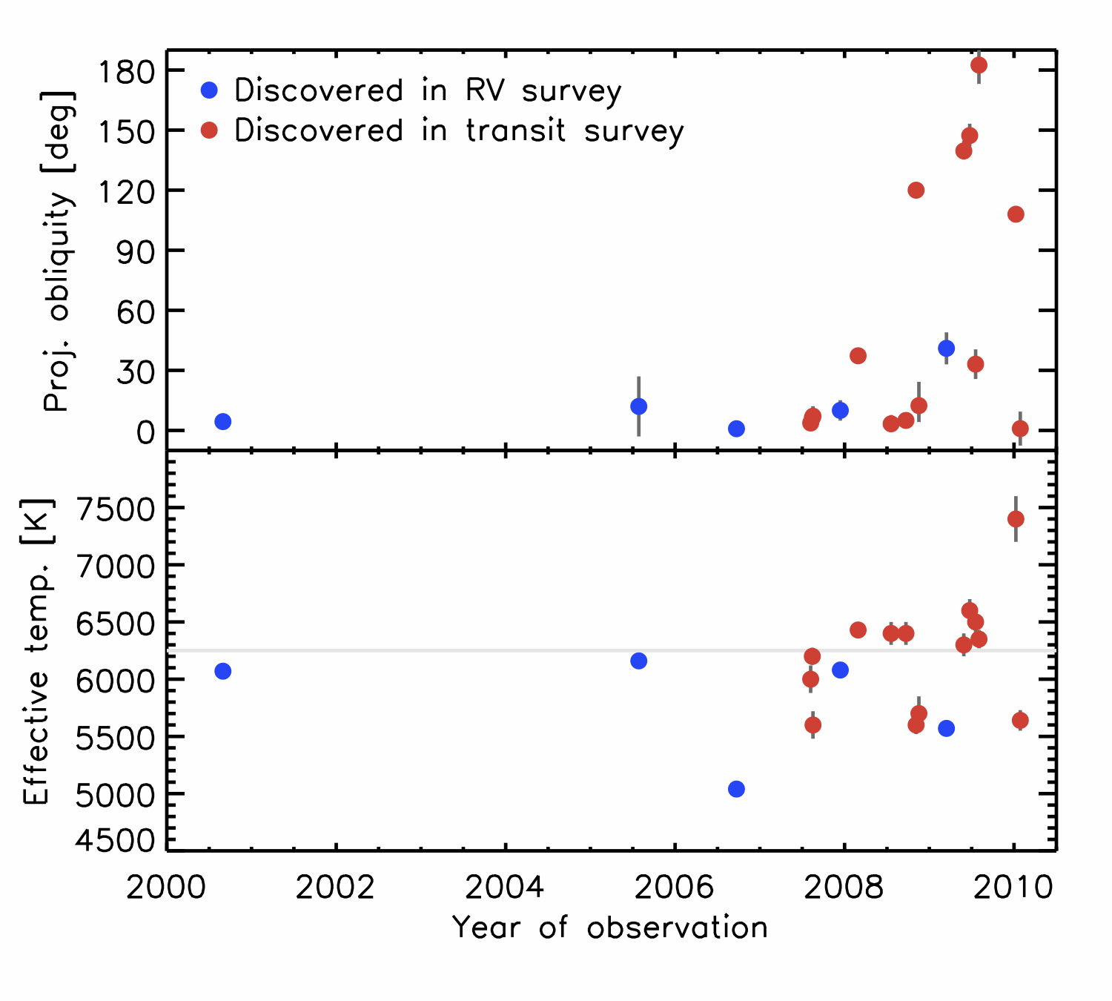
Radiative envelope
Convective envelope

Slide 65
Weak tidal dissipation
Rapid tidal dissipation

Slide 66
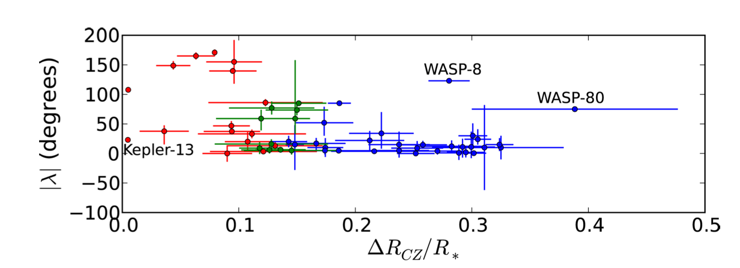
Weak tidal dissipation
Rapid tidal dissipation
Projected obliquity
Valsecchi & Rasio (2014)
Depth of convective zone [∆R_{CZ}/R*]

Slide 67
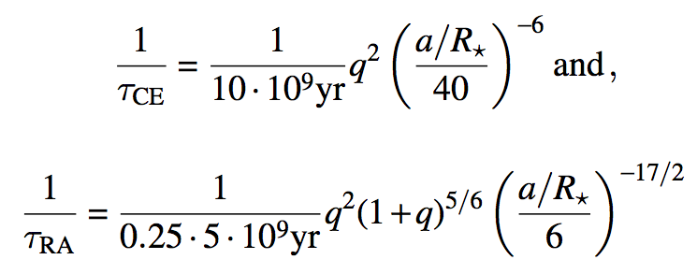
Obliquities of hot-Jupiter hosts
Observed low obliquities are due to tides
HAT–P–17 b
convective envelope
radiative envelope
not sure
Albrecht et al. (2013)

Slide 68
Obliquities of hot-Jupiter hosts
Low obliquities are due to tidal damping
Original obliquity distribution was apparently random
Observed low obliquities are due to tides
HAT–P–17 b
convective envelope
radiative envelope
not sure
Albrecht et al. (2013)

Slide 69
Implications for planet formation
Hot Jupiters formed beyond the snow line and migrated inward
Orbit and stellar spin were initially aligned
Hot Jupiters migrated inward via either disk migration, or few-body dynamics
  Disk migration damps inclinations
  Few-body dynamics excite inclinations
Many hot Jupiters have high inclinations
Therefore, many hot Jupiters migrated via few-body dynamics
Perhaps all of them, if the observed low inclinations are due to tides
Theorists: “Not necessarily!”
Bate et al. (2010)
Lai et al. (2011)
Cebron et al. (2011)
Rogers et al. (2012)
Batygin et al. (2012)

Slide 70
Implications for planet formation
Hot Jupiters formed beyond the snow line and migrated inward
Orbit and stellar spin were initially aligned
Hot Jupiters migrated inward via either disk migration, or few-body dynamics
  Disk migration damps inclinations
  Few-body dynamics excite inclinations
Many hot Jupiters have high inclinations
Therefore, many hot Jupiters migrated via few-body dynamics
Perhaps all of them, if the observed low inclinations are due to tides
Key test:
Measure obliquities of stars without hot Jupiters, particularly coplanar multiplanet systems

Slide 71
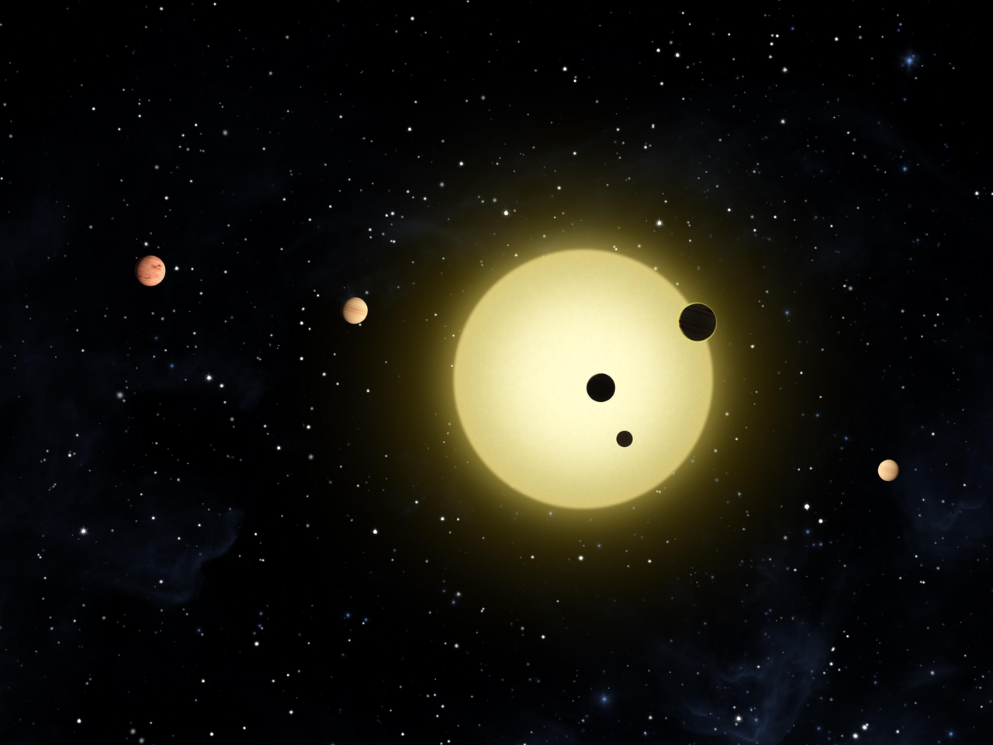

Slide 72
KOI-94
1.3 M , 1.6 R
P = 22 days
R_{p} = 12 R
54 d
7 R
10 d
4 R
4 d
2 R

Slide 73
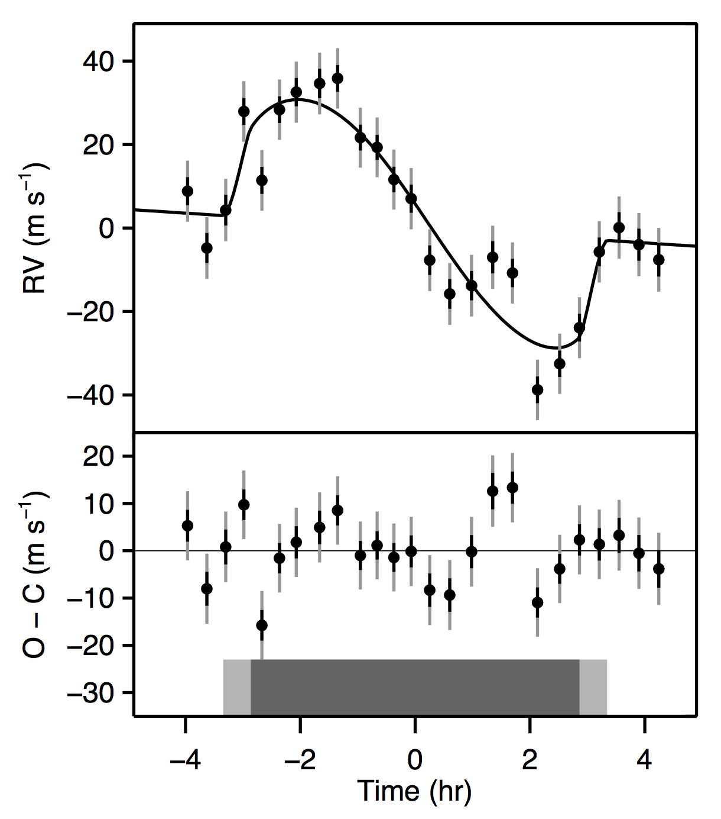
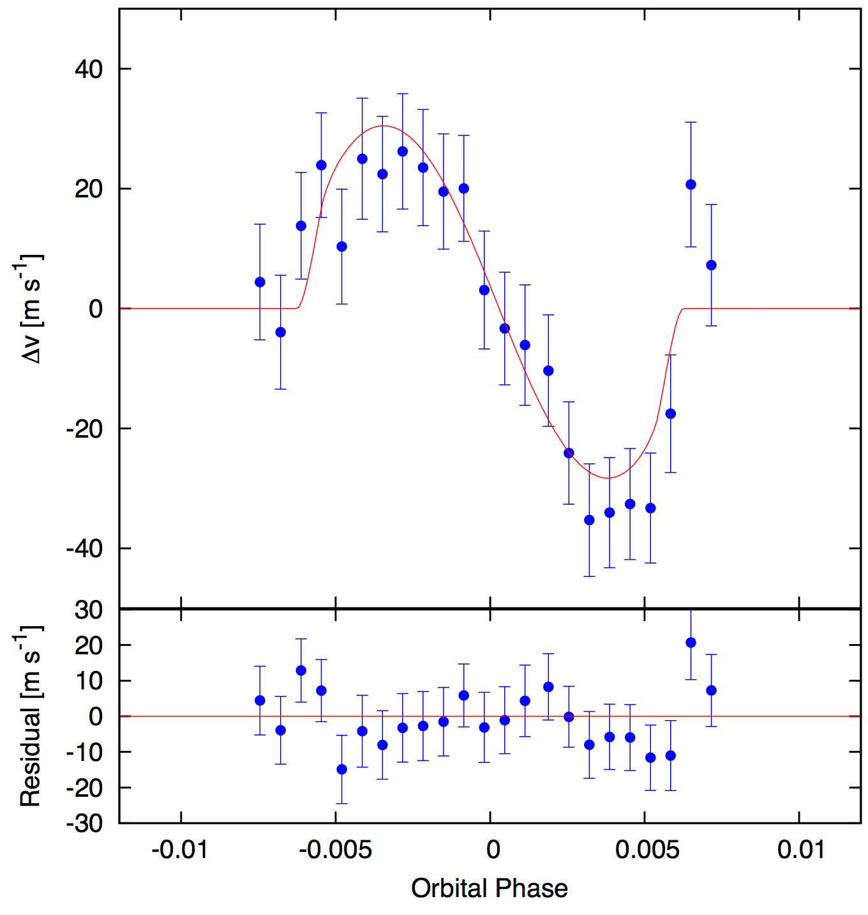
λ = –14° ± 13°
λ = –5° ± 12°
Hirano et al. (2012)
Albrecht et al. (2013)

Slide 74
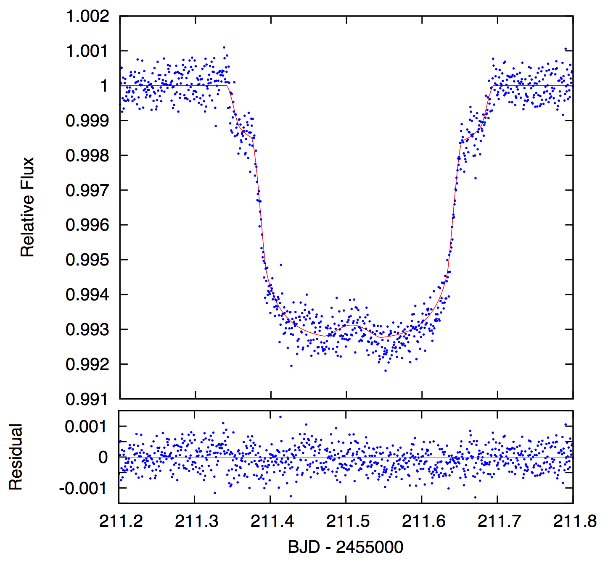
Hirano et al. (2012)

Slide 90
Kepler-30
1.0 M , 1.0 R
60 d
12 R
P = 143 days
R_{p} = 9 R
29 d
4 R

Slide 91
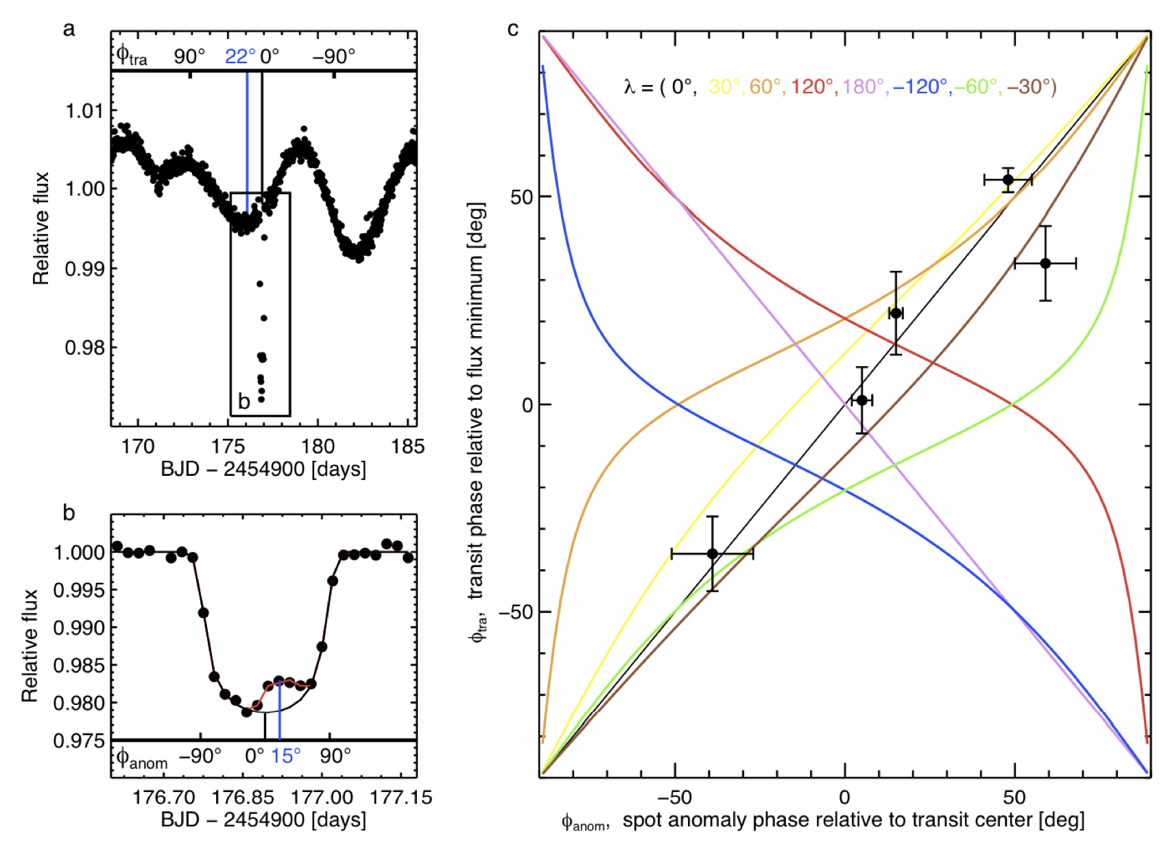
Phase of spot modulation
Obliquity < 10°
Timing of spot-crossing
Sanchis-Ojeda, Fabrycky, et al. (2012)

Slide 92
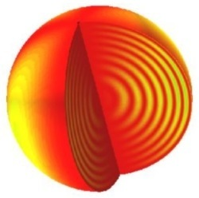
Asteroseismology

Slide 93
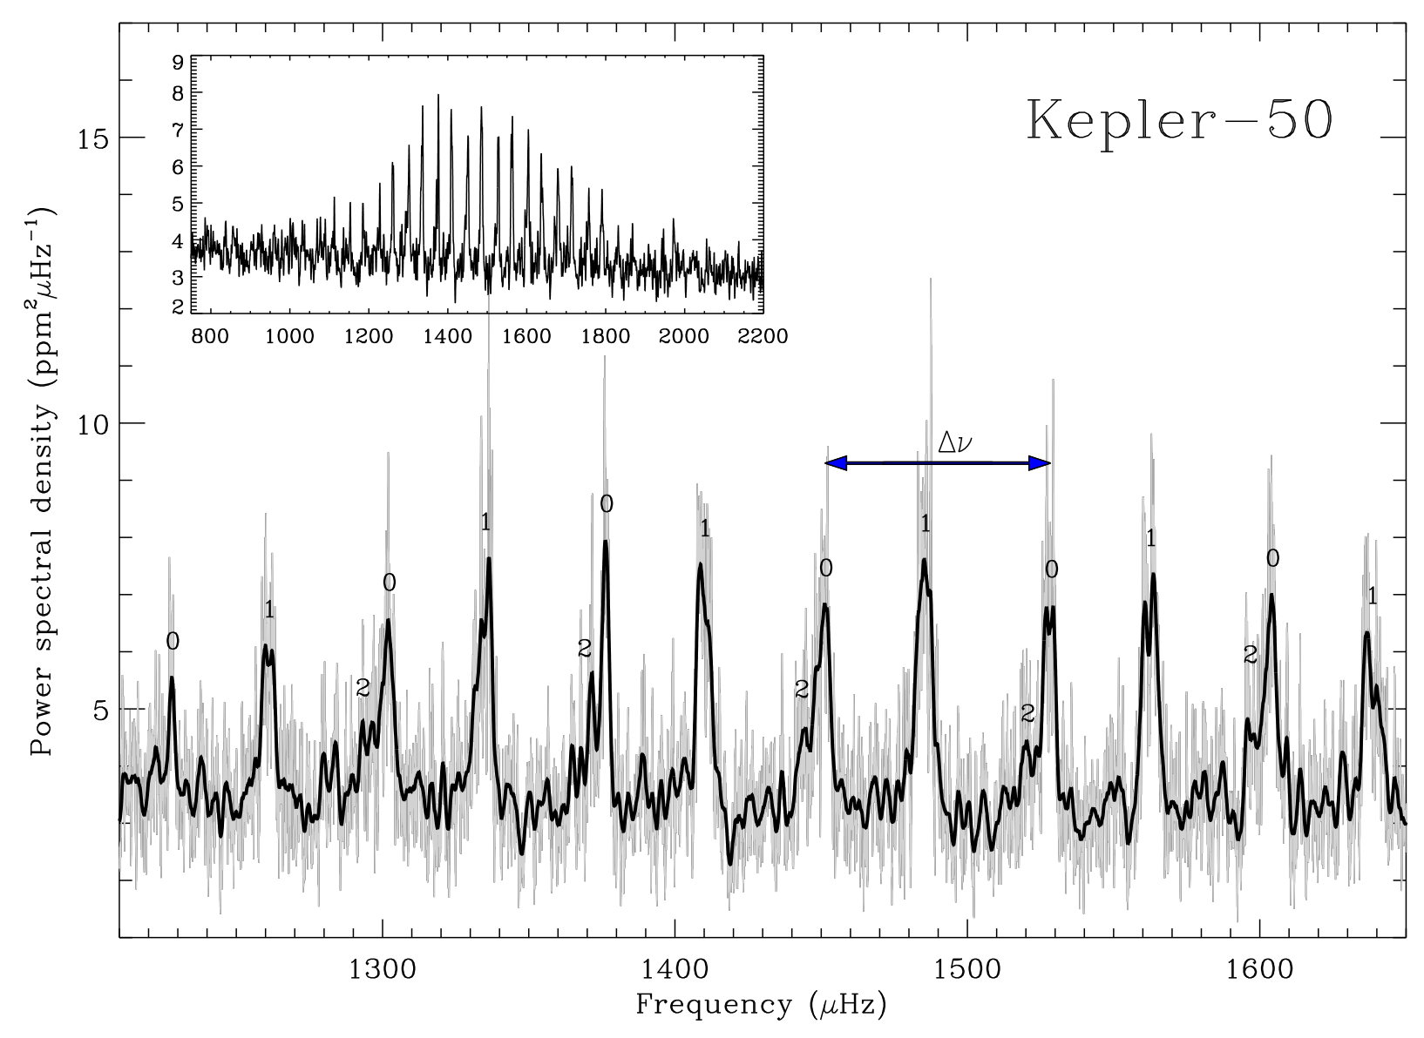
Asteroseismology
n = 18
n = 19
l = 0
l = 0
Chaplin et al. (2013)

Slide 94
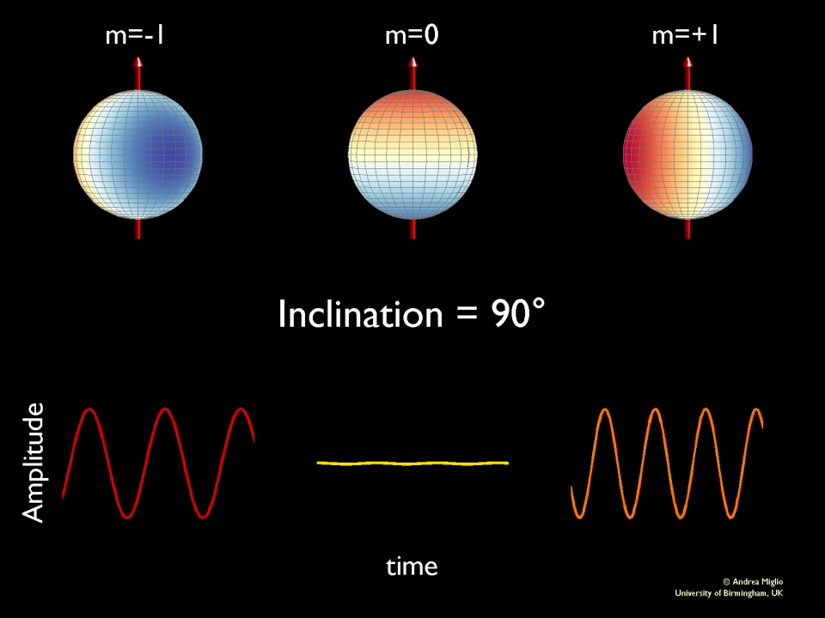

Slide 95
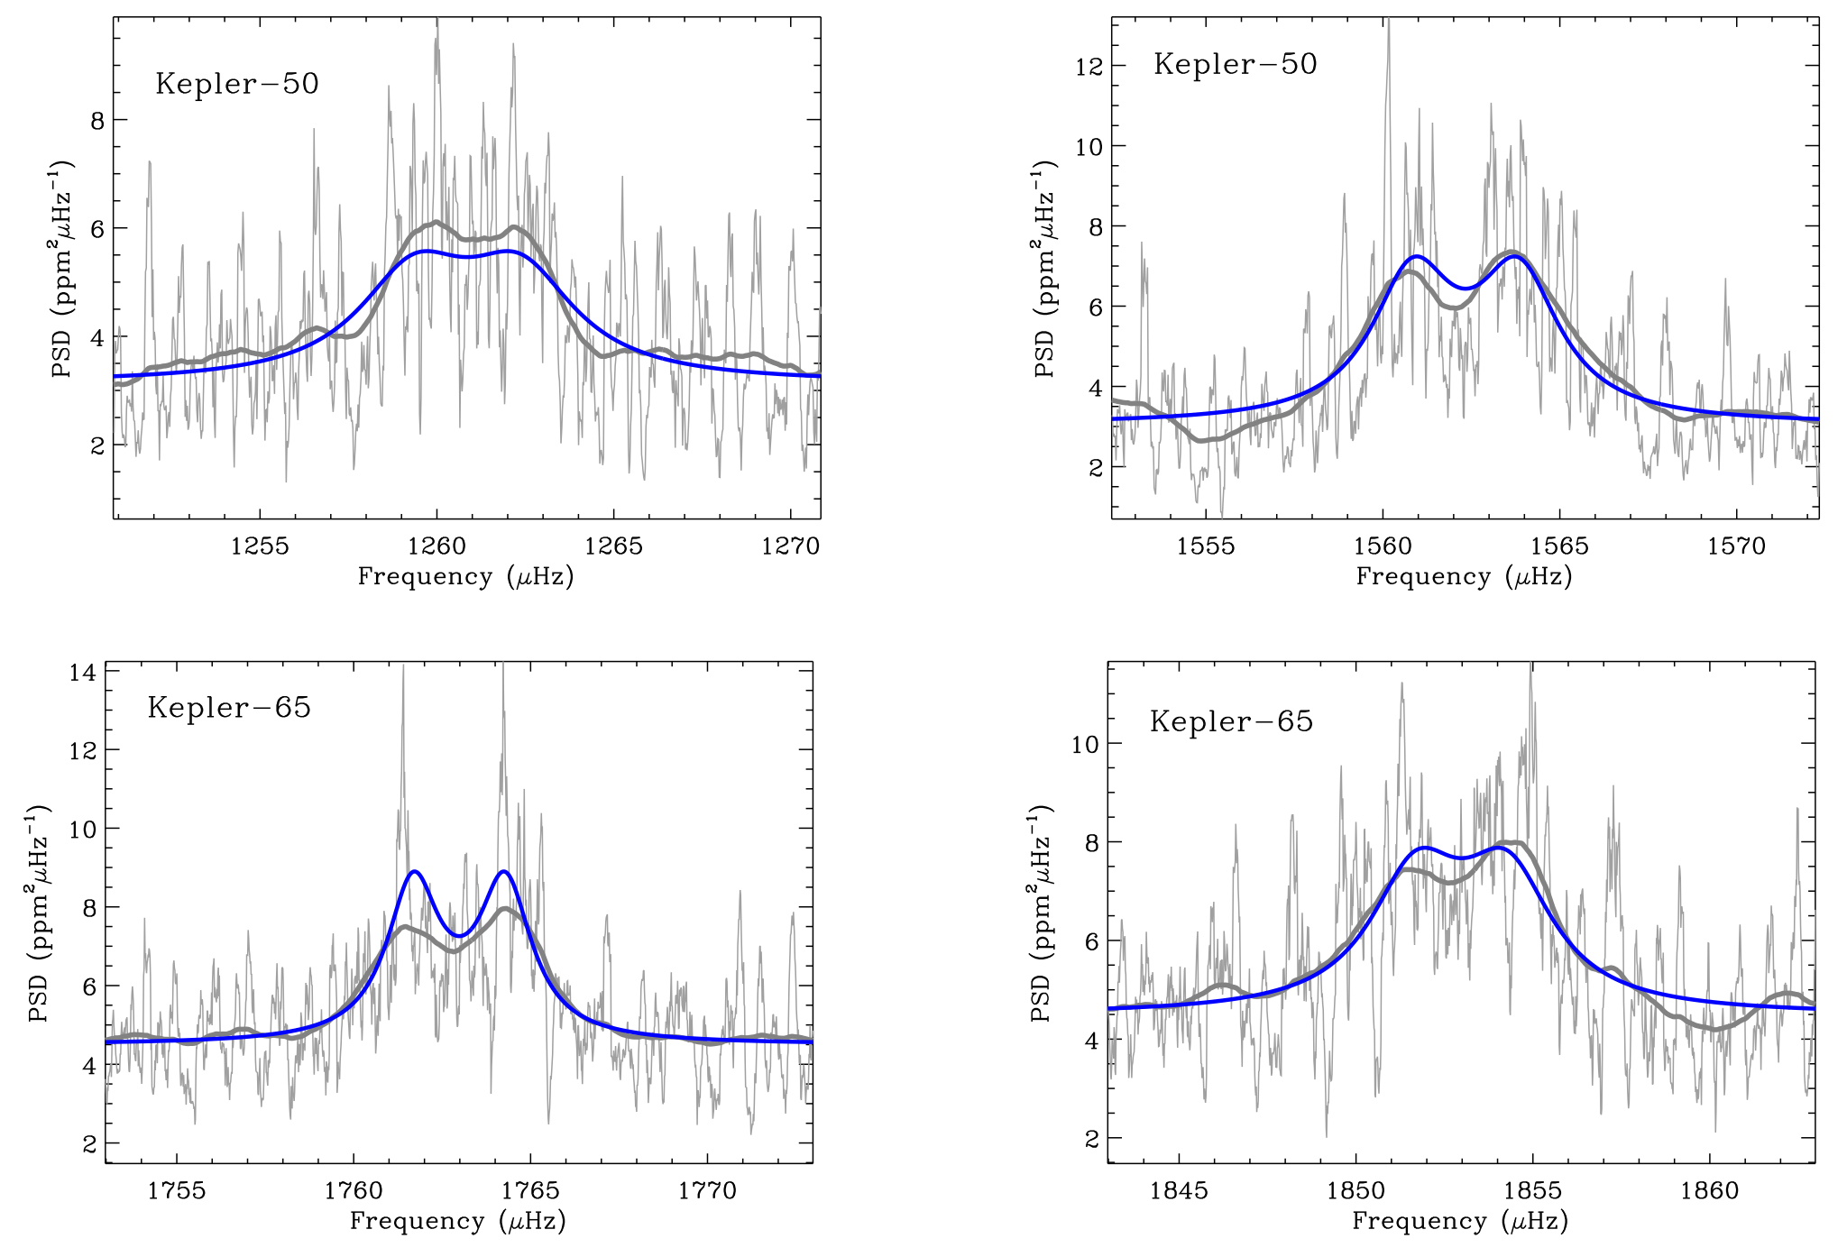
Two more multiplanet systems with low obliquities
l = 1
l = 1
l = 1
l = 1
Chaplin et al. (2013)

Slide 96
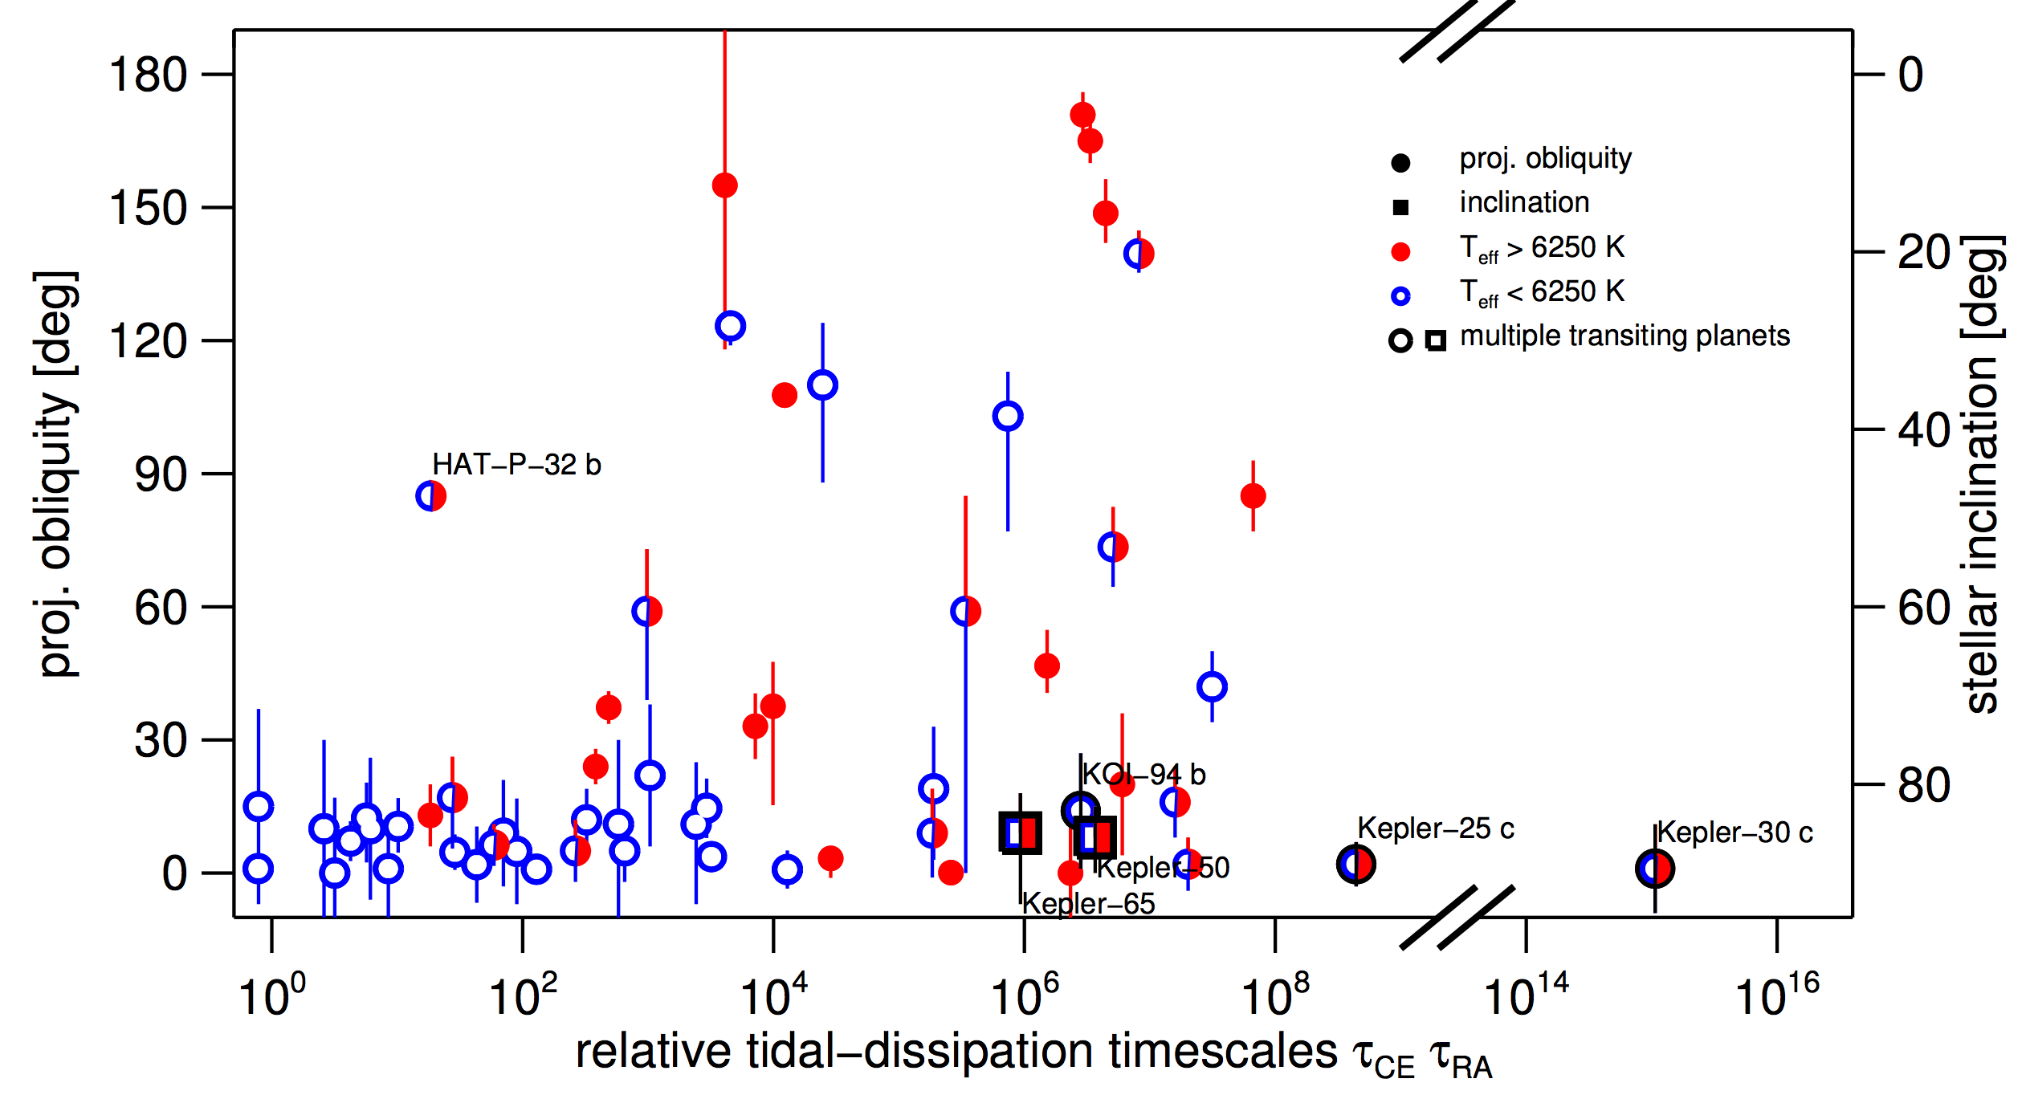
Low obliquities in compact multiplanet systems
Albrecht et al. (2013)

Slide 97
Kepler-56
1.3 M , 4.3 R
(subgiant)
10.5 d
7 R
P = 21 days
R_{p} = 10 R

Slide 98
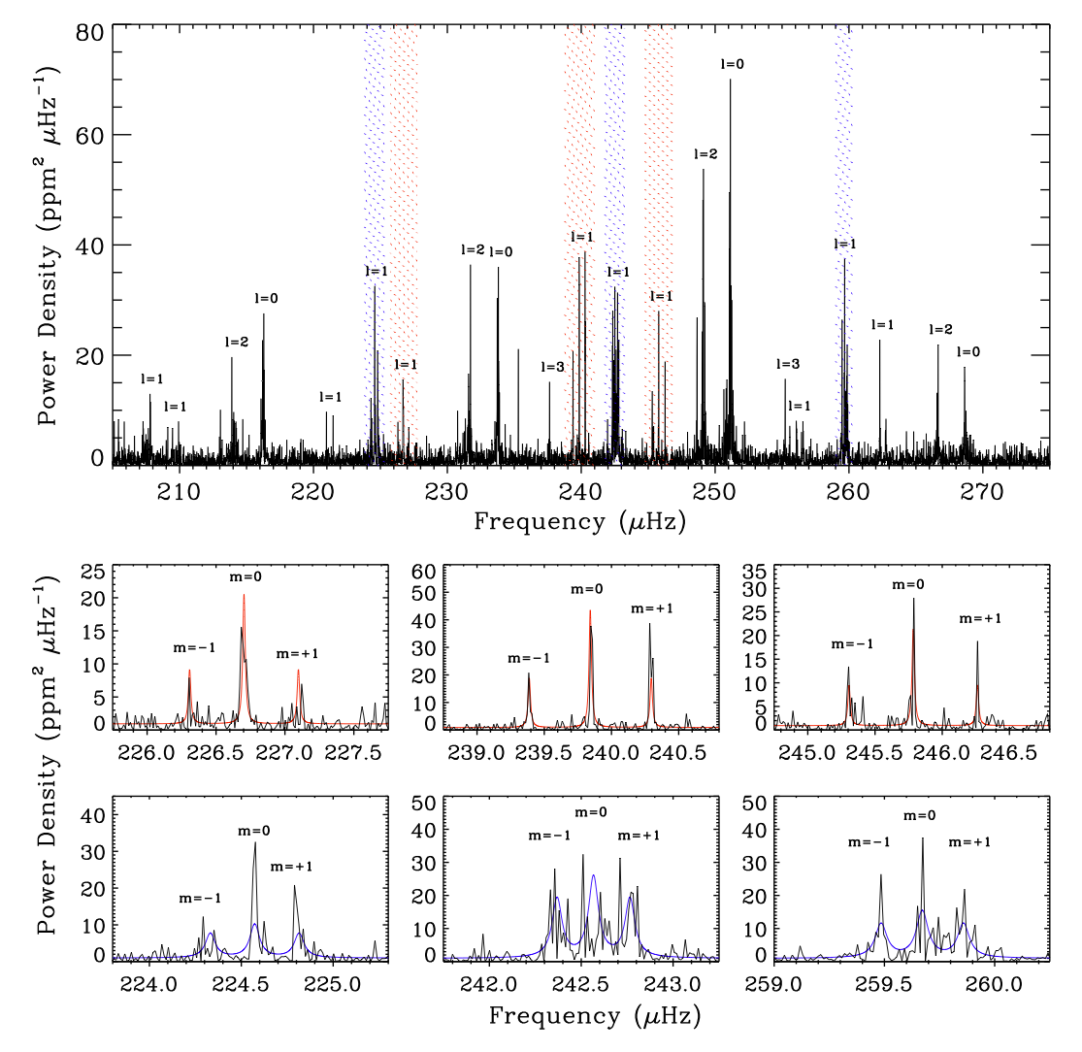
Huber et al. (2013)

Slide 99
Implications for planet formation
Hot Jupiters formed beyond the snow line and migrated inward
Orbit and stellar spin were initially aligned
Hot Jupiters migrated inward via either disk migration, or few-body dynamics
  Disk migration damps inclinations
  Few-body dynamics excite inclinations
Many hot Jupiters have high inclinations
Therefore, many hot Jupiters migrated via few-body dynamics
Perhaps all of them, if the observed low inclinations are due to tides
Key test:
Measure obliquities of stars without hot Jupiters, particularly coplanar multiplanet systems
Score so far:
5 low obliquities
1 high obliquity

Slide 100
Implications for planet formation
Hot Jupiters formed beyond the snow line and migrated inward
Orbit and stellar spin were initially aligned
Hot Jupiters migrated inward via either disk migration, or few-body dynamics
  Disk migration damps inclinations
  Few-body dynamics excite inclinations
Many hot Jupiters have high inclinations
Therefore, many hot Jupiters migrated via few-body dynamics
Perhaps all of them, if the observed low inclinations are due to tides
Theorists:
“We should see their progenitors on highly eccentric orbits.”
Socrates et al. (2012)
Observers:
“We don’t see as many as predicted.”
Dawson et al. (2013)
Dong et al. (2014)

Slide 103
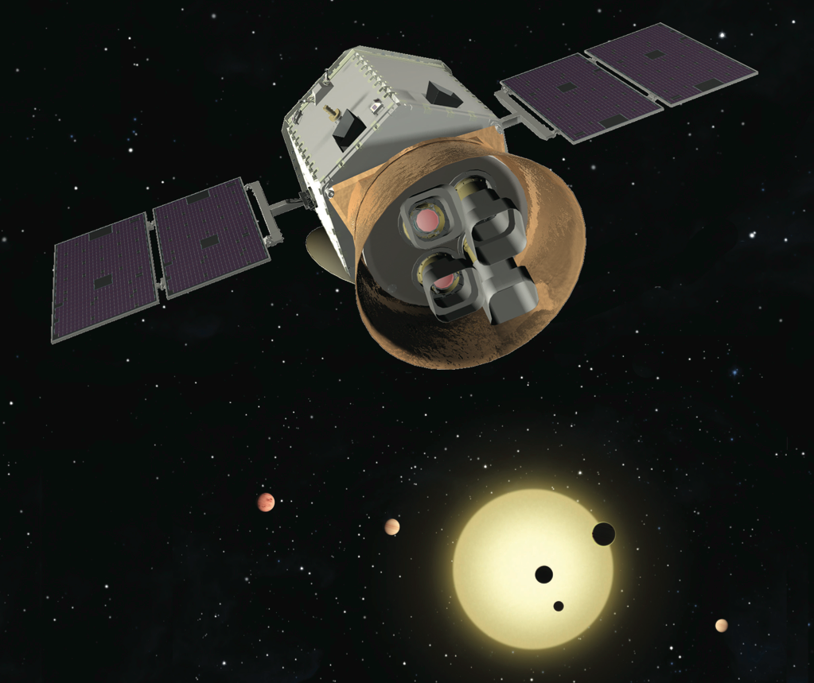
Transiting Exoplanet Survey Satellite
T E S S
Approved Explorer mission (2017-2020)
Survey the brightest stars in an all-sky survey
Thousands of planets, from Earth-sized to gas giants
Ames
MIT
CfA
GSFC
STScI
Orbital

Slide 104
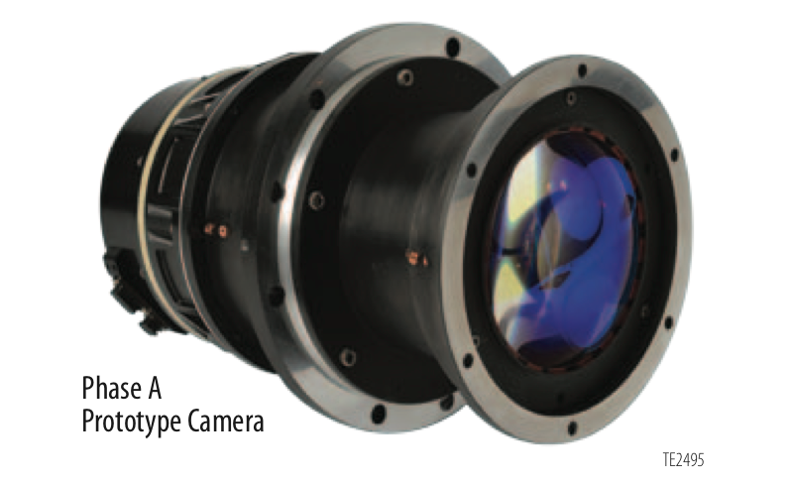
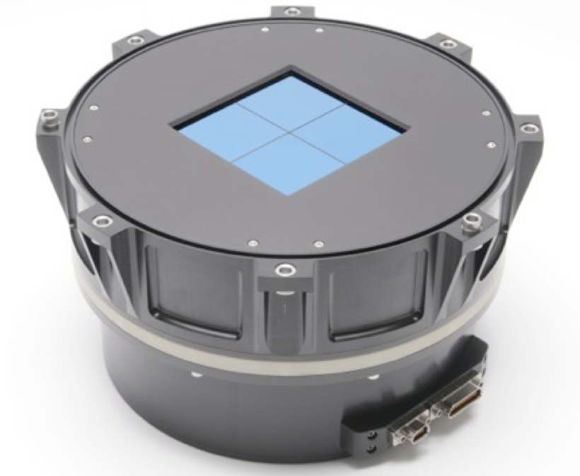

4 wide-field cameras (10 cm, f/1.6, 23° FOV)
each with a 4k CCD
on a common assembly,
canted at different angles

Slide 105

in a high-Earth orbit,
in 2:1 resonance with the Moon

Slide 106




Slide 110


Slide 111

Notes:
xie xie ningmun-da RUH ching-duh jow die - thank you for your warm hospitality

Slide 112


Slide 113

Huber et al. (2013) — scenario proposed by Kaib et al. (2011)

Slide 114

Transit timing variations
and (lack of) transit duration variations
planetary orbits are aligned to within 3°
Sanchis-Ojeda, Fabrycky, et al. (2012)

Slide 115





Slide 116
λ = 0°

Slide 117
λ = 0°

Slide 118
λ = 0°

Slide 119
λ = 60°

Slide 120
λ = 60°

Slide 121
λ = 60°

Slide 122
λ = 180°

Slide 123
λ = 180°

Slide 124
λ = 180°

