Slide 1
Supernova progenitors: clues from gamma-ray observations
Wei Wang
National Astronomical observatories, Beijing
Collaborations:
Zhuo Li (PKU), Roland Diehl, Thomas Siegert (MPE)
KIAA-PKU Auditorium Nov 24 2016

Slide 2
Contents
Background
supernovae – types and progenitors
gamma-rays from unstable nuclei
Core-collapse SNe
⁴⁴Ti in Cas A and SN 1987A
Type Ia SNe
⁴⁴Ti in Tycho; ⁵⁶Ni and ⁵⁶Co in SN 2014J
Future projects – gamma-ray detectors

Slide 3
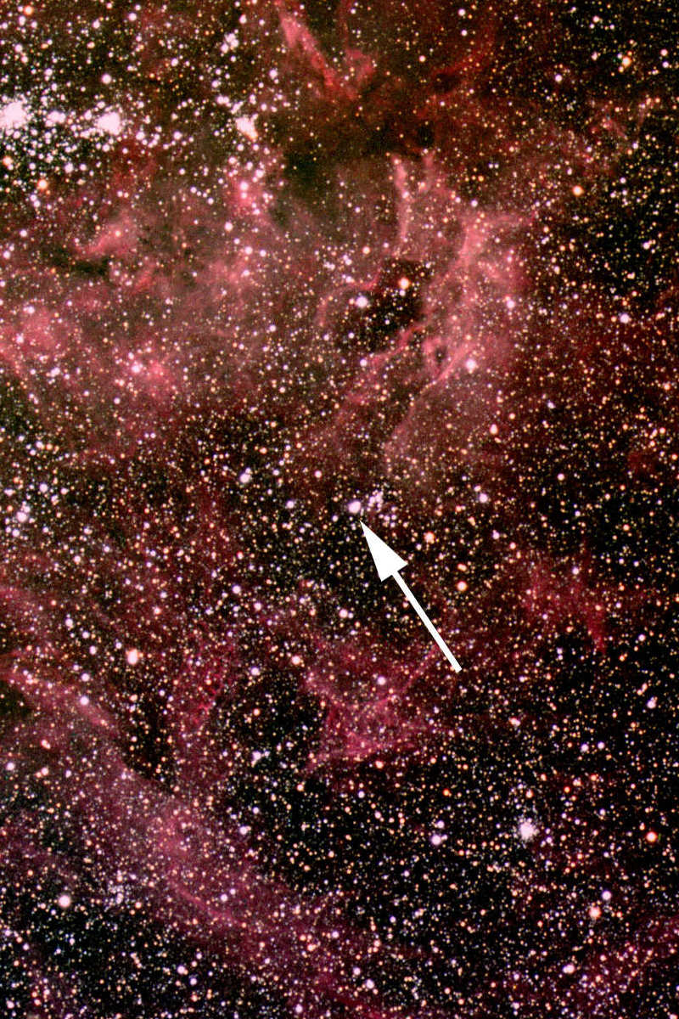
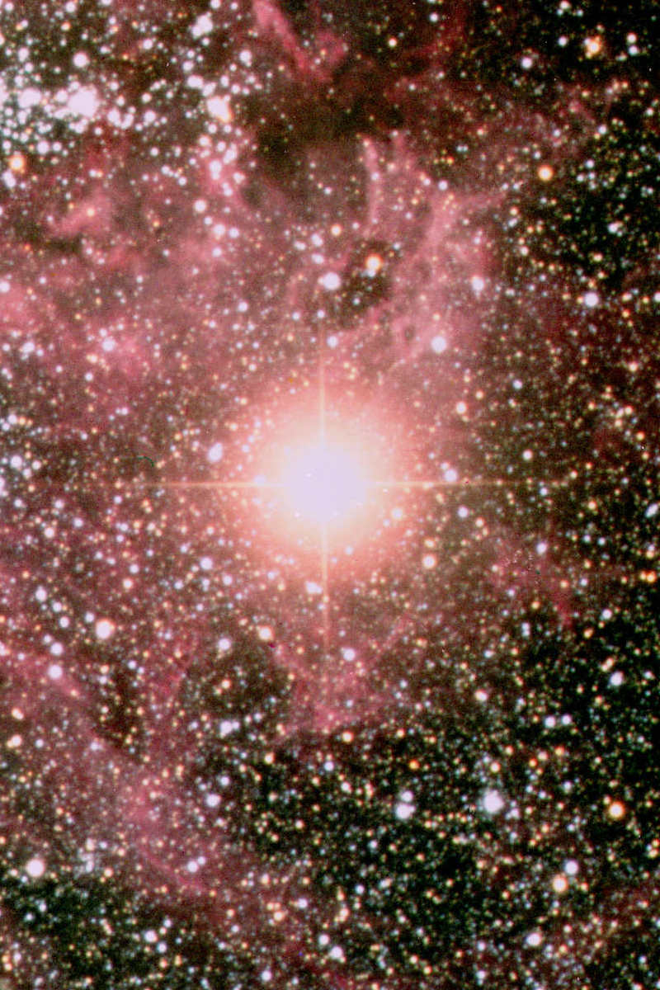
Supernova explosions
Sanduleak −69 202
Supernova 1987A 23 February 1987

Slide 4
Supernova types - observations
Spectral Type
Ia
Ib
Ic
II
Spectrum
Spectrum
Spectrum
No Hydrogen
No Hydrogen
No Hydrogen
Hydrogen
Hydrogen
Hydrogen
Silicon
Silicon
No Silicon
No Silicon
Helium
No Helium
Physical
Mechanism
Nuclear
explosion of
white dwarfs
Core collapse of evolved massive star
(may have lost its hydrogen or even helium
envelope during red-giant evolution)
Light Curve
Reproducible
Large variations
Neutrinos
Insignificant
∼ 100 × Visible energy
Compact
Remnant
None
Neutron star (typically appears as pulsar)
Sometimes black hole
Rate / 100yr
0.5 ± 0.3
0.3 ± 0.15
1.5 ± 0.7
Observed
Total > 4000 as of today (nowadays ∼200/year)

Slide 5
Supernova progenitors
Type II, Type Ib/Ic：
core-collapse explosion in the late phase of massive stars (>10 M⊙ )
center: neutron star/black hole/?
Type Ia-thermonuclear explosion：
Single scenario:
（1）standard: Chandrasekhar mass (1.4M⊙) CO white dwarf ；
（2）super- Chandrasekhar mass (1.6-2 M⊙) CO WD；
（3）sub- Chandrasekhar mass (0.8-1.2M⊙) CO WD；
Double scenario:
（4）double WD merger (CO WD+ CO WD/He WD)

Slide 6
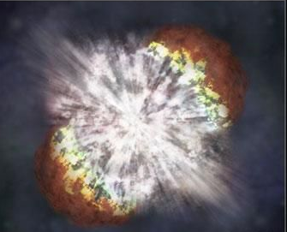
Most cosmos elements produced in SN explosion:
nuclear reaction chains - unclear
nuclear reaction cross section - unclear
explosion mechanism of SNe - unclear
neutron star/black hole/nothing - unclear
Unknown reaction chains：
Proton capture: ²⁶Al
Neutron capture: ⁶⁰Fe
Explosion mechanism?
⁴⁴Ti,⁵⁶Ni
What left in the center？
Some of them produce neutron stars – observed pulsars

Slide 7
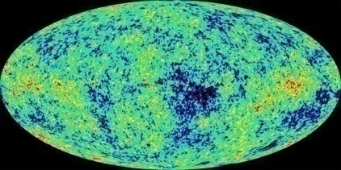
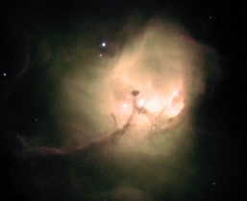
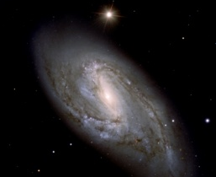
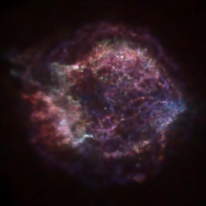
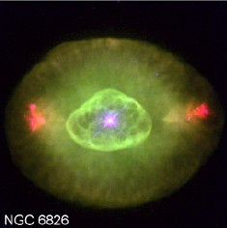
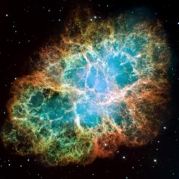
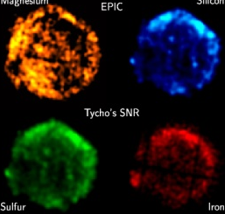
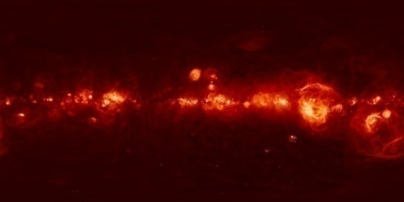
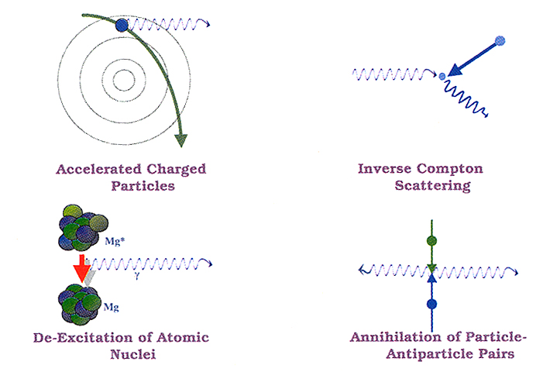
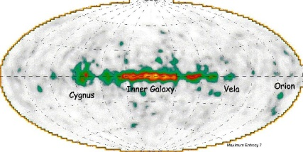
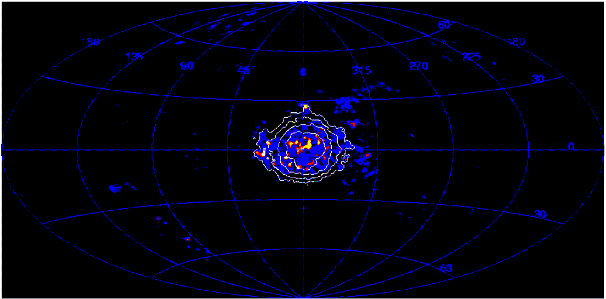
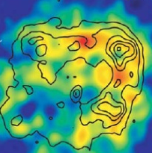
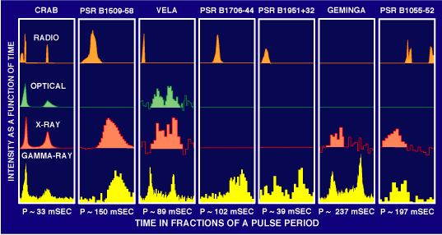
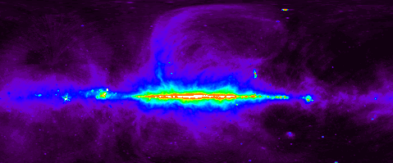
Origin of radiation
  Thermal (radio, IR, opt, X-ray )
  Molecule & atom (radio, opt, X-ray)
  Nuclei (gamma-ray)
  Anti-matter & matter (gamma-ray)
  Non-thermal(radio, gamma-ray)
INTEGRAL / SPI 511 keV
HESS

Slide 8
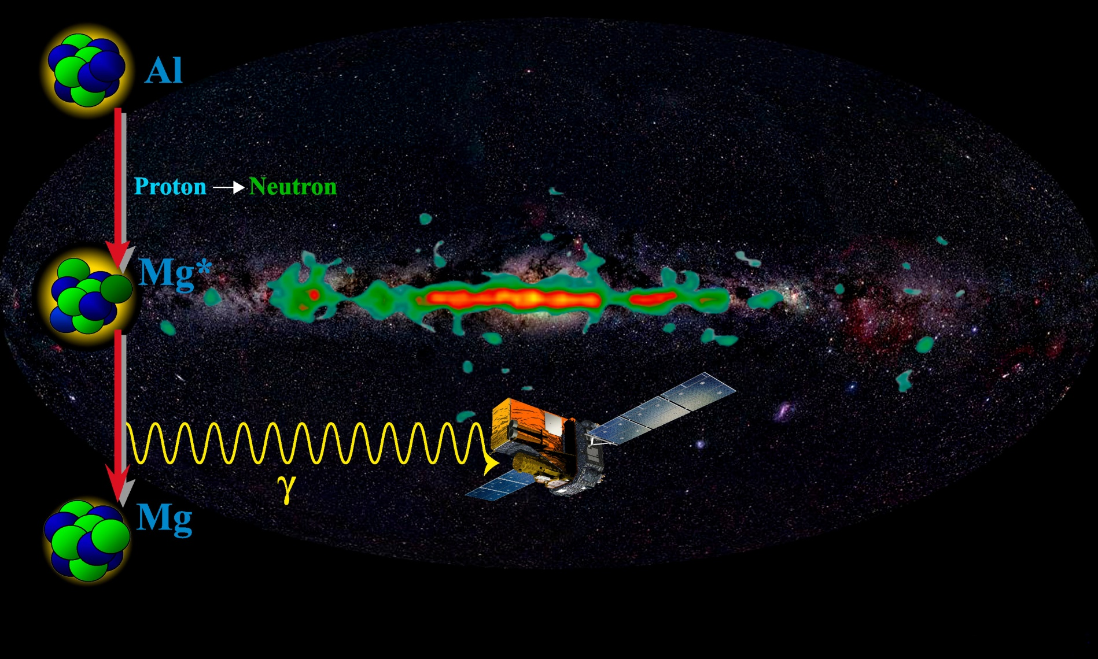
Gamma-ray line detections
Direct detection of nuclei freshly produced in the cosmos
Decay of the unstable nuclei
Gamma-ray lines
energy：MeV (10⁹ K)

Slide 9
Astronomy window: gamma-ray line
New window: from levels of molecule/atoms to levels of nuclei
novae
supernovae
supernovae
novae
supernovae
stars, supernovae
supernovae
anti-matter,
dark matter

Slide 10
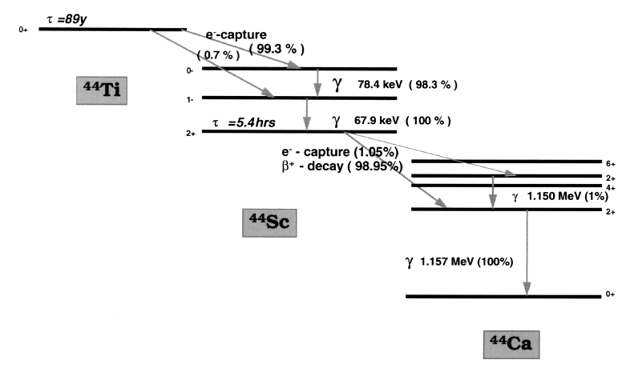
⁴⁴Ti
Half lifetime: 58 yr
Three gamma-ray lines:
68, 78, 1157 keV
Only produced in the center region of SN explosion!
Production sensitively depends on explosion mechanism and progenitors.

Slide 11
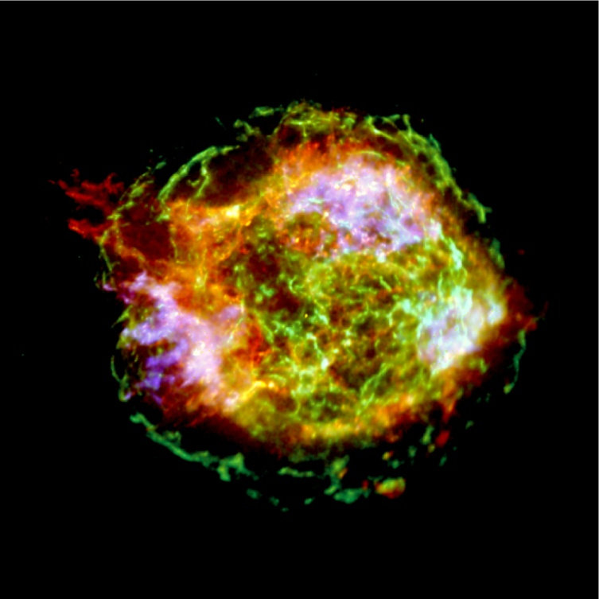
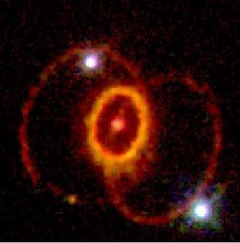
⁴⁴Ti in core-collapse SNe
Young supernova remnants:
Cas A
（330 years）
SN 1987A

Slide 12
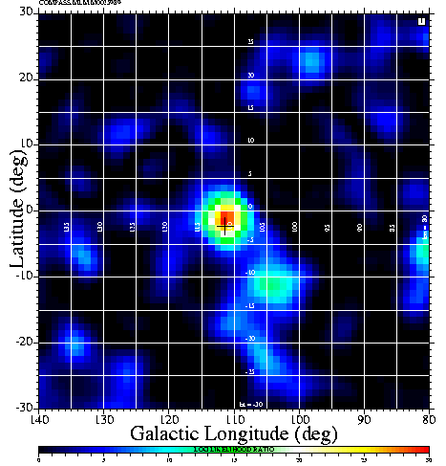
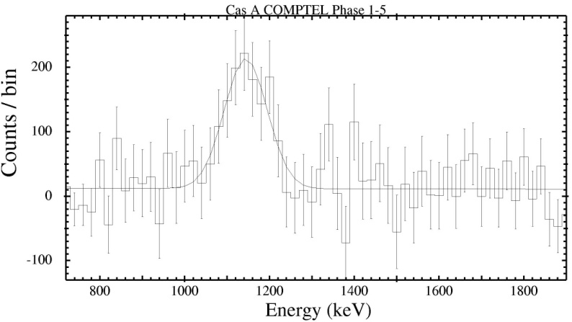
Cas A
1996, COMPTON/COMPTEL detect the gamma-ray line at 1157 keV
Cas A
Wide line - ejecta velocity : ~10000 km/s
Line flux：4.2 x10⁻⁵ photon cm⁻² s⁻¹
⁴⁴Ti yield in Cas A: 1 - 2.4x10⁻⁴ M⊙

Slide 13
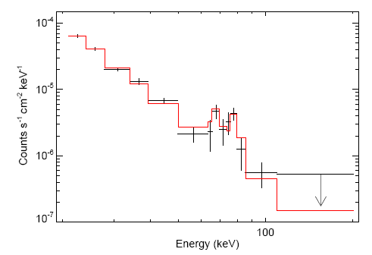
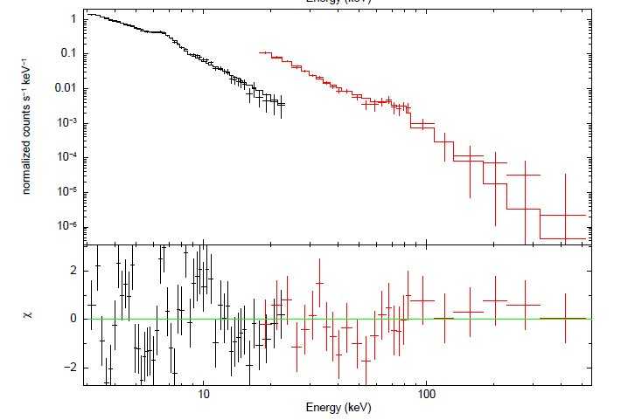
68, 78 keV lines detection
by INTEGRAL/IBIS
Renaud et al. 2006;
Wang & Li 2015
The average line flux of two lines gave the mass of ⁴⁴Ti ~1.5-2.2 x10⁻⁴ M⊙

Slide 14
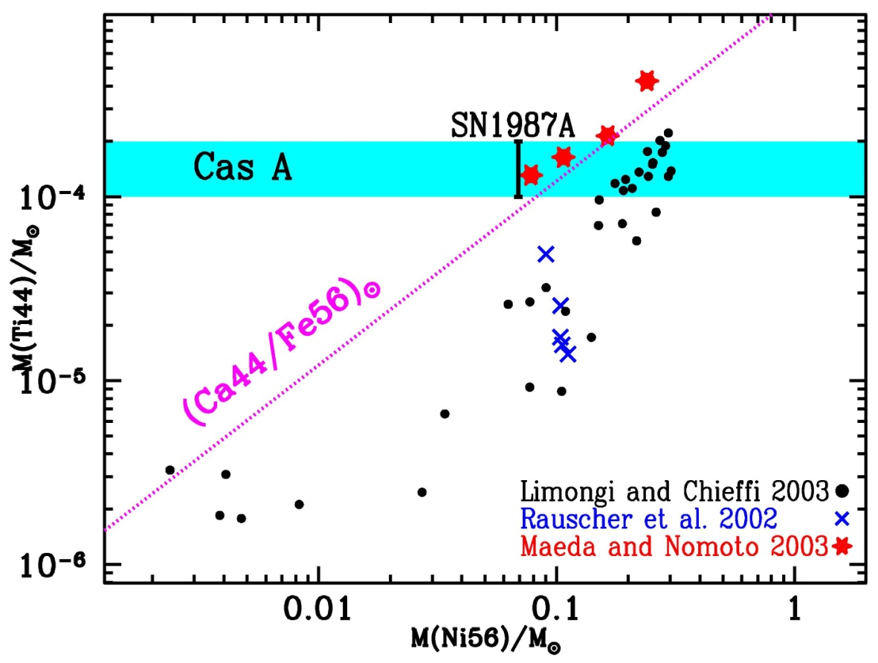
⁴⁴Ti yield in Cas A
The observed line flux implies M_{Ti}~1-2x10⁻⁴ M⊙
Simulations of spherical explosion models in CCSNe predict 0.3 – 0.6 x10⁻⁴ M⊙；
Non-spherical
explosion models can
predict more.

Slide 15
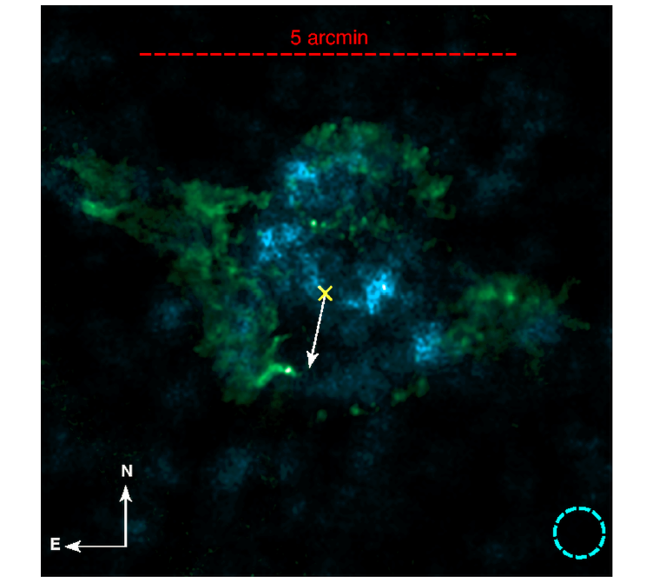
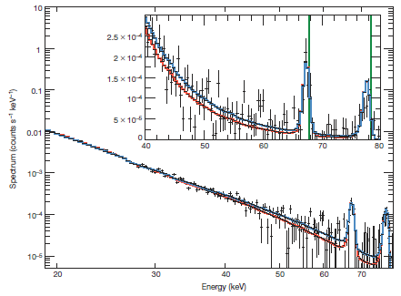
Observed evidence for non-spherical explosion
NuStar:
first focus hard X-ray photons from 3- 79 keV
Cas A
Green Si； Blue ⁴⁴Ti
Non-spherical explosion in Cas A！
68,78keV lines: redshift of 0.5keV
Grefenstette et al. 2014

Slide 16
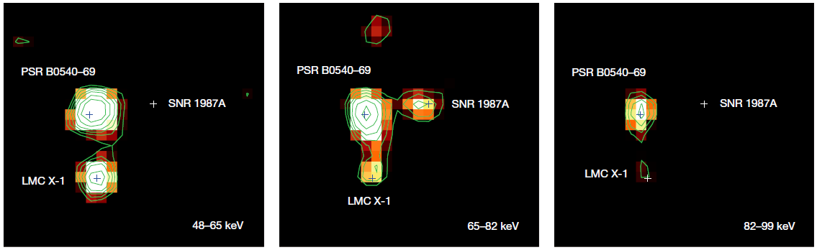
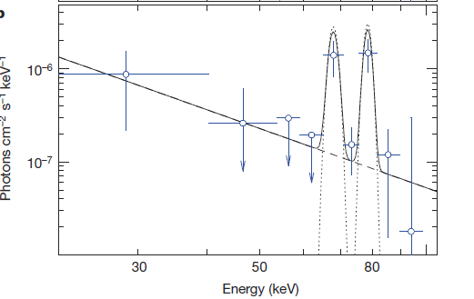
⁴⁴Ti detections in SN 1987A
INTEGRAL/IBIS discovered the signal of ⁴⁴Ti in SN 1987A
SN 1987A: yield of ⁴⁴Ti
~3x 10⁻⁴ M⊙
Grebenev et al. 2012

Slide 17
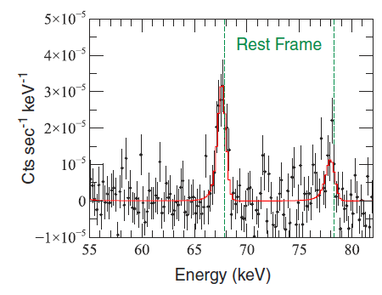
NuStar confirmed the non-spherical explosion in SN 1987A
Spectral features of ⁴⁴Ti lines in SN 1987A ：
Line redshift of 0.3 keV at 68, 78 keV
Bulk velocity of 700 km/s of the ejecta
Non-spherical explosion！
Non-spherical explosions implied in two cases of core-collapse SNe:
higher energy, high neutrino flux
Boggs et al. 2015

Slide 18
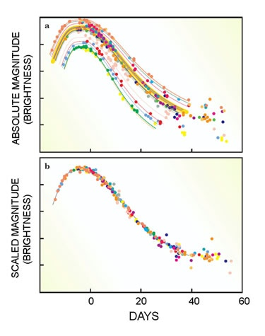
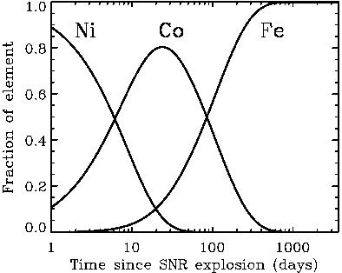
Type Ia SNe
IR, optical lightcurves:
radioactivity of ⁵⁶Ni -> ⁵⁶Co -> ⁵⁶Fe
First direct detection of gamma-rays from the decay chain?
About 40% of SN Ia lightcurves donot follow the Phillips relationship progenitors of SN Ia ?

Slide 19
Constraining progenitors of SN Ia by gamma-ray detections
⁴⁴Ti signal in young supernova remnant Tycho
First confirming the decay chain of ⁵⁶Ni -> ⁵⁶Co -> ⁵⁶Fe in nearby type Ia SN 2014J

Slide 20
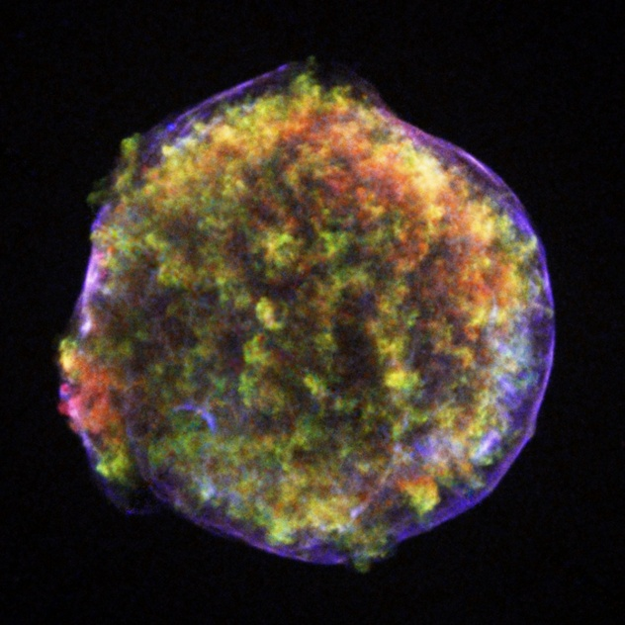
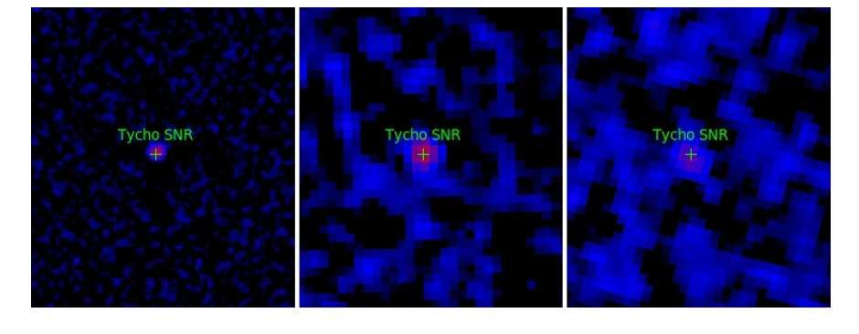
Tycho SNR:
famous type Ia explosion in 1572
INTEGRAL/IBIS observations：
3 – 10 keV 9.8σ 20 – 60 keV 11.6σ 60 – 90 keV 5σ

Slide 21
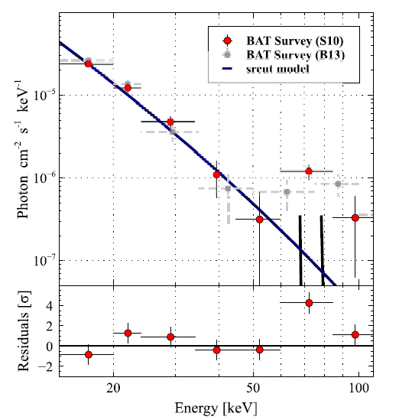
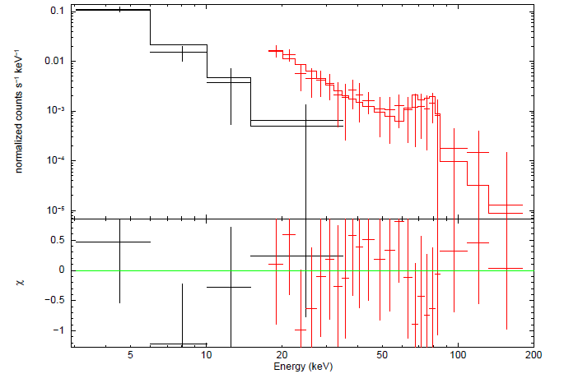
⁴⁴Ti detections in Tycho
⁴⁴Ti signal first detected by INTEGRAL/IBIS ;
confirmed by SWIFT/BAT
F_{44Ti} ~ (1.3±0.5)x10⁻⁵ ph cm⁻² s⁻¹
INTEGRAL/IBIS
（Wang & Li 2014)
SWIFT/BAT
(Troja et al. 2015)

Slide 22
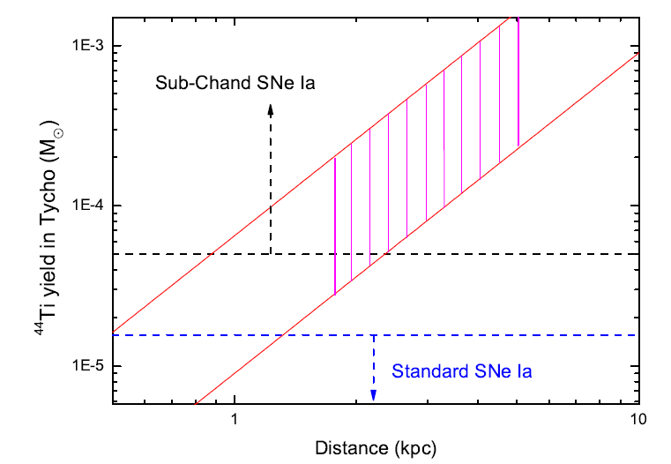
⁴⁴Ti yield in Tycho
Some 3D simulations carried out : predict ⁴⁴Ti yield in different parameter spaces.
⁴⁴Ti detection can first constrain the progenitor of Tycho
(1) Chandrasekhar mass (1.4 M⊙WD) models give a very small yield of ⁴⁴Ti.
(2)sub-Chandrasekhar mass (0.8-1.2 M⊙ WD) models can produce ⁴⁴Ti of >10⁻⁴ M⊙.
(3)No simulations for super-Ch models, a very small yield of ⁴⁴Ti .
(4) No simulations for double WD mergers, most cases cannot produce enough ⁴⁴Ti, except that one is He WD.

Slide 23
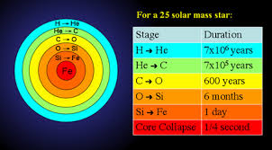
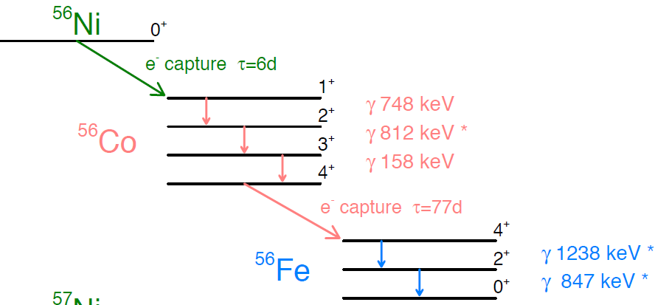
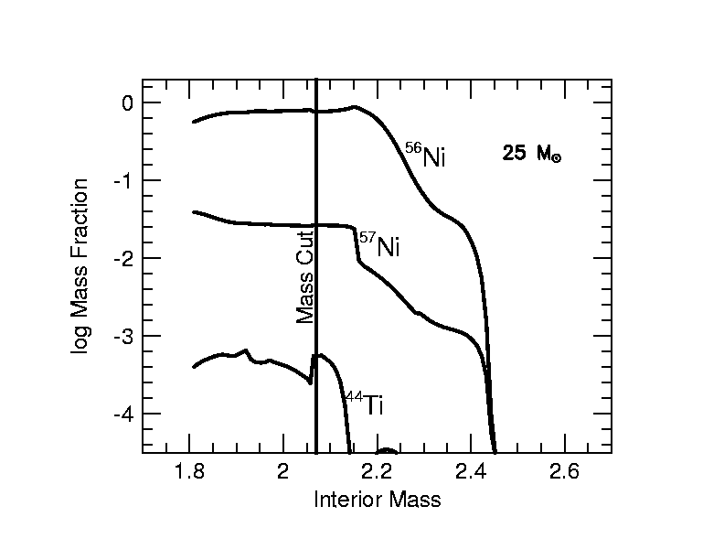
⁵⁶Ni->⁵⁶Co->⁵⁶Fe
Core-collapse SN cases:
Most ⁵⁶Ni became NS or BH, a very small part escaped from the explosion: 0.02-0.1 M⊙.
SNR
NS/BH

Slide 24
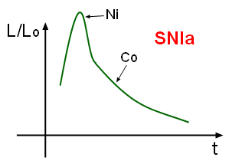
Most Fe produced by SN Ia in the Unverse
SN Ia explosion characteristics:
Whole stars（single WD or 2 WDs) explode completely, nothing left.
All ⁵⁶Ni produced by CO burnings ejected into medium.
0.5-0.6M⊙ of ⁵⁶Ni per explosion。
Some bright SN Ia may produce ⁵⁶Ni of >1M⊙。
⁵⁶Ni decay chains determine the IR/optical curves！
IR/optical observations and theories need the existence of ⁵⁶Ni decay chain – direct measurements ?
Gamma-ray detections!

Slide 25
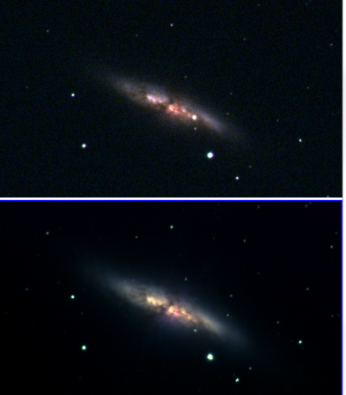
SN2014J in M82
2014.01.21: discovered by a student in UK；
identified as type Ia ;
located in M82，the nearest SN Ia in last 45 years.
Distance：3.5 Mpc !
A star is nearer to us, more physical information bring us！
Gamma-ray observations got the best chance!
2014 Jan 23
2013 Dec

Slide 26
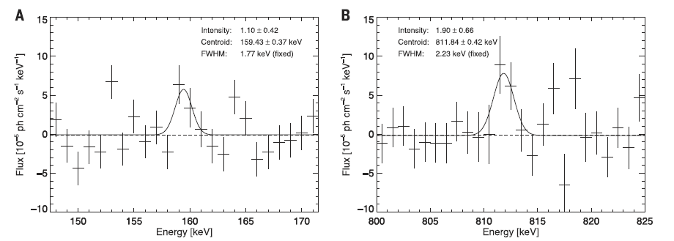
⁵⁶Ni decay
In the early stage of explosion, the environment is not transparent for gamma-rays. ⁵⁶Ni decay time is very short (6 days), so after tens of days, most ⁵⁶Ni has become ⁵⁶Co. Generally gamma-ray from decays of ⁵⁶Ni cannot be detected.
But after ten days of explosion, we detected gamma-ray lines from ⁵⁶Ni in SN2014J, unexpected!
17 days after explosion by INTEGRAL/SPI detections
Diehl et al. 2014

Slide 27
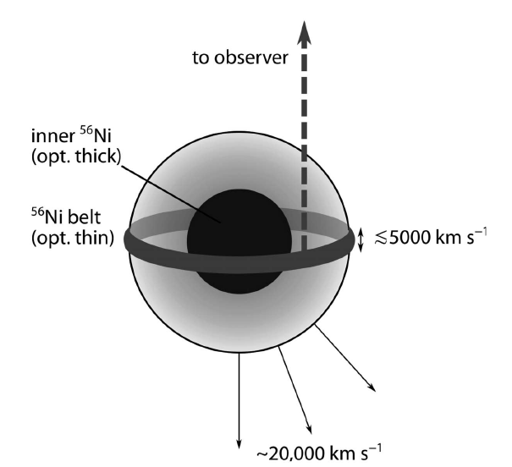
Progenitor in SN 2014J
Geometrical model for type Ia explosion：
spherical symmetry is broken, a part of ⁵⁶Ni is located at the outskirts.
Gamma-rays give a ⁵⁶Ni mass of 0.06M⊙
Corresponding to 10% of total expected amount of ⁵⁶Ni

Slide 28
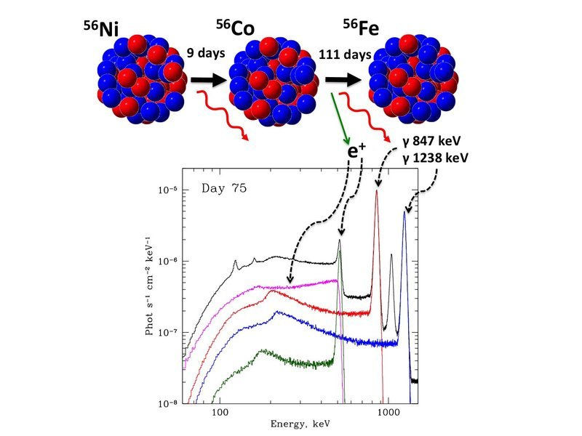
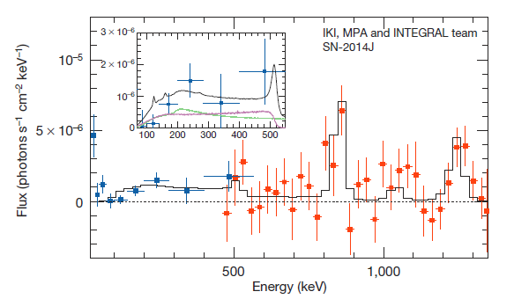
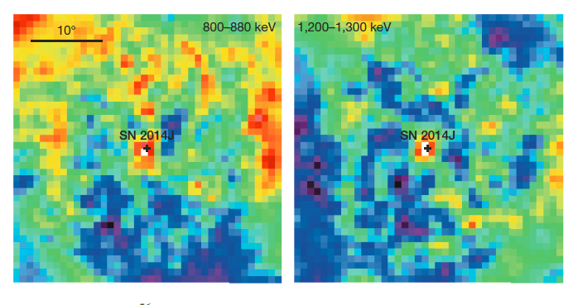
⁵⁶Co decay
After tens of days of explosion, the environment became transparent for gamma-rays, then emission lines from ⁵⁶Co can be detected!
INTEGRAL (IBIS and SPI):
75 days after the explosion
Gamma-ray observations of SN2014J: mass of ⁵⁶Ni 0.6±0.1M⊙。
Churazov et al. 2014

Slide 29
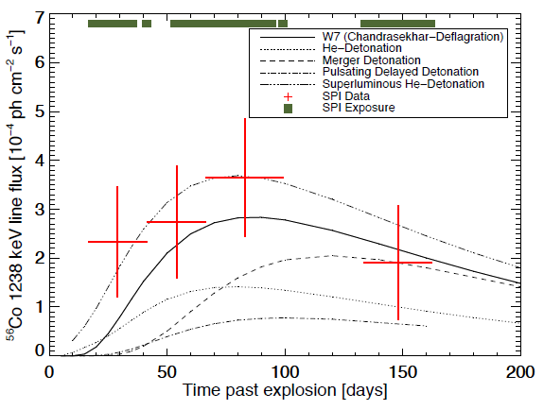
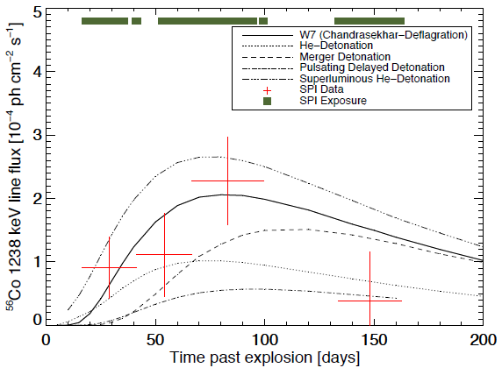
⁵⁶Co decay chain: more observations
Lightcurves of gamma-ray lines in SN2014J versus models of SN Ia
Chandrasekhar mass WD models still meet the curve。
847 keV
1238 keV
Diehl et al. 2015

Slide 30


Future projects
⁴⁴Ti line sky surveys by HXMT at 68, 78 keV
HXMT: 1-250 keV hard X-ray surveys:
detection of ⁴⁴Ti lines from known young SNRs in Galaxy – constraining the progenitors
discover new SNRs by ⁴⁴Ti line surveys: 2 SNe/100 yr, but in last 1000 yr, we only saw several explosions. ⁴⁴Ti (transparent for ISM) detections may discover more.

Slide 31

limitations for Gamma-ray detectors
Sensitivity of MeV gamma-ray detectors is very limited
Gamma rays cannot be focused
NuStar first focus hard X-rays up to ~79 keV
Present methods for gamma-ray detection:
(1) coded mask (SWIFT, INTEGRAL)
(2) Compton effect (COMPTEL)
(3) electron pair production (EGRET,
Fermi/LAT)

Slide 32



Gamma-ray line astronomy: present status
MeV bands detection:
1991 – 2000，Compton observatory
Gamma-ray imaging in MeV bands, no spectral line information : COMPTEL
INTEGRAL is launched in the end of 2002.
The best spectral resolution in gamma-ray bands:
2 keV@ 1MeV
The sensitivity is very limited.

Slide 33
Future of gamma-ray line detections
Sensitivity of gamma-ray detectors
Window of gamma-ray line detection
10 keV - GeV
INTEGRAL
HXMT/HE
FERMI/LAT

Slide 34


NExt-generation Compton Telescope (NECT)
    Energy bands: 200 keV – 50 MeV/100 MeV
    Wide FOV
    Spectral resolution: 2 keV@1MeV
    Sensitivity ~10⁻⁶-10⁻⁷ph cm⁻² s⁻¹
    Detector area: >10⁴ cm²
Si detectors
Ge detectors

Slide 35

Goals of gamma-ray line astronomy

Slide 36

⁵⁶Co detection in SN Ia
new observations

Slide 37
Other science objects for MeV gamma-ray detector
Gamma-ray point sources：<100 (now) → >1000 (future)
SNR– constrain hadronic acceleration (low energy cutoff - π⁰ decay)- origin of cosmic rays
MeV bright gamma-ray pulsars – a new type of gamma-ray pulsars？
Galactic center, nearby galaxies: dark matter, matter/anti-matter annihilations
Magnetars – bursts, high energy cutoff
Non-thermal emission of X-ray binaries at MeV bands, e⁺e⁻ annihilation line at 511 keV
Distant AGN/Blazars – origin of extra-galactic gamma-ray background
GRBs – spectra, GW/FRB counterparts

Slide 38
Thank you for the attention!
More questions: wangwei@bao.ac.cn

